Slide 1

All about Year 3

Slide 2
Year 3 Team
Miss Szadowski (Miss S)– Parakeets Class Teacher and Deputy Head(Mon-Weds)
Mrs Lant- Parakeets Class Teacher (Weds-Fri)
Miss Raya – Learning Support Assistant
Mr Simmons – Trainee Teacher
Miss Leatherbarrow – Greenjays Class Teacher
Mr Walters– Learning Support Assistant
Mr Frost – Cover Teacher

Slide 3
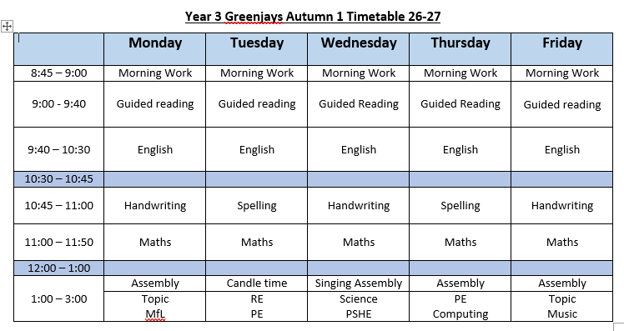
Our Weekly Timetables - Greenjays

Slide 4
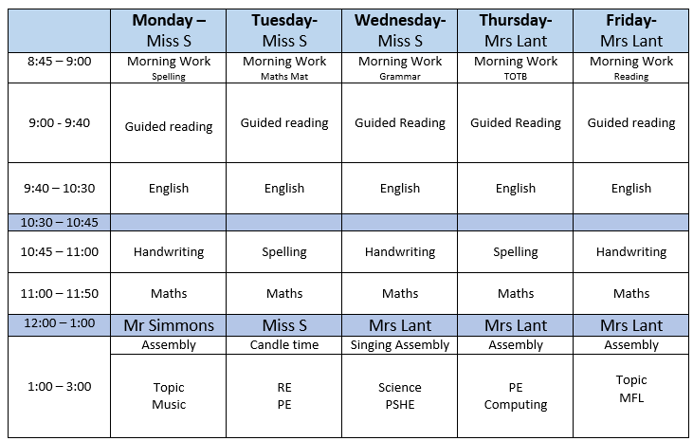
Our Weekly Timetables - Parakeets

Slide 5
Days to remember in Year 3
P.E days – Tuesday (outside) and Thursday (in hall)
Book Change Day – Children are encouraged to change their books when they need to at the start of the day
Home learning – New work is set on a Friday to be completed by the following Thursday
- 20 mins literacy task
- 20 mins maths task
- Spelling Frame words
- TT rockstars
- DAILY READING! (If you can’t fit in all the home tasks – do this one first!)

Slide 6
Remember…
A named water bottle every day
Reading books and bookmark every day
Clearly name all uniform including coats and footwear!

Slide 7

Bookmarks
  In Year 3, we move away from detailed reading records. Each child has a bookmark instead.
  When they read with you, simply date and initial the bookmark
  Complete bookmarks are entered into an end of term raffle to win a prize!

Slide 8
Reading in Year 3
Reading books and bookmarks should be in school every day.
Children take banded books each week. Please re-read these books twice with your children to develop comprehension and fluency.
Reading books will be changed by the children when they are needed. Children are expected/reminded to change them at the start of the day.

Slide 9
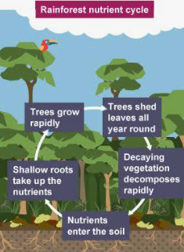
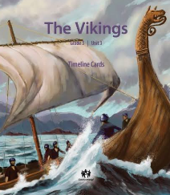
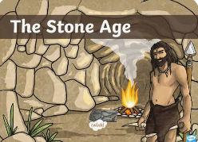
Topics in Year 3

Slide 10
Trips and Experiences
There are lots of exciting trips and experiences planned to make our topics fun and engaging including…
Stone Age workshop
Forest trips
Ufton Court Viking trip
Viking Day
Rainforest trip

Slide 11

Seesaw
Home learning is added to Seesaw each week for children to complete if they would like to.
Reminders will be sent out for key events or if children need to bring any resources to school as part of our learning.
You can post any learning or experience that your child may like to share for example an experience they might have had over the weekend or holidays.
If you have any questions or anything you need to share with the Year 3 team, please email the office or mention to a member of staff at the start or end of the day rather than posting it on Seesaw.

Slide 12
What can you do to support your child at home?
We know lots of parents are always keen to find out how they can support their child with their learning at home. Some ideas of activities that you could do if you would like to include..
Regularly reading with your child
Asking guiding questions to support their comprehension and understanding – What do you think will happen next? How do you think the character might be feeling?
Learning Times Tables. By the End of Year 3, we aim for them to know 1x, 2x, 3x, 4x, 5x, 6x, 8x, 10x tables

Slide 13
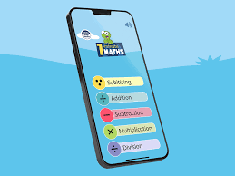


Encouraging writing opportunities to help them practise their phonics, spelling and handwriting skills.

Slide 14
What if I need to speak to you?
You can approach for quick concerns on the door in the morning / at home time (you may be asked to wait a few minutes until all children have gone/settled) but any other matters will require an appointment to be booked through the office team.

Slide 15

Any Questions

