Slide 1
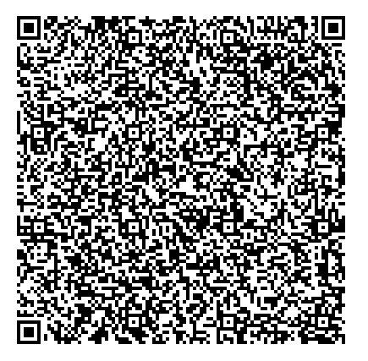
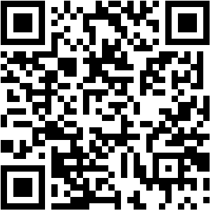
MINDSETS AND MOTIVATION
BUY MY BEHAVIOUR BOOK
SIGN UP FOR TIPS
robinlaunder@hotmail.com www.behaviourbuddy.co.uk

Slide 2



Slide 3


Slide 4
RFF

Slide 5
SMALL
GULP!

Slide 7
Intelligence
Your intelligence is something very basic about you that you can’t change very much.
  Strongly agree
  Mostly agree
  Partly
  agree
  Partly
  disagree
  Mostly disagree
  Strongly disagree

Slide 8
Intelligence
You can learn new things, but you can’t really change how intelligent you are.
  Strongly agree
  Mostly agree
  Partly
  agree
  Partly
  disagree
  Mostly disagree
  Strongly disagree

Slide 9
Intelligence
No matter how much intelligence you have, you can always change it quite a bit.
  Strongly agree
  Mostly agree
  Partly
  agree
  Partly
  disagree
  Mostly disagree
  Strongly disagree

Slide 10
Intelligence
You can always substantially change how intelligent you are.
  Strongly agree
  Mostly agree
  Partly
  agree
  Partly
  disagree
  Mostly disagree
  Strongly disagree

Slide 11
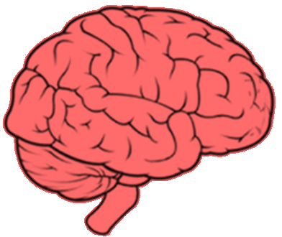

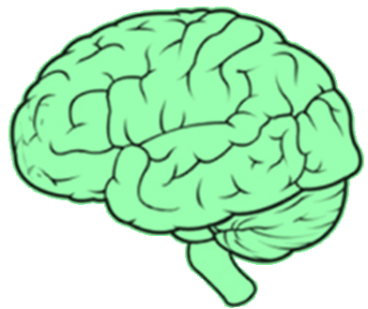
fixed
mindset
growth
mindset
Prof. Carol
Dweck

Slide 12
Intelligence
Your intelligence is something very basic about you that you can’t change very much.
You can learn new things, but you can’t really change how intelligent you are.
  Strongly agree
  Mostly agree
  Partly
  agree
  Partly
  disagree
  Mostly disagree
  Strongly disagree

Slide 13
Intelligence
Your intelligence is something very basic about you that you can’t change very much.
You can learn new things, but you can’t really change how intelligent you are.
  Strongly agree
  Mostly agree
  Partly
  agree
  Partly
  disagree
  Mostly disagree
  Strongly disagree

Slide 14
Intelligence
No matter how much intelligence you have, you can always change it quite a bit.
You can always substantially change how intelligent you are.
  Strongly agree
  Mostly agree
  Partly
  agree
  Partly
  disagree
  Mostly disagree
  Strongly disagree

Slide 15
Intelligence
No matter how much intelligence you have, you can always change it quite a bit.
You can always substantially change how intelligent you are.
  Strongly agree
  Mostly agree
  Partly
  agree
  Partly
  disagree
  Mostly disagree
  Strongly disagree

Slide 16


fixed
mindset
growth
mindset
The way you think about intelligence affects
how intelligent you are

Slide 17
challenges
obstacles
effort
feedback
success of others
avoid
give up
pointless
attack
threat
embrace
persist
path to mastery
learning opportunity
inspiration
fixed
mindset
growth
mindset

Slide 18

So which is right? Is intelligence fixed and unchanging or can it be increased through effort?

Slide 19
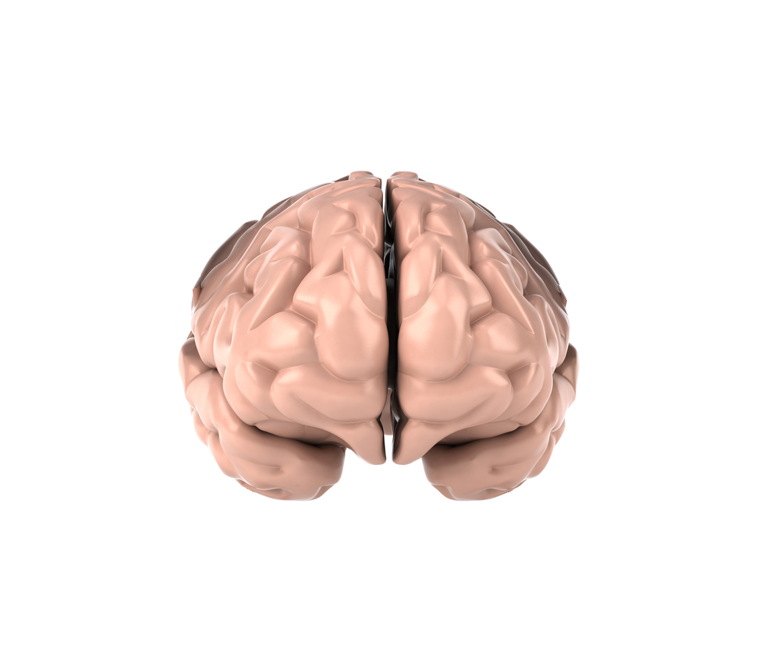

Slide 20
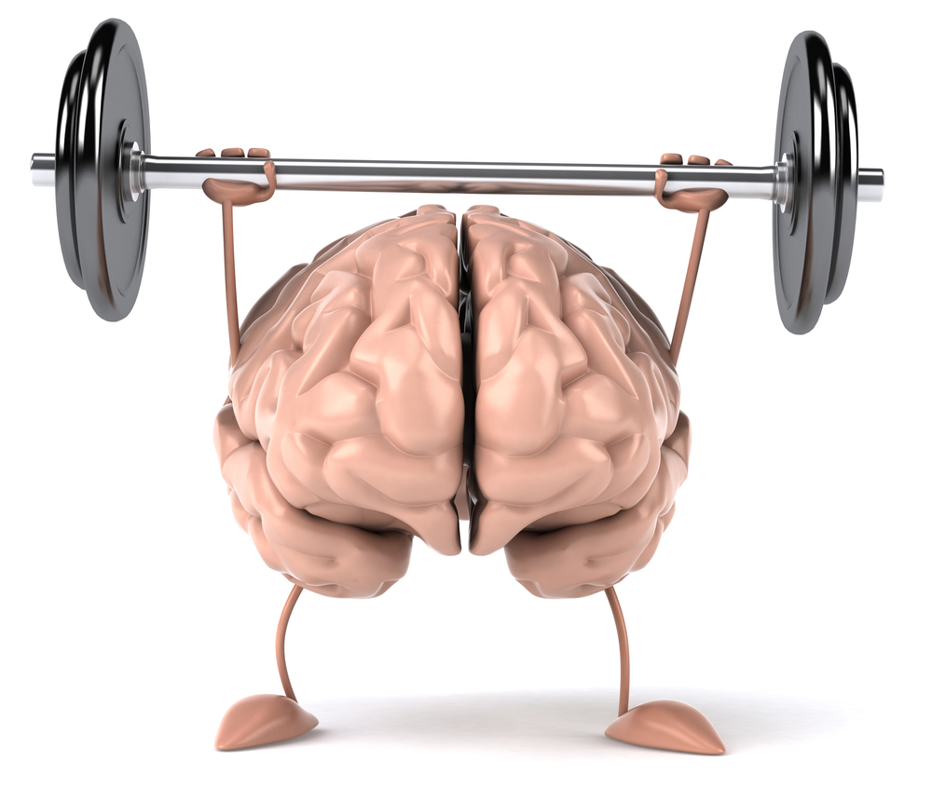

Slide 21
neuroplasticity

Slide 22
plasticity

Slide 23
But come on, Robin, for goodness sake, surely some people are just born more intelligent than others, yea?
Adam Urbanski

Slide 24


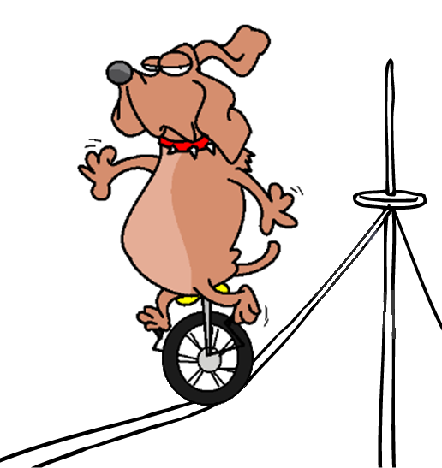
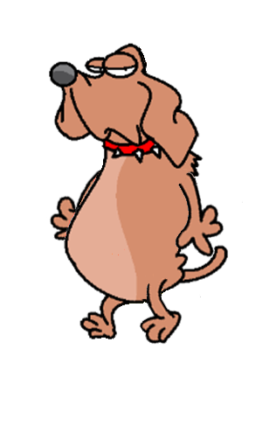
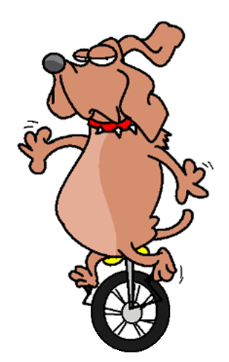
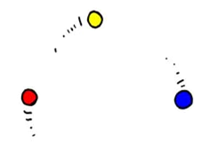
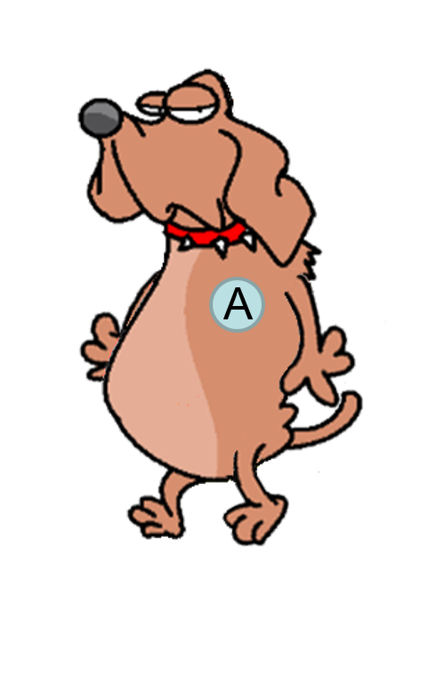
B

Slide 25
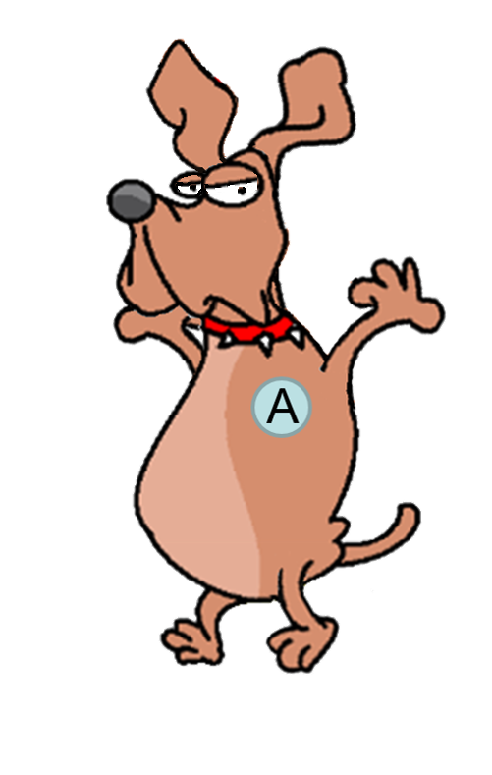
B
B

Slide 26


Slide 27


Slide 28
But come on, Robin, for goodness sake, EVERYONE knows that geniuses are born, not made, yea?
Adam Urbanski

Slide 29


?
?
?
Genius 1
Genius 2
Genius 3

Slide 30
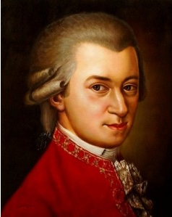

?
?
Mozart
Genius 2
Genius 3
It is a mistake to think that the practice of my art has become easy to me. I assure you, dear friend, no one has given so much care to the study of composition as I

Slide 31
?
?
Mozart
Genius 2
Genius 3

Slide 32
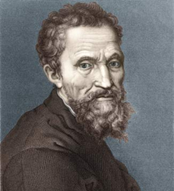
?
Mozart
Michelangelo
Genius 3
If people knew how hard I had to work to gain my mastery, it would not seem so wonderful at all

Slide 33
?
Mozart
Michelangelo
Genius 3

Slide 34
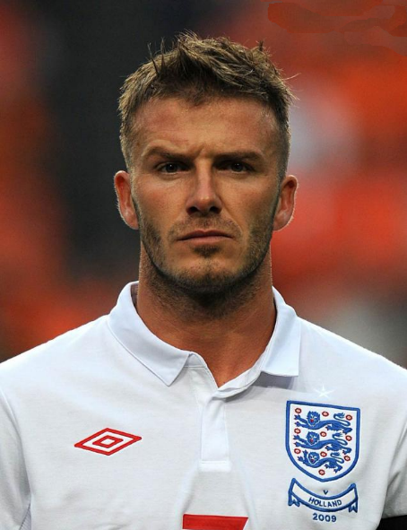
Mozart
Michelangelo
Beckham
I have always believed that if you want to achieve anything special in life you have to work, work and then work some more

Slide 35
But come on, Robin, for goodness sake, surely your definition of intelligence isn’t right, right? You’re defining potential or something, yea, not intelligence?

Slide 36
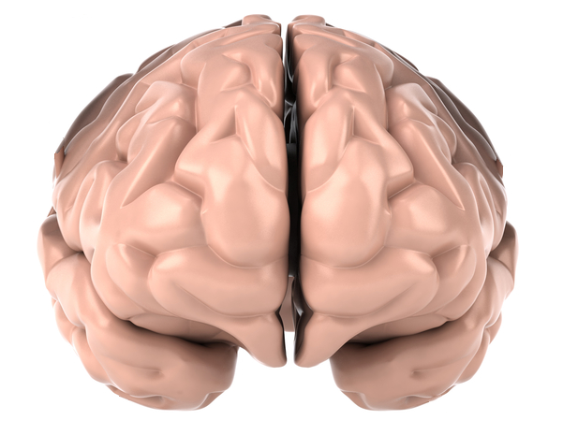


physical exercise
=
increased strength
mental exercise
=
increased intelligence

Slide 37
Let me put it another way…

Slide 38
EVERY mainstream student in mainstream education can get an A* in EVERY subject

Slide 39
Does your misbehaving or
plateau student have a fixed
or a growth mindset?

Slide 40
challenges
obstacles
effort
feedback
success of others
avoid
fixed
mindset
growth
mindset

Slide 41
challenges
obstacles
effort
feedback
success of others
embrace
fixed
mindset
growth
mindset

Slide 42
challenges
obstacles
effort
feedback
success of others
give up
fixed
mindset
growth
mindset

Slide 43
challenges
obstacles
effort
feedback
success of others
persist
fixed
mindset
growth
mindset

Slide 44
challenges
obstacles
effort
feedback
success of others
pointless
fixed
mindset
growth
mindset

Slide 45
challenges
obstacles
effort
feedback
success of others
path to mastery
fixed
mindset
growth
mindset

Slide 46
challenges
obstacles
effort
feedback
success of others
attack
fixed
mindset
growth
mindset

Slide 47
challenges
obstacles
effort
feedback
success of others
learning opportunity
fixed
mindset
growth
mindset

Slide 48
challenges
obstacles
effort
feedback
success of others
threat
fixed
mindset
growth
mindset

Slide 49
challenges
obstacles
effort
feedback
success of others
inspiration
fixed
mindset
growth
mindset

Slide 50
Two questions:
1. What would it be like if we could turn our fixed mindset child into a growth mindset child?

Slide 51
Two questions:
2. So how do we do it?

Slide 52
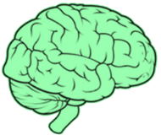
The necessary three
?
?
?

Slide 53
The necessary three
growth mindset theory
?
?

Slide 54
neuroplasticity

Slide 55
plasticity

Slide 56
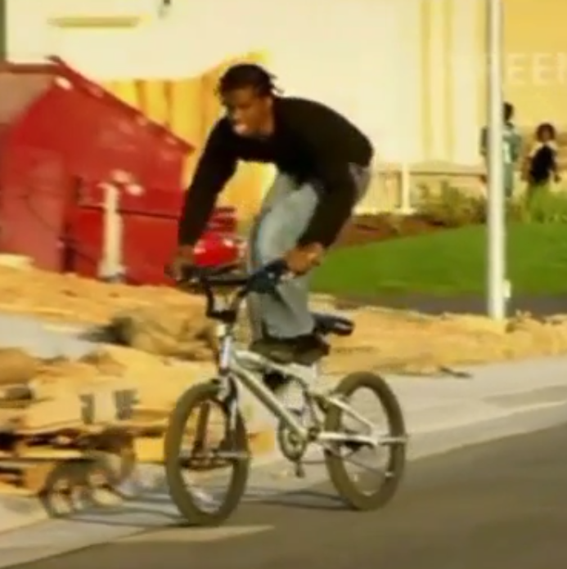

Slide 57


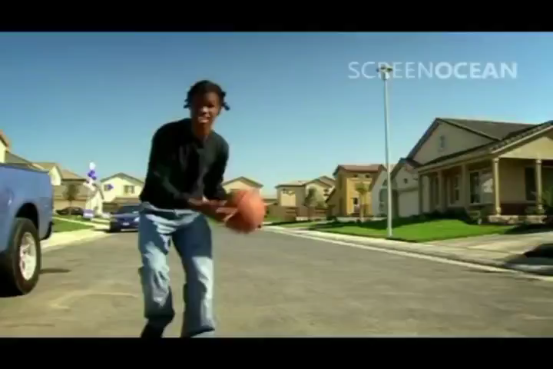
BehaviourBuddyTV

Slide 58
The necessary three
growth mindset theory
?
?

Slide 59
The necessary three
growth mindset theory
stretch, feedback & practice
?

Slide 61
The necessary three
growth mindset theory
stretch, feedback & practice
?

Slide 62
The necessary three
growth mindset theory
stretch, feedback & practice
embrace failure

Slide 63
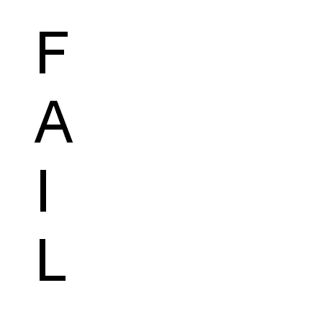
The necessary three
growth mindset theory
stretch, feedback & practice
fail

Slide 64
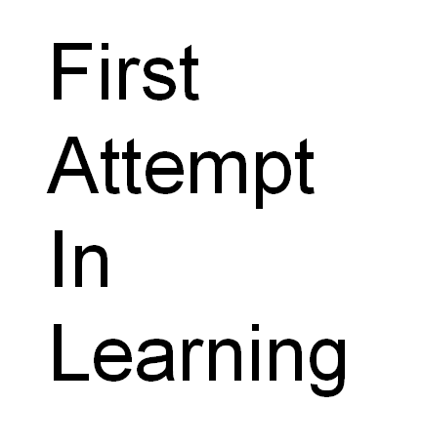
The necessary three

Slide 65
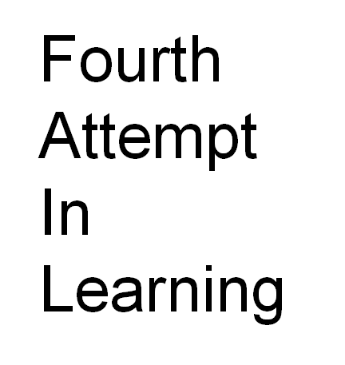
The necessary three

Slide 66

The necessary three
mindset theory & the brain
stretch and feedback
fail

Slide 67

The necessary three
growth mindset theory
stretch, feedback & practice
fail

Slide 68



Slide 69
The necessary three
growth mindset theory
stretch, feedback & practice
embrace failure

Slide 70

The necessary three
teach
growth mindset theory
teach
stretch, feedback & practice
teach
embrace failure

Slide 71
The necessary three
teach, model
growth mindset theory
teach, model
stretch, feedback & practice
teach, model
embrace failure

Slide 72
The necessary three
teach, model, provide opportunities
growth mindset theory
teach, model, provide opportunities
stretch, feedback & practice
teach, model, provide opportunities
embrace failure

Slide 73
Where do fixed mindsets come from?

Slide 74
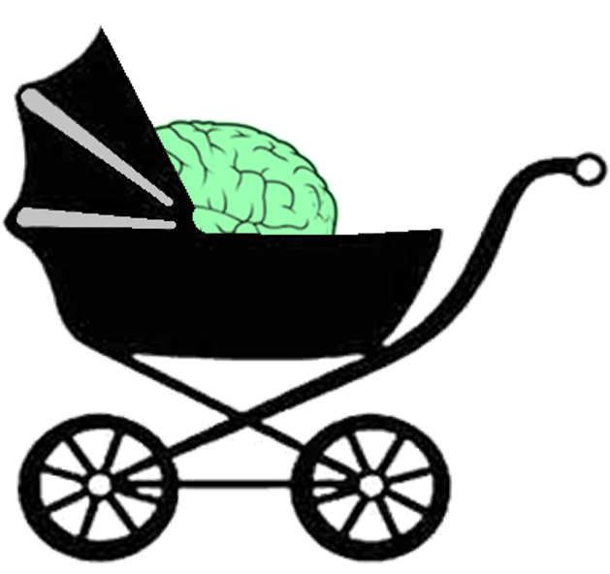

Slide 75
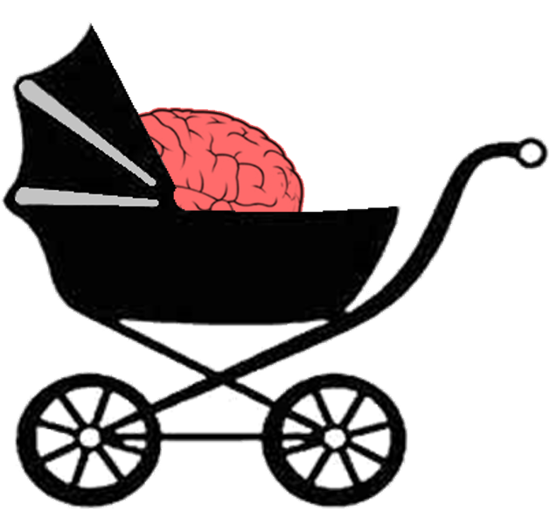
genius
quick-witted
perfect pitch
god-given talent
a natural
G&T
village idiot
slow-witted
tone deaf
not blessed
a numpty

Slide 76
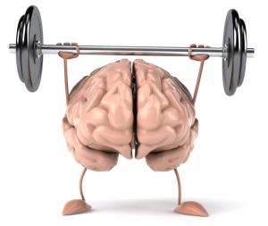

keepy-uppy
…
…
maths
…
French
…
…
…
biology
…
…
…
…
…
music
geography
…
…
drama
…
Spanish
…
dance
…
English
philosophy
…
philosophy
algebra
DT
engineering
ICT
Mandarin
psychology
art
gymnastics
mime
chemistry
…
…
…
…
physics

Slide 77

I can’t do
this
can’t do it
avoid
vicious circle
discount
feedback
give up

Slide 78
See, I knew
I couldn’t
do it
can’t do it
avoid
vicious circle
discount
feedback
give up

Slide 79

I can do
this
can do it
embrace
virtuous circle
incorporate
feedback
persist

Slide 80
See, I knew
I could
do it
can do it
embrace
virtuous circle
incorporate
feedback
persist

Slide 81

Your mindset
affects how intelligent
you are
Prof. Carol Dweck

Slide 82
Your intelligence
affects how motivated
you are
Prof. Carol Dweck

Slide 83
Your motivation
affects the quality of
your life
Prof. Carol Dweck

Slide 84

You must be really
bright to have achieved such a high mark
You must have tried
really hard to have achieved such a
high mark
Prof. Carol Dweck

Slide 85
Praising intelligence induces a fixed mindset
Praising
effort induces
a growth mindset
Prof. Carol Dweck

Slide 86
Praising intelligence makes children feel good but
it can also induce
a fear of failure
…
Prof. Carol Dweck

Slide 87
Praising intelligence makes children feel good but
it can also create
a fear of failure
Praising effort
also makes children
feel good and it builds up resilience to
setbacks
…
Prof. Carol Dweck

Slide 88
Praising intelligence makes children feel good but
it can also create
a fear of failure
Praising effort
also makes children
feel good and it builds up resilience to
setbacks
Prof. Carol Dweck

Slide 89
Prof. Carol Dweck

Slide 90
Praising
intelligence means that children take it personally when they fail
Praising effort
means that children see failure as a stage in the process of getting something right
Prof. Carol Dweck

Slide 91
Prof. Carol Dweck

Slide 92
Praising
intelligence tells
children that they do not have to work hard to
perform well
Prof. Carol Dweck

Slide 93
Praising
intelligence tells
children that they do not have to work hard to
perform well
Praising effort
tells children that performance is the result
of hard work
Prof. Carol Dweck

Slide 94
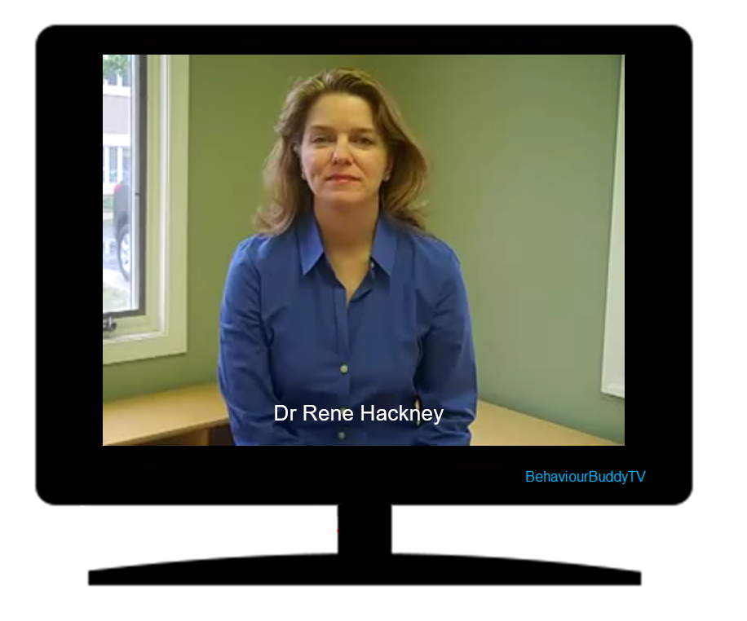

Slide 95
Descriptive Praise
effort
progress
process
detail
Grace, well done for your hard work.

Slide 96
Descriptive Praise
effort
progress
process
detail
Grace, well done for your hard work.

Slide 97
Descriptive Praise
effort
progress
process
detail
Grace, well done for your hard work. When I saw your picture last lesson you hadn’t really managed to capture its movement, but now I get a sense of the train coming towards me.

Slide 98
Descriptive Praise
effort
progress
process
detail
Grace, well done for your hard work. When I saw your picture last lesson you hadn’t really managed to capture its movement, but now I get a sense of the train coming towards me.

Slide 99
Descriptive Praise
effort
progress
process
detail
Grace, well done for your hard work. When I saw your picture last lesson you hadn’t really managed to capture its movement, but now I get a sense of the train coming towards me. You’ve thought about perspective and been careful about how you’ve shown it.

Slide 100
Descriptive Praise
effort
progress
process
detail
Grace, well done for your hard work. When I saw your picture last lesson you hadn’t really managed to capture its movement, but now I get a sense of the train coming towards me. You’ve thought about perspective and been careful about how you’ve shown it.

Slide 101
Descriptive Praise
effort
progress
process
detail
Grace, well done for your hard work. When I saw your picture last lesson you hadn’t really managed to capture its movement, but now I get a sense of the train coming towards me. You’ve thought about perspective and been careful about how you’ve shown it. How the track narrows, the size of the engine at the front, that adds to the sense of movement.

Slide 102
Descriptive Praise
effort
progress
process
detail
Grace, well done for your hard work. When I saw your picture last lesson you hadn’t really managed to capture its movement, but now I get a sense of the train coming towards me. You’ve thought about perspective and been careful about how you’ve shown it. How the track narrows, the size of the engine at the front, that adds to the sense of movement.

Slide 103
Descriptive Praise
effort
progress
process
detail
Grace, well done for your hard work. When I saw your picture last lesson you hadn’t really managed to capture its movement, but now I get a sense of the train coming towards me. You’ve thought about perspective and been careful about how you’ve shown it. How the track narrows, the size of the engine at the front, that adds to the sense of movement.

Slide 104
Descriptive Praise
effort
progress
process
detail
Grace, well done for your hard work. When I saw your picture last lesson you hadn’t really managed to capture its movement, but now I get a sense of the train coming towards me. You’ve thought about perspective and been careful about how you’ve shown it. How the track narrows, the size of the engine at the front, that adds to the sense of movement. What else can you do to make the picture better?

Slide 105
Descriptive Praise
effort
progress
process
detail
Grace, well done for your hard work. When I saw your picture last lesson you hadn’t really managed to capture its movement, but now I get a sense of the train coming towards me. You’ve thought about perspective and been careful about how you’ve shown it. How the track narrows, the size of the engine at the front, that adds to the sense of movement. What else can you do to make the picture better?

Slide 106
Is giving this type of praise easy to do?

Slide 107
neuroplasticity

Slide 108

Descriptive Praise
effort
progress
process
detail
Grace, well done for your hard work. When I saw your picture last lesson you hadn’t really managed to capture its movement, but now I get a sense of the train coming towards me. You’ve thought about perspective and been careful about how you’ve shown it. How the track narrows, the size of the engine at the front, that adds to the sense of movement. What else can you do to make the picture better?
or
or
or
intelligence

Slide 109
MINDSETS AND MOTIVATION
BUY MY BEHAVIOUR BOOK
SIGN UP FOR TIPS
robinlaunder@hotmail.com www.behaviourbuddy.co.uk

