Slide 1

All about Year 2

Slide 2
Year 2 Team
Mrs C Clarke – Yellowhammers Class Teacher
Miss A Bean - Canaries Class Teacher
Mrs B McAlees – HLTA
Miss J Croft– Trainee Teacher
Miss A Seera – Trainee Teacher

Slide 3
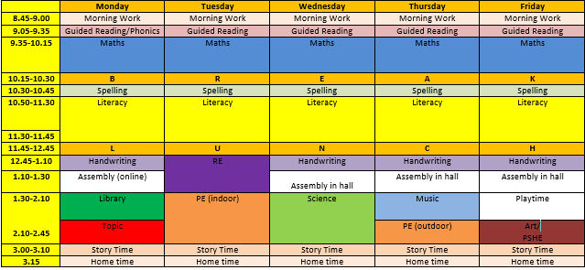
Our Weekly Timetable

Slide 4
Days to remember in Year 2
P.E days – Tuesday and Thursday
Book Change Day – Monday
Library Day – Monday
Homework - Friday
                Don’t forget…
                • A named water bottle in school every day
                • Reading books and reading records every day
                • School uniform clearly named

Slide 5
Reading in Year 2
Reading books and reading records should be in school every day.
Children take home 2 books each week. Please re-read these books with your children as this will help develop their comprehension and fluency.
Reading books will be changed on a Monday.
Whilst reading try to ask simple questions such as ‘What do you think might happen next?’ or ‘How do you think the character is feeling?
Please record when you have read with your child.

Slide 6



Topics in Year 2

Slide 7
Trips and Experiences
There are lots of exciting trips and experiences planned to make our topics fun and engaging including…
Building our own Tudor houses
Making Tudor bread
Trunk Theatre visit
Trip to Windsor Castle – Spring Term
Sir Teachalot workshop

Slide 8

Seesaw
Used to share pictures of children learning and work that they have completed.
Home learning is added to Seesaw each week for children to complete if they would like to.
Reminders will be sent out for key events or if children need to bring any resources to school as part of our learning.
You can post any learning or experience that your child may like to share for example an experience they might have had over the weekend or holidays.
If you have any questions or anything you need to share with the Year 2 team, please email the office or mention to a member of staff at the start or end of the day rather than posting it on Seesaw.

Slide 9
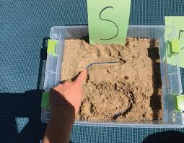
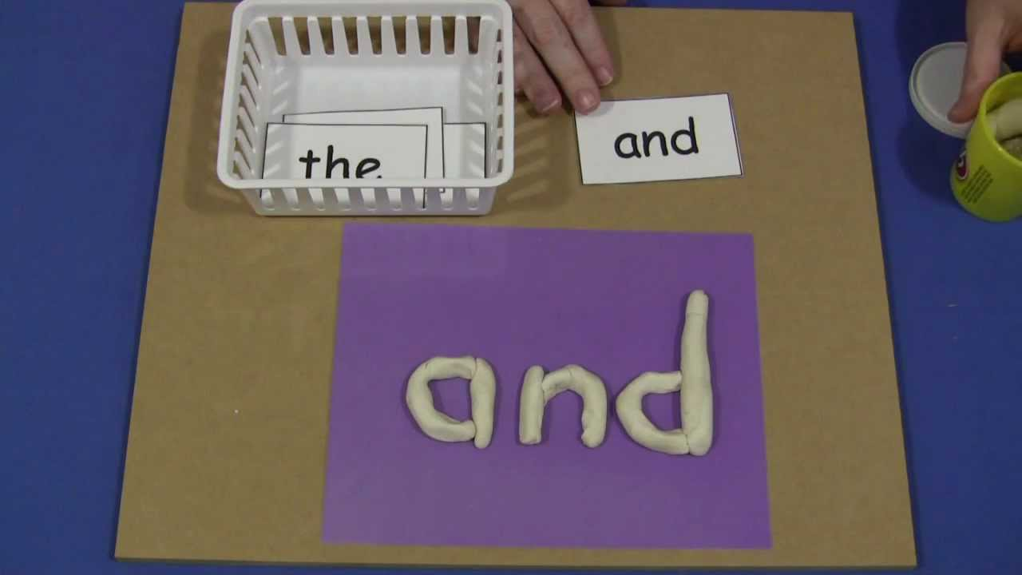
What can you do to support your child at home?
We know lots of parents are always keen to find out how they can support their child with their learning at home. Some ideas of activities that you could do if you would like to include..
Regularly reading with your child
Asking guiding questions to support their comprehension and understanding – What do you think will happen next? How do you think the character might be feeling?
Practising spellings of the Year 1 and 2 common exception words.

Slide 10
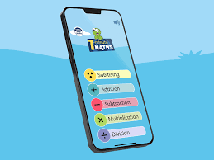
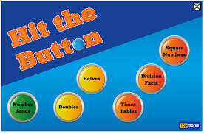


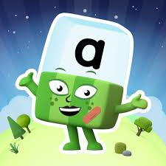
Encouraging writing opportunities to help them practise their phonics, spelling and handwriting skills.
In Maths you could practise subitising skills, number bonds to 10 and 2, 5 and 10 times tables.
    Some great practical ideas to support your child with this could be playing board games and using the dice to subitise to 6, maths ping pong, number bond snap, building lego towers to 10, chanting,
There are also some great free apps and websites that you can use with your child if you would like to.

Slide 11

Any Questions

