Slide 1

Pupil Voice: What Children Think About JP School
Exploring student perspectives on education and learning
Notes:
---

Slide 2
You think we have Fun Learning Activities
Notes:
---
This slide references information from the following file: https://ranelaghschool-my.sharepoint.com/personal/esavage_jennetts_bonitas_org_uk/_layouts/15/Doc.aspx?sourcedoc=%7B17B8D0FB-D086-404B-974B-B85ADBF7F05F%7D&file=pupil%20voice.docx&action=default&mobileredirect=true
Hands-On and Creative Learning, Trips and Physical Activities

Slide 3
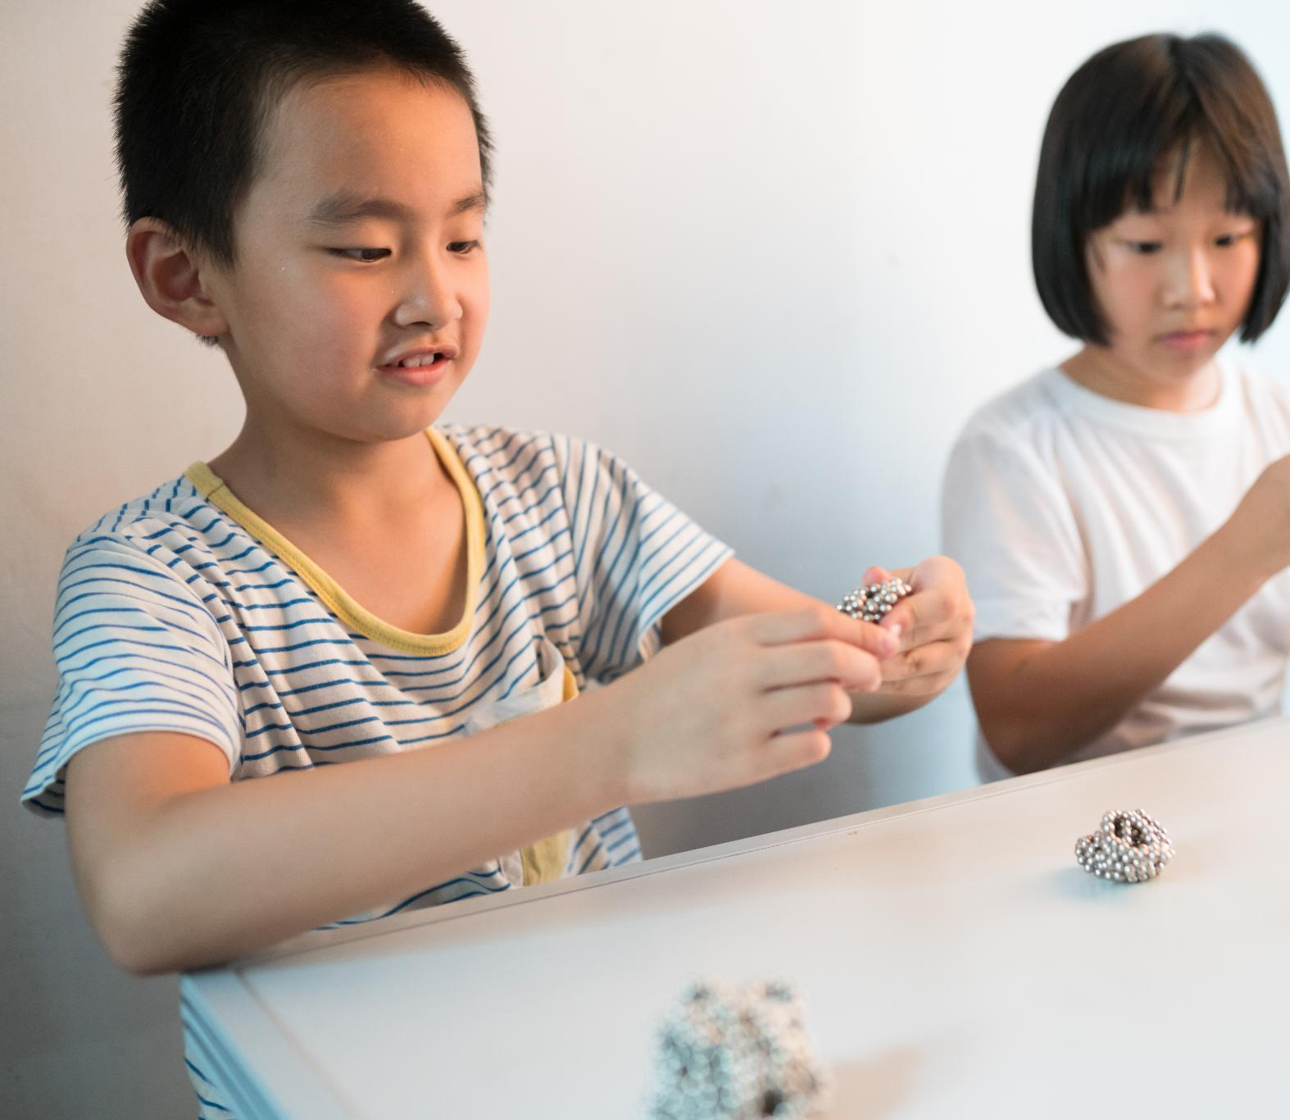
Hands-On and Creative Learning
Hands-On Activities
  Children learn better by building toy cars, conducting experiments, and using math tools actively.
Creative Expression
  Art, drama, and music classes help children express themselves and enjoy learning calmly.
Interactive Technology Use
  Using iPads for games and research makes lessons interactive and sparks curiosity.
Collaborative Learning
  Working in pairs or groups promotes fun and shared learning experiences among children.
Notes:
---
This slide references information from the following file: https://ranelaghschool-my.sharepoint.com/personal/esavage_jennetts_bonitas_org_uk/_layouts/15/Doc.aspx?sourcedoc=%7B17B8D0FB-D086-404B-974B-B85ADBF7F05F%7D&file=pupil%20voice.docx&action=default&mobileredirect=true
Children love learning when they can use their hands and be creative. They enjoy building toy cars, doing science experiments, and using special tools in maths. These activities help them understand things better and make learning exciting. Creative subjects like art, drama, and music are also favourites. These lessons let children express themselves, feel calm, and have fun. Using iPads for games and research is another way children enjoy learning. It makes lessons more interactive and helps them explore new ideas. Working with friends in pairs or groups is also popular because it makes learning more fun and helps everyone learn together.

Slide 4
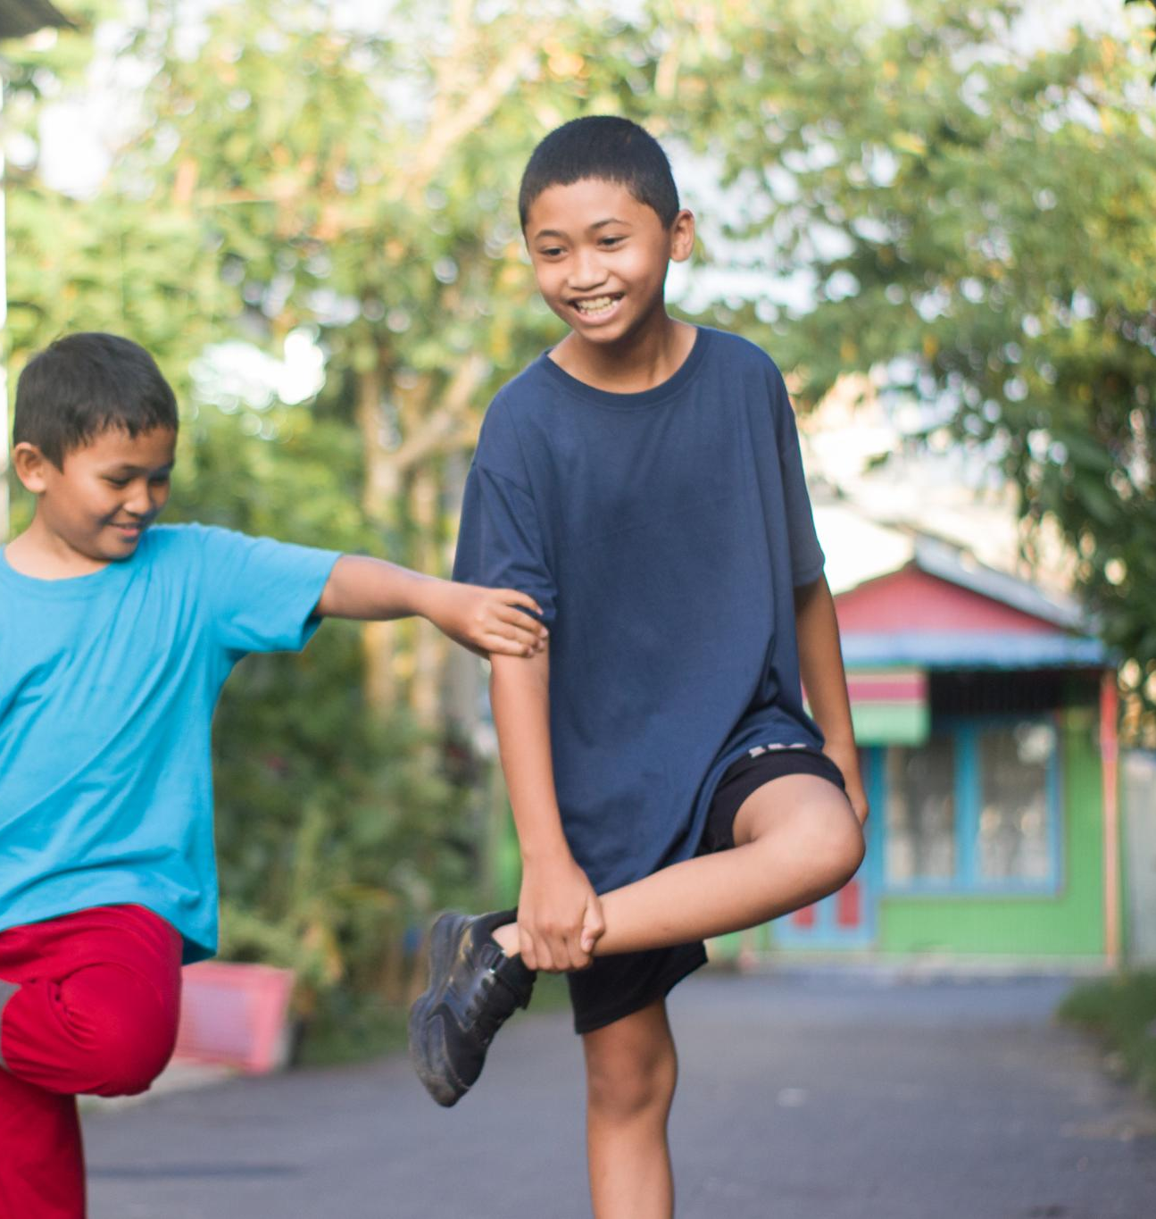
Trips and Physical Activities
Educational School Trips
  Trips to places like castles and sea life centers make learning engaging and memorable for children.
Themed Learning Days
  Special days like Pirate Day and Roman Day offer fun, immersive learning experiences that children enjoy.
Physical Education and Fitness
  PE lessons, sports events, and daily exercise help children stay fit and active while having fun.
Notes:
---
This slide references information from the following file: https://ranelaghschool-my.sharepoint.com/personal/esavage_jennetts_bonitas_org_uk/_layouts/15/Doc.aspx?sourcedoc=%7B17B8D0FB-D086-404B-974B-B85ADBF7F05F%7D&file=pupil%20voice.docx&action=default&mobileredirect=true
School trips and sports are some of the most exciting parts of learning. Children remember visits to places like PGL, Windsor Castle, and the Sea Life Centre. These trips help bring lessons to life and make learning more memorable. Special themed days like Pirate Day and Roman Day are also loved because they are fun and different. Physical activities like PE lessons, sports events, and the daily mile are important too. They help children stay fit and healthy while having fun. These activities give children a break from sitting and let them move around, which they really enjoy.

Slide 5
You thought we could think about Improving School Life by
Notes:
---
This slide references information from the following file: https://ranelaghschool-my.sharepoint.com/personal/esavage_jennetts_bonitas_org_uk/_layouts/15/Doc.aspx?sourcedoc=%7B17B8D0FB-D086-404B-974B-B85ADBF7F05F%7D&file=pupil%20voice.docx&action=default&mobileredirect=true
Ideas to Make Learning Better, Favourite School Moments

Slide 6
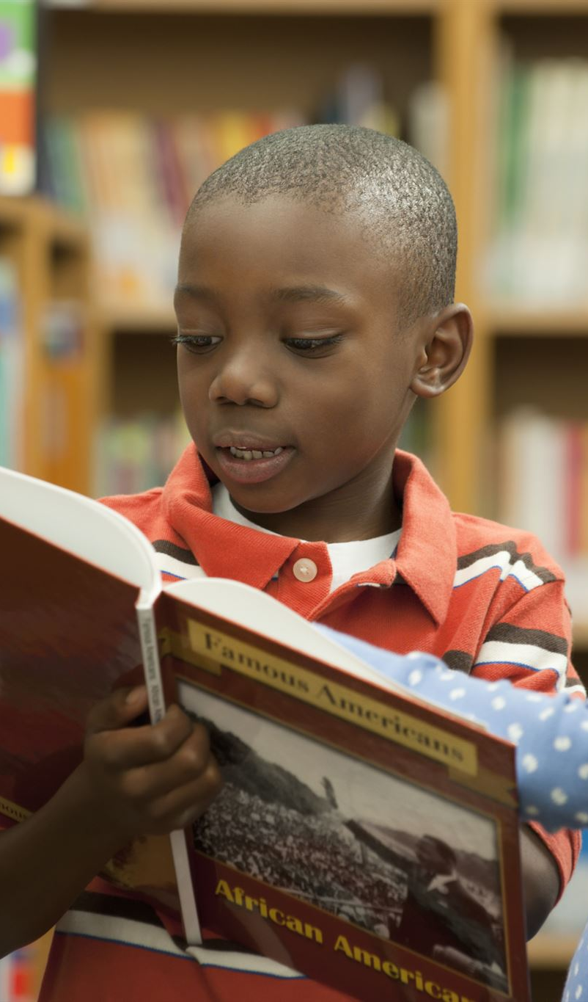
Ideas to Make Learning Better
Student Choice in Learning
  Children desire more control over what they learn, including picking topics and engaging in creative projects.
Balanced Subject Mix
  Students want more computing, design technology, and PE, with less repetitive writing to keep learning engaging.
Improved Facilities and Meals
  Suggestions include better tasting and larger school meals plus keep improving bathrooms and playground equipment.
Learning Support and Challenge
  Some children want more help while others seek harder work to stay challenged and supported.
Notes:
---
This slide references information from the following file: https://ranelaghschool-my.sharepoint.com/personal/esavage_jennetts_bonitas_org_uk/_layouts/15/Doc.aspx?sourcedoc=%7B17B8D0FB-D086-404B-974B-B85ADBF7F05F%7D&file=pupil%20voice.docx&action=default&mobileredirect=true
Children have shared thoughtful ideas to make school even better. They want more choices in what they learn, like picking topics, writing stories, and doing art projects. They also wish for a balanced mix of subjects, with more computing, design technology, and PE, and less repetitive writing. Some children think the school meals could taste better and be bigger. They also mentioned that bathrooms and playground equipment could be improved. While many children feel supported in their learning, some want more help, and others want harder work to challenge them. These suggestions show that children care about their learning and want it to be the best it can be.

Slide 7

Favourite School Moments
Exciting Residential Trips
  Residential trips like PGL and Little Canada offer fun, adventure, and unforgettable experiences for children.
Engaging Workshops and Celebrations
  Special workshops such as science Lego and celebrations like Ramadan make school life vibrant and educational.
Learning Through Culture and History
  Museum visits and themed days help children learn about history and diverse cultures in an interactive way.
Notes:
---
This slide references information from the following file: https://ranelaghschool-my.sharepoint.com/personal/esavage_jennetts_bonitas_org_uk/_layouts/15/Doc.aspx?sourcedoc=%7B17B8D0FB-D086-404B-974B-B85ADBF7F05F%7D&file=pupil%20voice.docx&action=default&mobileredirect=true
Children have many favourite memories from school. Residential trips like PGL and Little Canada are highlights because they are fun and full of adventure. Special workshops, like science Lego and celebrations like Ramadan, are also loved. These events make school exciting and help children learn in new ways. Learning about history and different cultures through museum visits and themed days helps children understand the world better. These experiences are not only fun but also help children remember what they learn. They make school feel special and give children something to look forward to.

Slide 8
Teaching and Safety
Notes:
---
This slide references information from the following file: https://ranelaghschool-my.sharepoint.com/personal/esavage_jennetts_bonitas_org_uk/_layouts/15/Doc.aspx?sourcedoc=%7B17B8D0FB-D086-404B-974B-B85ADBF7F05F%7D&file=pupil%20voice.docx&action=default&mobileredirect=true
How Teachers Help, Feeling Safe and Supported

Slide 9
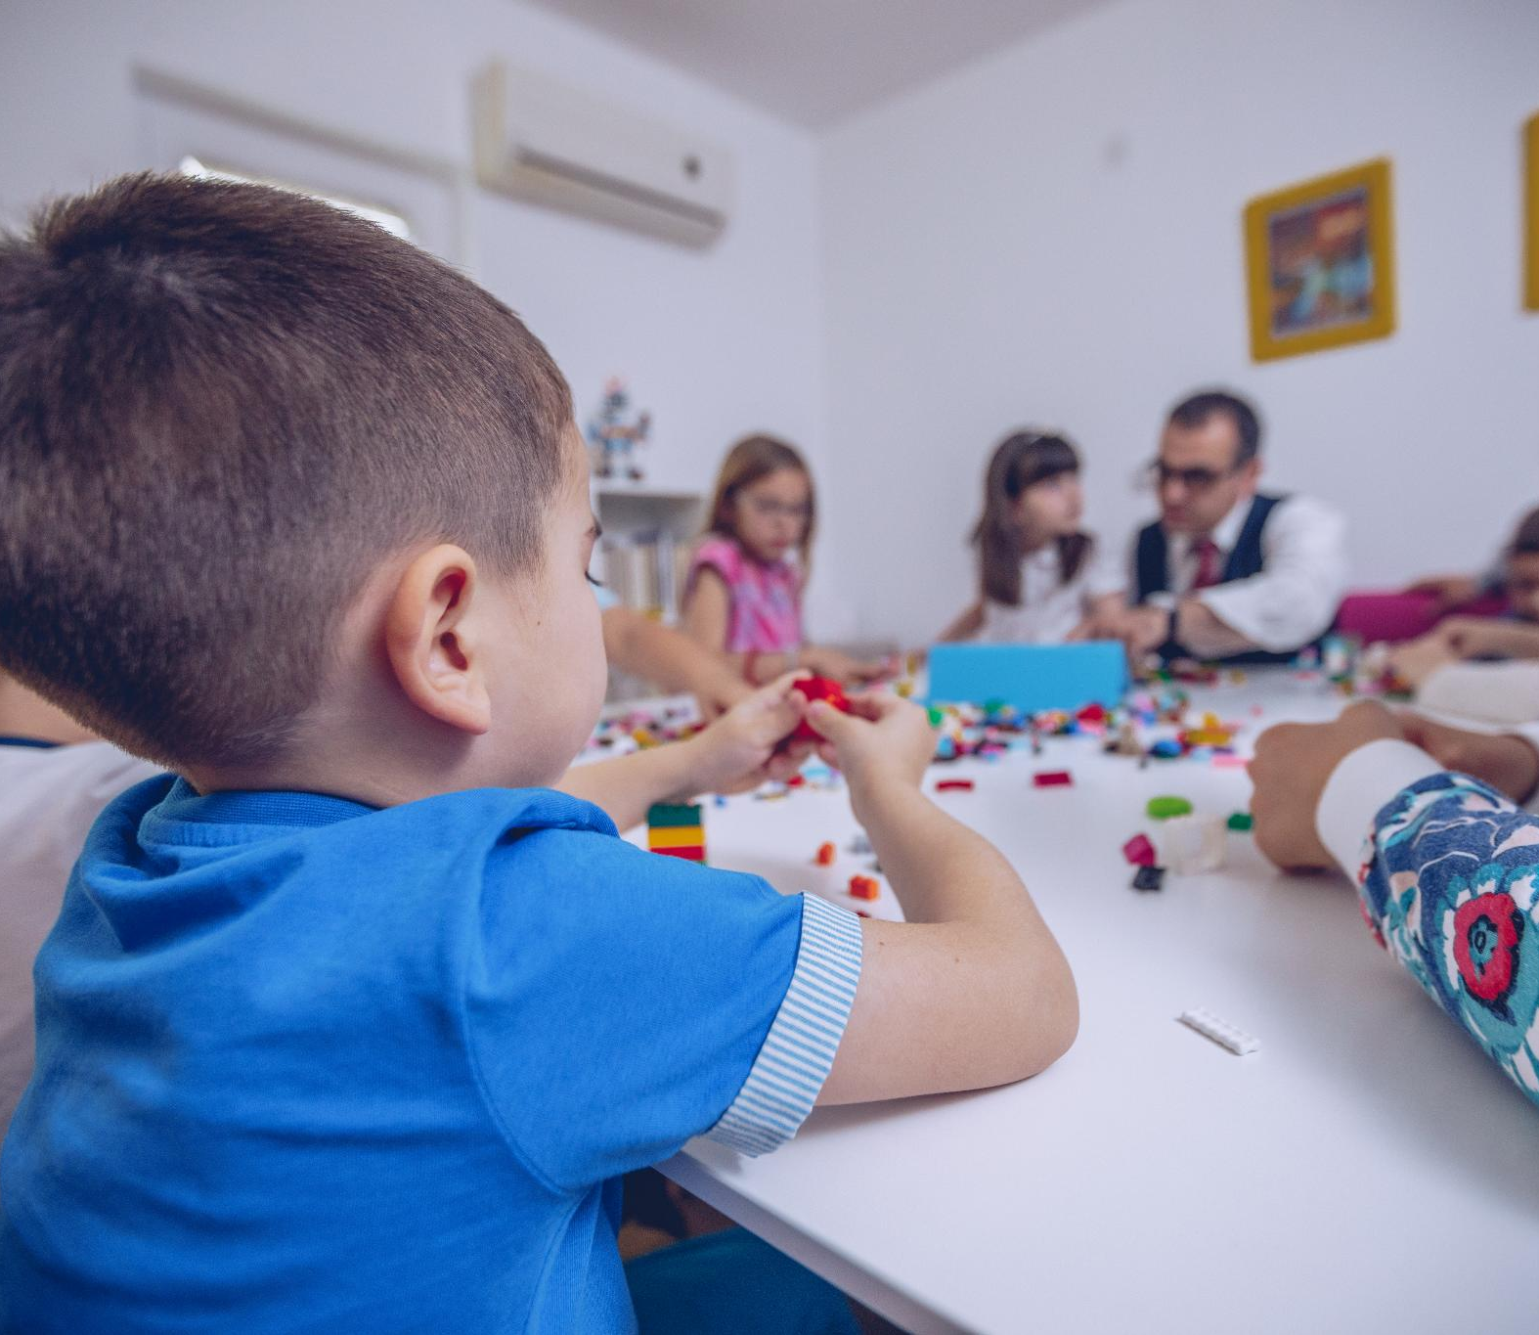
How you think Adults Help
Engaging Learning Methods
  Teachers make lessons fun using games, stories, and activities to keep children interested and motivated.
Clear Feedback
  Providing clear feedback through marking and discussions helps children understand how to improve their work.
Supporting Independent Learning
  Tools like working walls, checklists, and self-assessment encourage children to become independent learners.
Balanced Challenge
  Children appreciate being challenged, though some want difficulty levels better matched to their abilities.
Notes:
---
This slide references information from the following file: https://ranelaghschool-my.sharepoint.com/personal/esavage_jennetts_bonitas_org_uk/_layouts/15/Doc.aspx?sourcedoc=%7B17B8D0FB-D086-404B-974B-B85ADBF7F05F%7D&file=pupil%20voice.docx&action=default&mobileredirect=true
Children appreciate when teachers make lessons fun and interesting. They like when teachers use games, activities, and stories to help them learn. Clear feedback from teachers, like marking and talking about their work, helps children know how to improve. Tools like Olex AI also support learning. Children enjoy being independent learners by using working walls, checklists, and self-assessment tools. Many children like being challenged in their work, but some think the difficulty level could be better matched to their abilities. Overall, children feel that teachers care about their learning and try to make school a great place to learn.

Slide 10
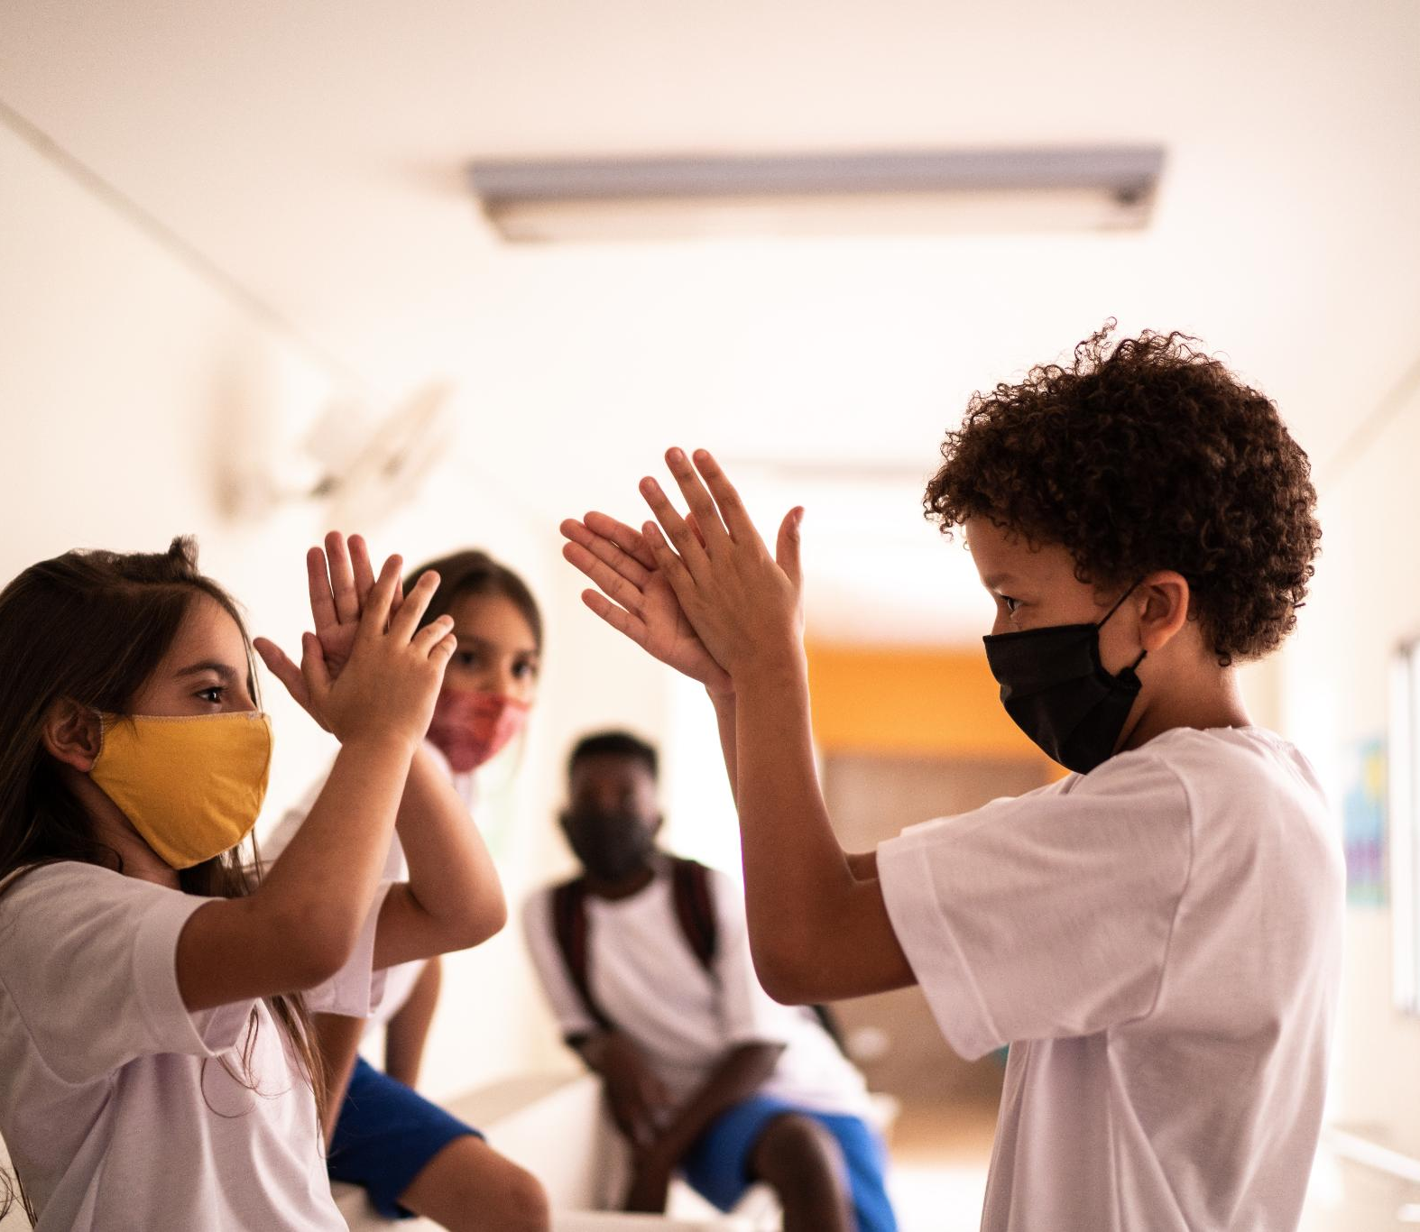
Feeling Safe and Supported
Physical Safety Measures
  Secure gates and online safety lessons ensure children feel physically protected at school.
Emotional Support
  Children trust teachers and friends for emotional support when feeling upset or worried.
Inclusive Values
  Rainbow Values promote kindness, respect, and inclusion to create a welcoming school community.
Positive Learning Environment
  Feeling safe and supported helps children enjoy learning and achieve their best at school.
Notes:
---
This slide references information from the following file: https://ranelaghschool-my.sharepoint.com/personal/esavage_jennetts_bonitas_org_uk/_layouts/15/Doc.aspx?sourcedoc=%7B17B8D0FB-D086-404B-974B-B85ADBF7F05F%7D&file=pupil%20voice.docx&action=default&mobileredirect=true
Most children feel safe at school. They trust the adults around them and feel protected by secure gates and lessons about online safety. Emotional support from teachers and friends is very important. When children feel upset or worried, they know they can talk to someone who will help. The school’s Rainbow Values teach kindness, respect, and inclusion, which help everyone feel welcome and cared for. These values create a friendly and safe environment where children can learn and grow. Feeling safe and supported helps children enjoy school and do their best.

Slide 11
Behaviour and Leaders
Notes:
---
This slide references information from the following file: https://ranelaghschool-my.sharepoint.com/personal/esavage_jennetts_bonitas_org_uk/_layouts/15/Doc.aspx?sourcedoc=%7B17B8D0FB-D086-404B-974B-B85ADBF7F05F%7D&file=pupil%20voice.docx&action=default&mobileredirect=true
Behaviour and Rewards, Having a Voice at School

Slide 12
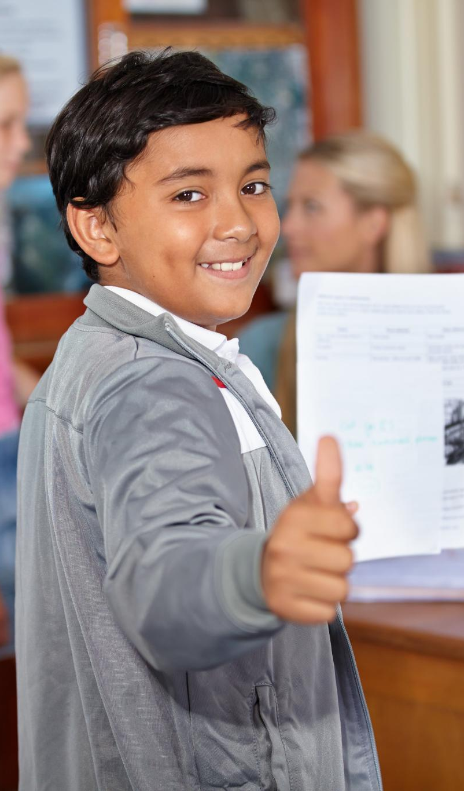
Behaviour and Rewards
Positive Behaviour in School
  Children generally experience good behaviour in class and playground, enjoying a calm and friendly learning environment.
Challenges in Behaviour
  Small problems like disruptions or unkind behaviour sometimes occur, especially during free time, but overall behaviour is improving.
Encouraging Rewards
  Rewards such as rainbow points, stickers, and celebration assemblies motivate children and make them feel proud of their achievements.
Creating a Happy School
  Rewards and positive behaviour recognition help create a happy school atmosphere where kindness and good behaviour are celebrated.
Notes:
---
This slide references information from the following file: https://ranelaghschool-my.sharepoint.com/personal/esavage_jennetts_bonitas_org_uk/_layouts/15/Doc.aspx?sourcedoc=%7B17B8D0FB-D086-404B-974B-B85ADBF7F05F%7D&file=pupil%20voice.docx&action=default&mobileredirect=true
Most children say that behaviour in class and on the playground is good. They enjoy learning in a calm and friendly environment. Sometimes, there are small problems like disruptions or unkind behaviour, especially during free time. But overall, children feel that behaviour is improving. Rewards like rainbow points, stickers, and celebration assemblies are exciting and help children feel proud of their achievements. These rewards encourage children to do their best and be kind to others. They make school a happy place where good behaviour is noticed and celebrated.

Slide 13
Having a Voice at School
Student Leadership Roles
Children take part in councils and prefect roles to feel important and express their ideas effectively.
Listening to Student Voice
Many students feel heard by teachers, fostering a positive environment for open communication and feedback.
Impact on School Improvement
Student involvement in decisions teaches leadership and helps improve the school based on their feedback.
Notes:
---
This slide references information from the following file: https://ranelaghschool-my.sharepoint.com/personal/esavage_jennetts_bonitas_org_uk/_layouts/15/Doc.aspx?sourcedoc=%7B17B8D0FB-D086-404B-974B-B85ADBF7F05F%7D&file=pupil%20voice.docx&action=default&mobileredirect=true
Children enjoy having roles like School Council, Eco Council, Worship Council, and being prefects. These roles help them feel important and give them a chance to share their ideas. Many children feel that their voices are heard and that teachers listen to their suggestions. However, some children would like to see more changes based on their feedback. Being part of school decisions helps children feel involved and teaches them about leadership. It also shows that their opinions matter and can help make the school better for everyone.

Slide 14
Health and Improvements
Notes:
---
This slide references information from the following file: https://ranelaghschool-my.sharepoint.com/personal/esavage_jennetts_bonitas_org_uk/_layouts/15/Doc.aspx?sourcedoc=%7B17B8D0FB-D086-404B-974B-B85ADBF7F05F%7D&file=pupil%20voice.docx&action=default&mobileredirect=true
Staying Healthy and Active, What’s Better and What Can Improve

Slide 15
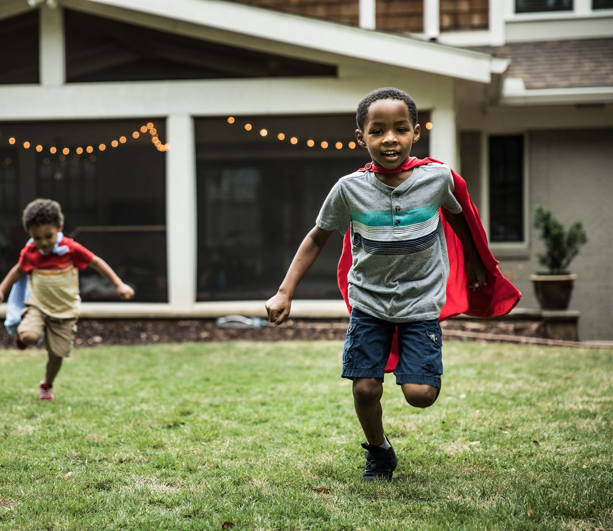
Staying Healthy and Active
Importance of Physical Activity
  Children enjoy PE lessons, sports clubs, and the daily mile which keep them fit, healthy, happy, and energetic.
Healthy Eating Habits
  Some children appreciate healthy meal options at school, though some want tastier or larger portions.
Balancing Activity and Nutrition
  Eating well and staying active are both essential for children to feel good and succeed in school.
Desire for More Healthy Opportunities
  Children want to learn more about healthy habits and have more chances to be physically active throughout the day.
Notes:
---
This slide references information from the following file: https://ranelaghschool-my.sharepoint.com/personal/esavage_jennetts_bonitas_org_uk/_layouts/15/Doc.aspx?sourcedoc=%7B17B8D0FB-D086-404B-974B-B85ADBF7F05F%7D&file=pupil%20voice.docx&action=default&mobileredirect=true
Children know that staying active is important. They enjoy PE lessons, sports clubs, and the daily mile because these activities keep them fit and healthy. Being active also helps them feel happy and energetic. When it comes to food, some children like the healthy options at school, while others think the meals could taste better or be bigger. Eating well and moving around are both important for feeling good and doing well in school. Children want to learn more about healthy habits and have more chances to be active during the day.

Slide 16
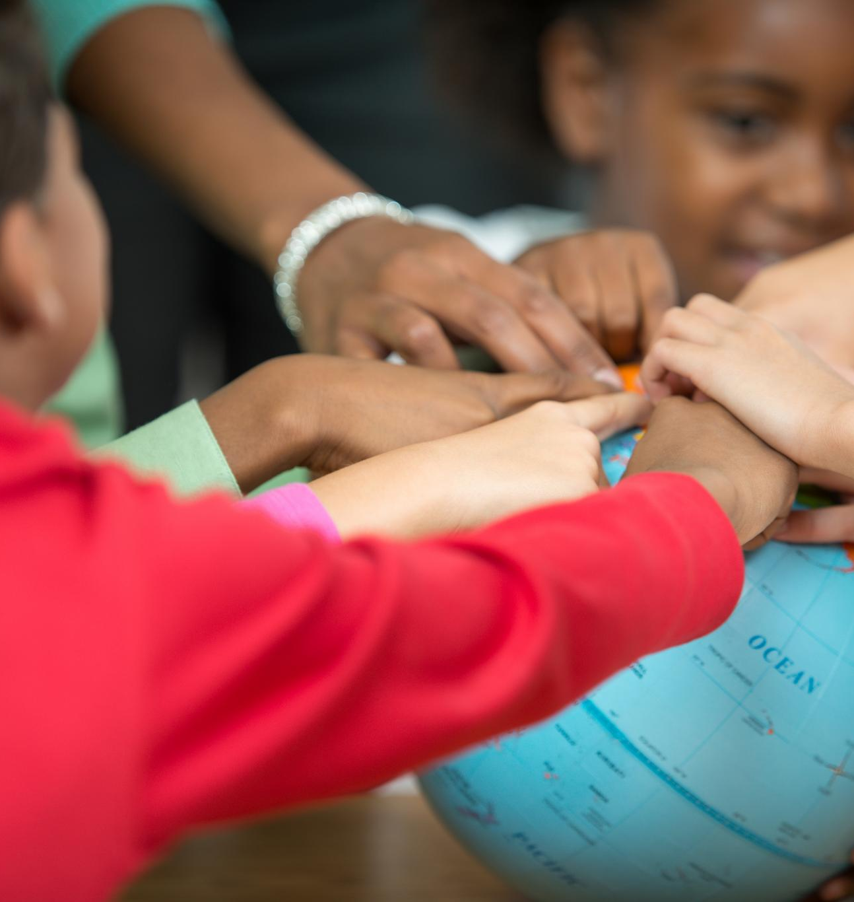
What’s Better and What Can Improve
Current School Improvements
  Lessons now include more hands-on activities and trips, making learning enjoyable and engaging for children.
Improved Classroom Behavior
  Better behavior in some classrooms has created a positive learning environment that supports student focus and growth.
Future Suggestions for School
  Children suggest more outdoor learning, better technology access, diverse learning topics, improved facilities, and more physical education.
Notes:
---
This slide references information from the following file: https://ranelaghschool-my.sharepoint.com/personal/esavage_jennetts_bonitas_org_uk/_layouts/15/Doc.aspx?sourcedoc=%7B17B8D0FB-D086-404B-974B-B85ADBF7F05F%7D&file=pupil%20voice.docx&action=default&mobileredirect=true
Children have noticed some great improvements at school. Lessons are more fun and include more hands-on activities. There are more trips and exciting events that make learning enjoyable. Behaviour in some classrooms has also gotten better, making it easier to learn. For the future, children suggest having more trips and outdoor learning, better access to technology and creative tools, more choices in learning topics, improved food and facilities, and more PE and active lessons. These ideas show that children are thinking about how to make school even more fun and helpful for everyone.

