Slide 1
Year 3 Meet the Teacher
Mrs McGill & Miss Jennings

Slide 2
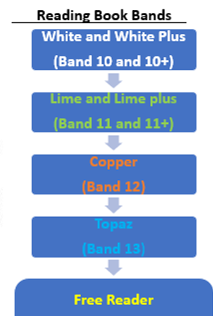
Changing books
Children can change their books first thing in the morning, or before they go home at the end of the day.
The children will be continuing with their book banded books, if they are reading from these, and we will continue with free readers.
Reading books will be going home as soon as we have read with the children. Children will be provided with a bookmark, these are to be signed when reading with your child.

Slide 3
Home learning
Maths & English will be given on alternate weeks
Maths will often have a times table focus,(2,5,10, 3, 4, 8) we would like children to go on Times Table Rockstars a few times a week, the more often the better the progress.
English tasks will be written on Seesaw.
Home learning will be set on a Friday to be completed before the following Friday. If this has not been done by Friday break time. Home learning should take less than 10 minutes, it is designed for the children to do independently.
Spellings
We do not do spelling tests, but it is helpful for children to go on Spellingframe each week and complete the tasks given. This resource covers the same as we are in class and therefore reinforces the learning as well as going back over Year 2 objectives.
Reading
Reading homework is to read 5 x week for a minimum of 15 minutes. We would like adults to hear their child read out loud for at least one of these sessions. We are using reading bookmarks this year, and the children will be changing their reading books when parents/carers have signed off a book as read. They are encouraged to take ownership of this.
Topic
We will, on occasion, upload topic homework, which may link to our science, or our history/ geography.
All home learning will be set on SeeSaw
We will also use seesaw to notify parents of changes to the timetable or important reminders about trips.
We will also update the Year 3 blog termly!

Slide 4
Timetable
Timetable does vary between classes, but this is a rough outline of our daily routine.
Foundation subjects include: art, geography, history, music, MFL, RE.
PE days are Fridays and Wednesdays
Break times are at 10.30 – 10.45- Can provide a snack if you would like
Lunchtimes are 12.00 – 13:00 which includes eating and play time.

Slide 5
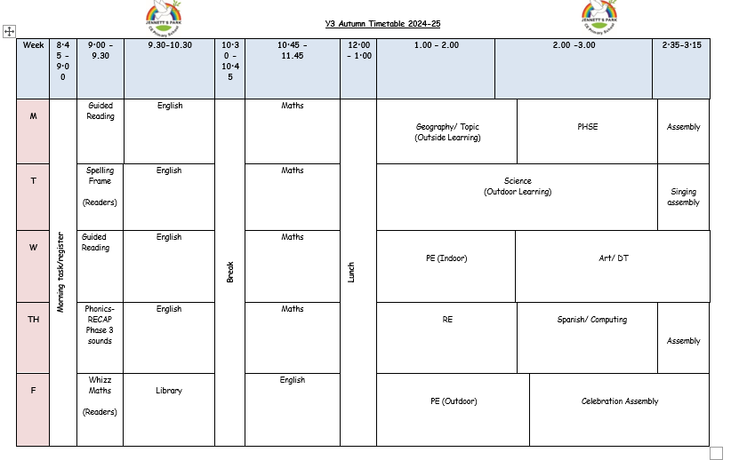

Slide 6
Topics by term and trips
Autumn: Stone Age – Portals from the past will be coming in on 1st October for a days workshop with us
Spring term: Vikings – we hope to go to Ufton court for their Viking experience day
Summer term: Rainforests – we hope to visit the living rainforest in Summer 1 and continue with Forest school in Summer 2

Slide 7
Outdoor learning!
We have been invited to take part in a brand new outdoor learning pilot! Due to this we will be spending at least two hours a week conducting learning in nature. We will be going outside whatever the weather!
To ensure that we can do this properly, we are asking if children can be provided with a spare set of clothing and wellington boots. Children can keep these in the cloakroom and change when necessary. This way we can adapt our outdoor sessions without having to send constant reminders home asking for clothing!
This project is being led by The Harmony Project and Canterbury Christchurch University!

Slide 8
Children do not to bring any of these: Toys/cards/pencil cases
Please make sure that every item of clothing is named, this includes water bottles, jumpers even shoes! Please don’t assume we will have a support assistant to help children find lost items.
If items brought into school are named they will usually make their way back to class by the end of the day.
If your child has lost something, the best thing to do is to let us know and we will do our best to help the child locate the item, however we simply cannot spend valuable learning time tracking down lost jumpers. Lost property is located outside the front office.
Snacks
As we don’t have free fruit provided in Year 3, children are encouraged to bring a health snack, fruit for example in for breaktimes.
Questions…?

