Slide 1

All about Year 1

Slide 2

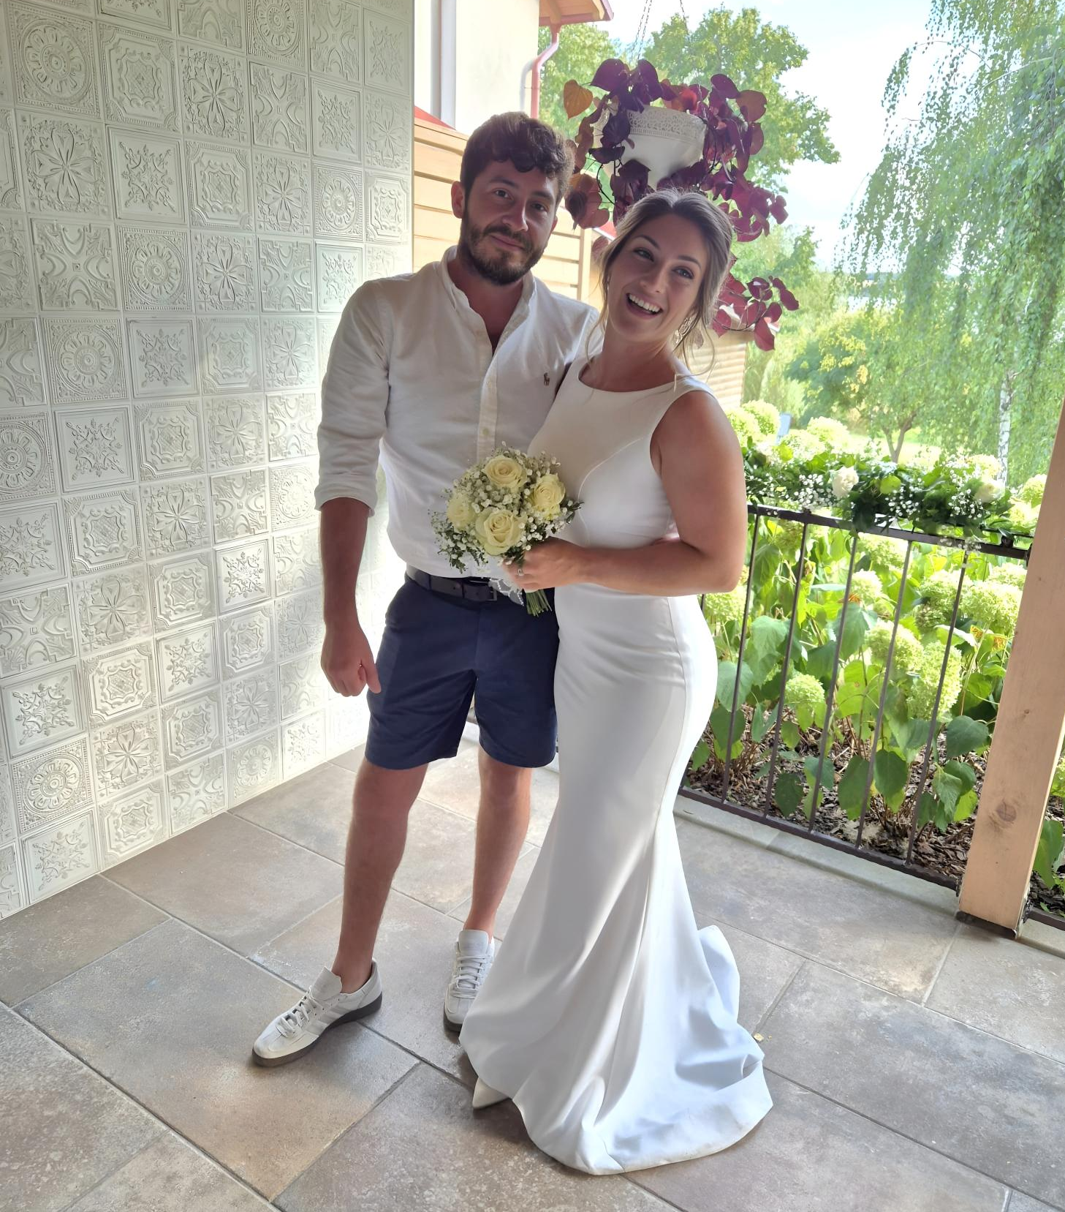
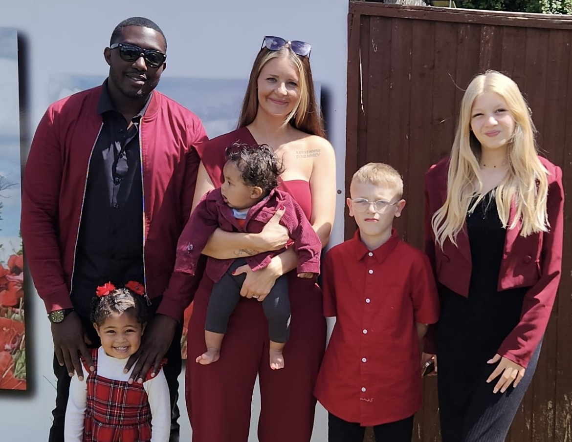
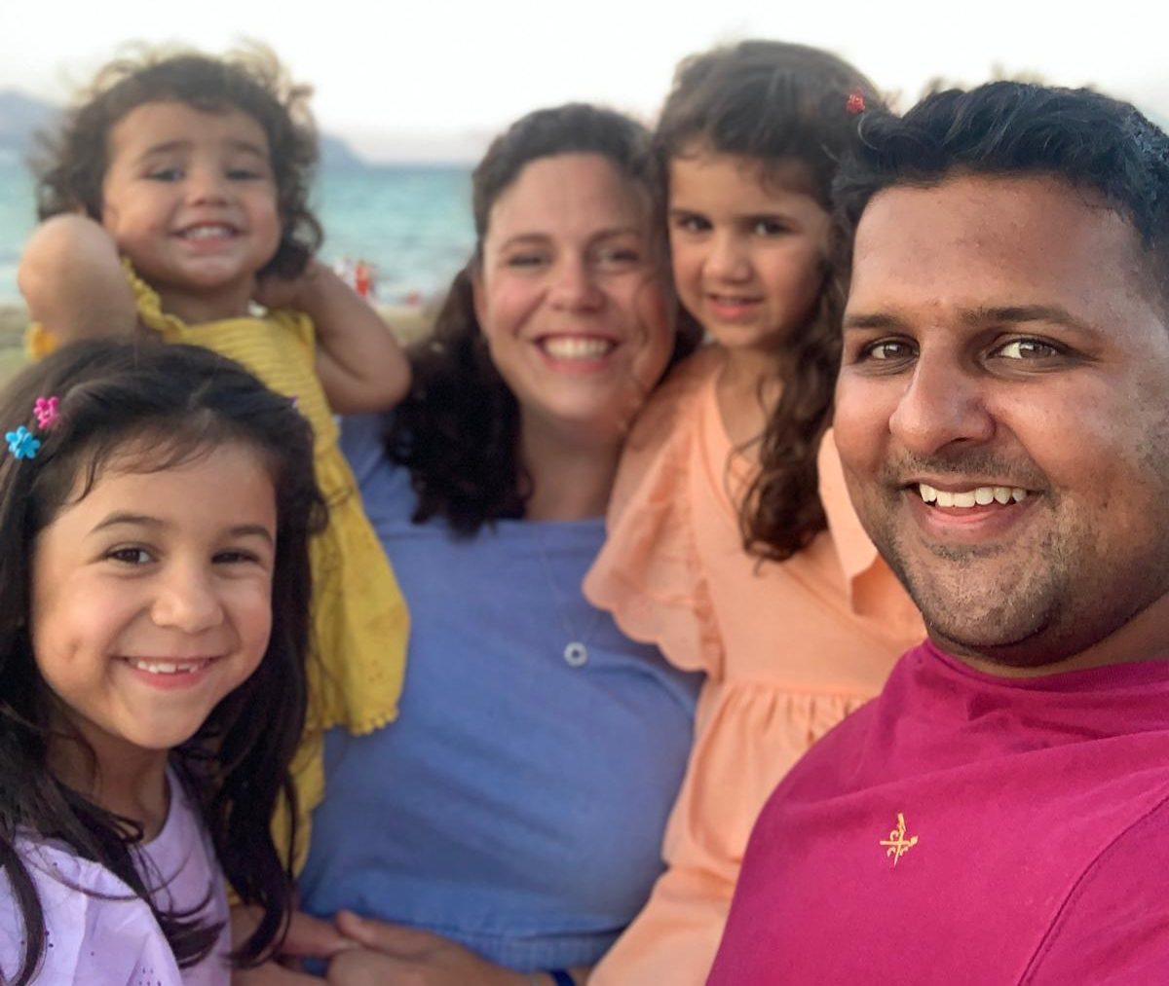
Year 1 Team
Miss L Kaye– Whinchats teacher
Miss Claridge (M/T/W) and Mrs Dhillon (W/T/F)– Stonechats teachers
LSA - Mrs Olejko -Tuesday-Friday 9.00-2.45

Slide 3
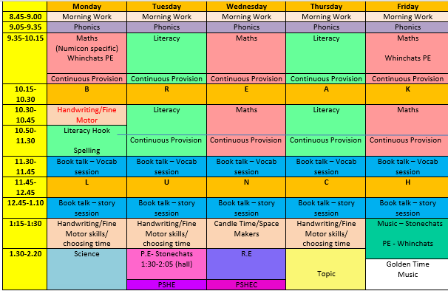

Our weekly time table ( this could change especially around seasonal events)

Slide 4

Days to remember in Year 1
P.E day –Stonechats-Tuesday and Wednesday. Whinchats- Thursday and Friday.
Book change day – Friday
Library day – Stonechats – Friday. Whinchats - Thursday
Don’t forget…
A named water bottle in school every day
A spare change of clothes/underwear (if required)
Reading books and reading records every day
School uniform labelled

Slide 5

Reading in Year 1
Reading books and reading records MUST be in school EVERY day.
Children take home 2 books each week. Please re-read these books with your children as this will help develop their fluency. ☺
Reading books will be changed on a Friday.
Children in Year 1 are expected to read at home 4 times a week, this is their homework.
Please record when you have read with your child in their reading record, even just a date, book title and your initials please.

Slide 6

Phonics Screening Check
Statutory government check takes place in June for all children in Year 1.
Children read 40 words (20 real words/20 nonsense words).
Check is completed on a 1:1 basis alongside the class teacher.
All parents are informed of their child’s pass mark at the end of the Summer term in their end of year report.
Phonics home learning to support children for this check will be sent home on Seesaw in the Spring/Summer term.

Slide 7






Topics in Year 1
We also hope the children can go on an external trip to Milestone Museum this year. We would love to also source an internal experience related to our Pirates topic. These ideas will depend on many factors such as funds, staffing and the destination availability.

Slide 8

Seesaw
Used to share pictures of children’s learning and work that they have completed.
Home learning is added to Seesaw later in the school year.
Reminders will be sent out for key events or if children need to bring any resources to school.
You can post any learning or experiences that have occurred over the weekend or holidays if you wish.
If you have any questions or would like to arrange a meeting with the Year 1 team, please email the office.

Slide 9
Just a reminder that all medications are to go through the office and not to be left in school bags. We are not allowed to take any medications through the door.
Lost property- unnamed will go to the office, named items will be delivered to classrooms.
In Year 1, we promote independence. Please encourage this anytime, anywhere!
Afternoon snacks – If you think your child can’t last from lunchtime until bringing a snack at home time, please send a fruit or a vegetable. We will offer any leftover NHS School fruit and vegetables from morning until October half term to support transition. (Snacks MUST be either a fruit or a vegetable please.)

Slide 10

Any questions?

