Slide 1
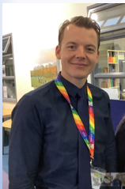
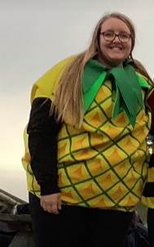
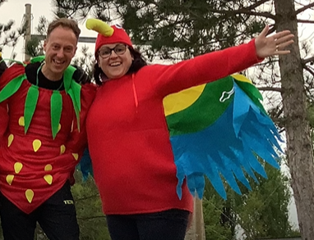
Welcome to meet the Year 6 teaching team.

Slide 2
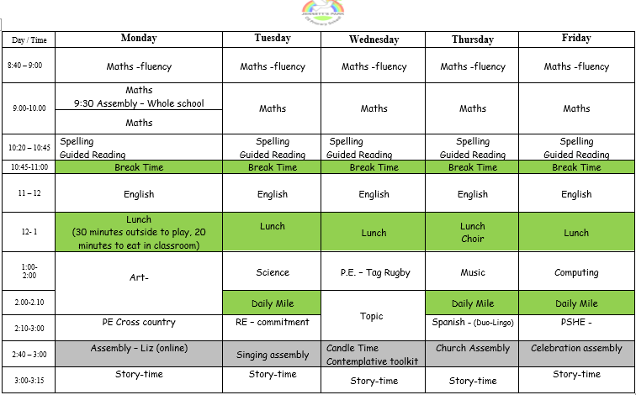
Timetable - PE this term will be on Monday and Wednesday. Please attend school in PE Kit on these days.

Slide 3
What a difference 5 minutes makes…
Please encourage your child to arrive to school on time. Each morning (from 8:40 – 9:00) there will be a learning task that often helps to consolidate the learning from the day before.
Arriving at 8:45 rather than 8:50 = 5 minutes of extra learning
5 minutes each school day = 25 minutes a week
25 minutes a week over the 38 week school year = 950 minutes
950 minutes = approximately 16 hours
16 hours = 3 school days
So every 5 minutes is equivalent to 3 school days. Imagine arriving at 8:40 rather than 9:00 that’s 12 school days or over 2 school weeks.

Slide 4
Home learning expectations
The government expectation is that a Year 6 child will spend 2 and 1/2 hours a week on home learning. If you child struggles with the home-learning, please let us know before Thursday and we will find time to support them with it. If you do not have the time to complete it at home, please stay in during lunchtime to complete the tasks.
We will set home learning on a Friday (on Seesaw) and ask for it to be uploaded by the following Thursday.
Each week there will be :
maths - that will consolidate the learning of that week
writing - that will link with the current writing unit covered in class
roger challenge- a little practice each week will help
reading- at least five times of 20 minute reads a week is expected and recorded on the bookmark
spelling frame - weekly spellings will be set and tested on spelling frame
owl learning log - the aim of this is that your child should be able to share their successes in the owl learning behaviours each week. Please discuss these each week with your child. There is also a space for you to make a comment via Seesaw.
extra home-learning—some of you have asked for extra. There are trays at the back of the classroom with additional sheets.
marking – our aim will be to give an effort grade

Slide 5
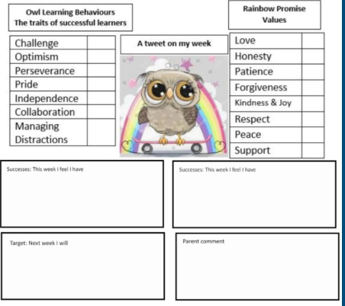
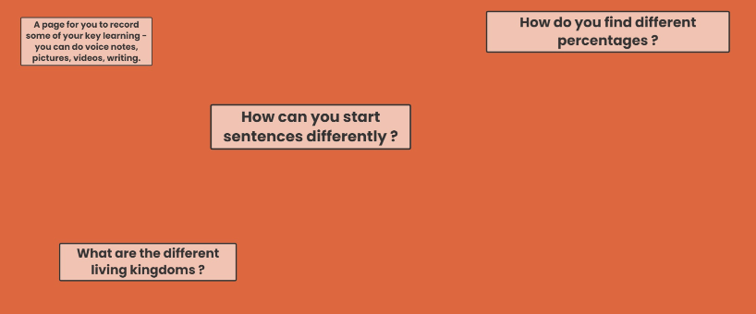

Slide 6
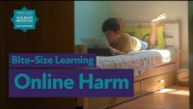
Do your best to protect your child on line.

Slide 7


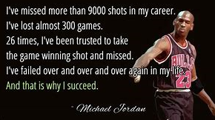
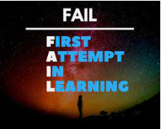
A Growth mindset
Our aim is to praise the learning process and therefore celebrate the owl learning behaviours that are shown. The outcome is not the important part.

Slide 8
Reading at home
5 times per week for at least 20 minutes each time
Your child has been given a reading book mark
The bookmark will be checked every Friday
They will be entered into a prize draw for every completed bookmark

Slide 9
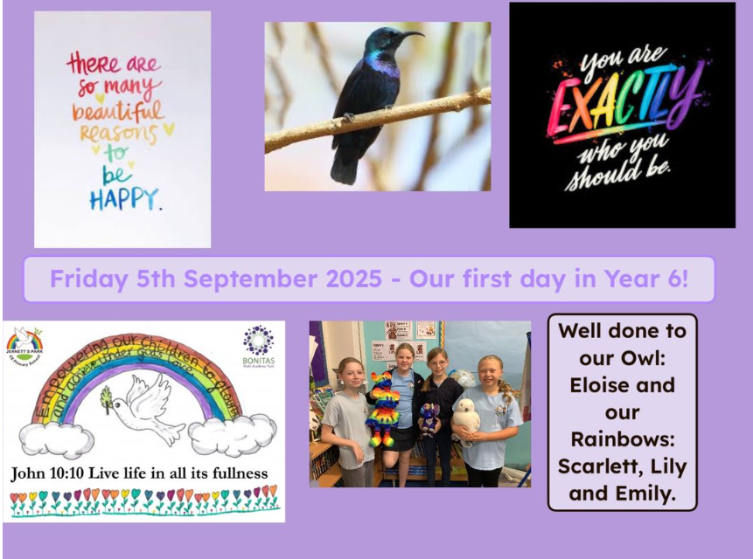
Brief introduction to Seesaw/activities to expect
The class blog is to aid discussion at home and to be a learning aid to support with home-learning.
We will also use Seesaw during learning time.

Slide 10
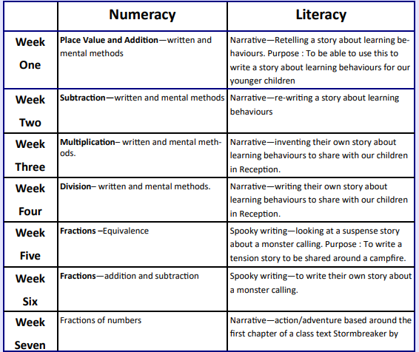
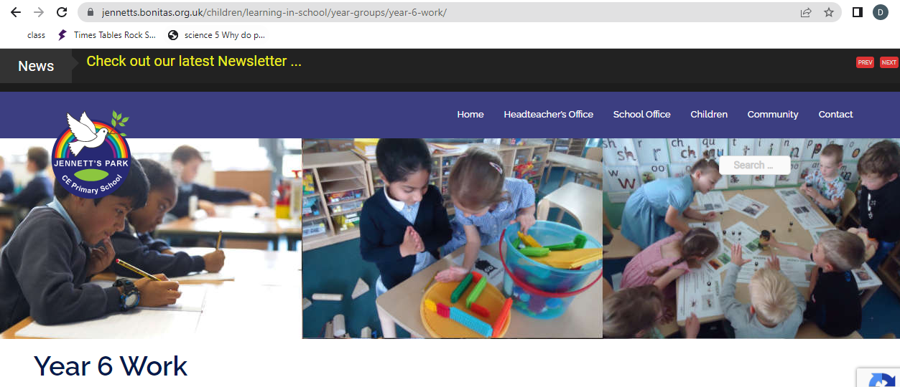
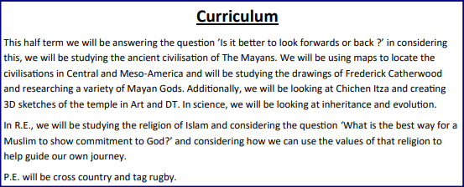

Slide 11
Year group expectations
Home-learning is completed
Children show positive Owl Learning Behaviours
Children are Rainbows both inside and outside of school
The role of being a year 6 – prefects, running clubs for younger children, a community project, role models across our school
Work hard play hard
We are a team together

Slide 12
Educational visits
Autumn Term – Oxford museum linked to our learning about evolution and the Maya civilisation.
Spring Term – The children will plan a trip to Reading to see the Victorian influence on the town. Likely to be on the train.
Summer Term – Residential visit –27th April – 1st May (meeting in early April to discuss finer details).
Possibility of a Legoland trip during the last week.

Slide 13

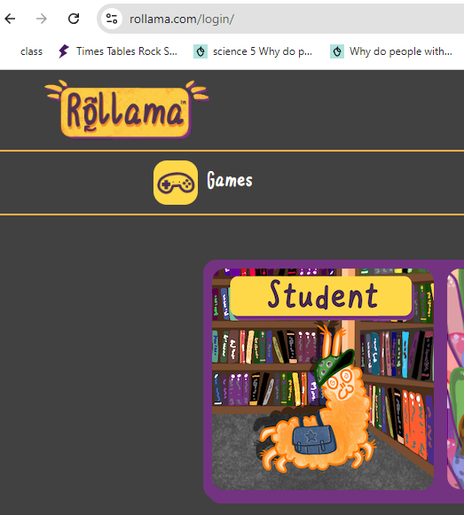
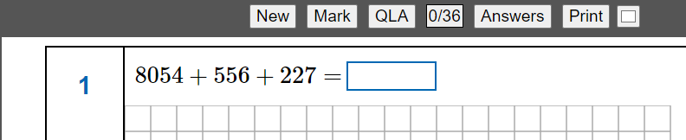

SATs
After Christmas, there will be links in the home-learning to useful revision sites.
We will run a separate meeting after Christmas to go over finer SATs details.

Slide 14
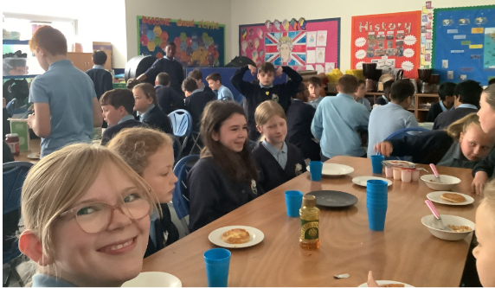
But the best thing about SATs week is…

Slide 15
End of year 6
We will organise the leavers hoodies – these will be given out as part of our leavers’ service
We will aim to have a summer production
The children will organise and run a 20p fair, in school time
Leavers’ service
In the past, parents have organised a leavers’ event. We are more than happy to work with you and support you with this

Slide 16
Any questions ?

