Slide 1
Meet the teachers
Mrs Venediktou and mr Luxon
Welcome to Year 4 2025-26

Slide 2
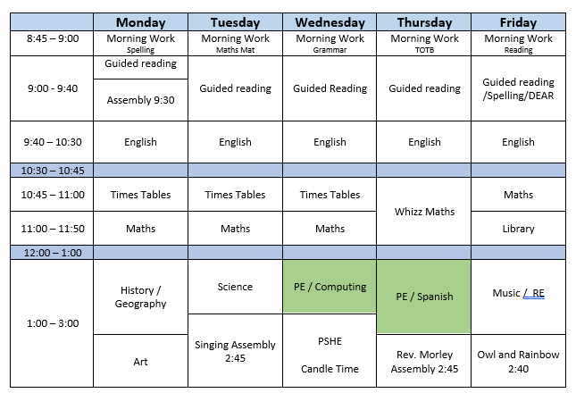
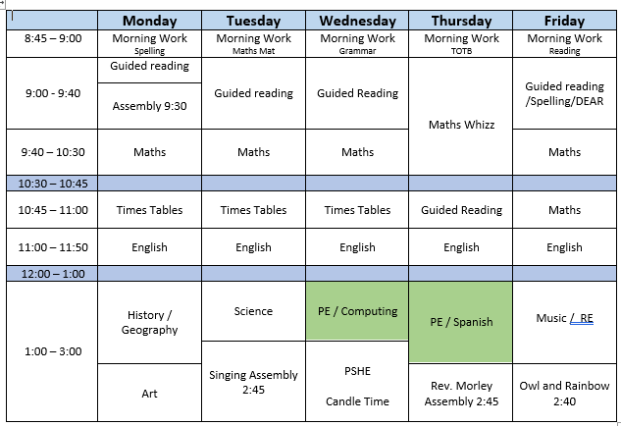
MACAWS
KINGFISHERS

Slide 3
Communication with Parents/Carers
Parents Evening x 2 – autumn and spring term
Reports x 1 – summer term
Letters in advance of trips
Seesaw

Slide 4
Topics:
Place Value, multiplication, decimal places, symmetry, rotation, co-ordinates, time, properties of shape
Word classes, regular, irregular verbs, writing different styles of texts (descriptive setting, poem, fact file, report), punctuation (CL, FS, commas, brackets, colon)
Enjoyment of reading, reading different genres, understanding, predication, inference of what has been read

Slide 5
A closer look
Topics: Polar Regions, Ancient Romans, Ancient Greeks,
Science: States of Matter, Electricity, Sound, Living Things and their habitats
RE: Judaism, Christianity (alternate half terms)
PE: movement, balance, focus on fine motor skills and hand eye coordination
Others: Spanish, Ukulele lessons, countries within Europe

Slide 6
Trips:
Explorers Sleepover
Roman Visit Day
Greek Theme Day

Slide 7
National Multiplication Tables Check (MTC) in Year 4
https://www.timestables.co.uk/multiplication-tables-check/
June 2025 (TBC, usually falls within first 2/3 weeks)
Regular practise at home

Slide 8
FAQs
What can I do to help my child? Reading at home – this includes reading to them in conjunction with hearing them read - 15 mins is plenty. As long with reading to enhance fluency and accuracy, ask them questions regarding what they have just read. Ask them to make a prediction; ask them to infer something about the character’s feelings; ask them to give you an alternative ending; ask them if they enjoyed the book and encourage them to explain why. Practising times tables at home is key to boosting your child(ren)’s knowledge and confidence.
What if I need to speak to you? You can approach for quick concerns on the door in the morning / at home time (you may be asked to wait a few minutes until all children have gone/settled) but any other matters will require an appointment to be booked through the office team.

Slide 9
FAQs
What are the home work expectations? Home learning is set on a Friday, with the expectation that it is to be completed the following Thursday.
When is PE? Wednesday and Thursday – please come in full PE kit

Slide 10
Any other questions?

