Slide 1
Welcome to the Year 2 Meet the teacher!

Slide 2
Staff
Yellowhammers- Mrs Clarke
Canaries- Mrs Lant
Extra adults in Year 2:
Miss Raya
Miss Sagoo
Other KS1 adults

Slide 3
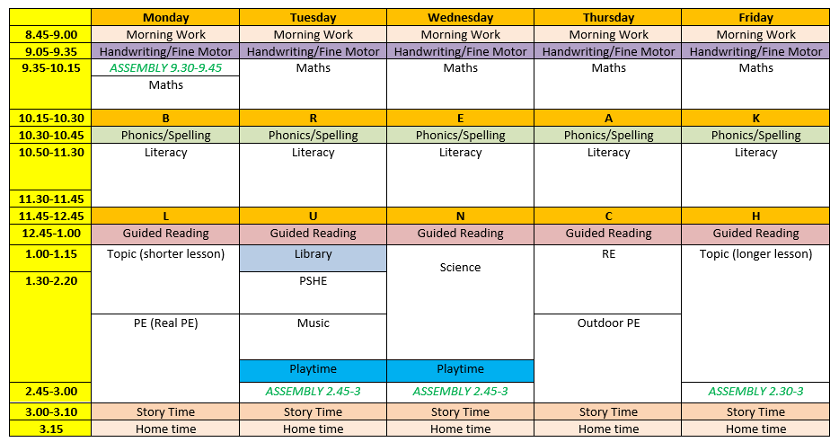
Timetable

Slide 4
What we cover in Year 2
In Maths we will start by focusing on place value then addition and subtraction.
In Literacy we allow the children to write for a variety of purposes including, Non-Chronological reports, letters to persuade and stories.
In Science we cover:
Animals Including Humans
Plants
Materials
-Living things and their Habitats
In the Autumn term our topic is ‘The Great Fire of London’
The children tend to love this topic, and not only does it link to our Geography and History lessons, but we also use it for Literacy.
We have a selection of class texts linked to our topic also.
We also have a topic on ‘Castles’ and ‘Under the Sea’.

Slide 5
Extra Information
The children will participate in 2 hours of PE each week.
The children should come to school in their school uniform or school PE kit on the set days.
For Autumn 1 our PE days are Monday and Thursday
Our library day is Tuesday.
Please make sure the children have labels on their jumpers and cardigans. It is also highly recommended that bottles and lunchboxes are named.

Slide 6
Year 2 expectations
We encourage you to read with your children 3 times a week for 15 minutes.
Reading books will be changed on a Monday, please ensure your children bring their books into school every day.
Home learning will be set every Friday on Seesaw and we check to make sure the homework has been completed by the following Thursday. We will alternate between Maths and Literacy each week.

Slide 7
Experiences
The children will have many amazing opportunities throughout the year. We have a range of dance workshops as well as set days such as World Book Day, Number Day, Yellow Day, Reindeer Run, Red Nose Day and Sports Day.
We also hope the children can go on a couple of external trips to Windsor Castle and Sea Life London Aquarium this year. This does depend on many factors such as funds, staffing and the destination availability.

Slide 8
Sats
A recent change to the curriculum are the KS1 SATs. SATs are no longer statutory for Year 2. However, the assessments serve as a marker to how well children are learning and retaining the information taught in KS1 before they progress into KS2.
We believe it is important that the children do not worry about SATs.
We will not be putting any additional pressure on the children, we will not speak about it to them at the start of the year, but we will make it a fun and exciting week for them.
The children will be used to the test formalities as throughout the year we complete various tests.
We do this to allow the children to become familiar with sitting on their own table as well as in silence. This helps us support the children’s learning as well as preparing them for later in their school journey.

