Slide 1
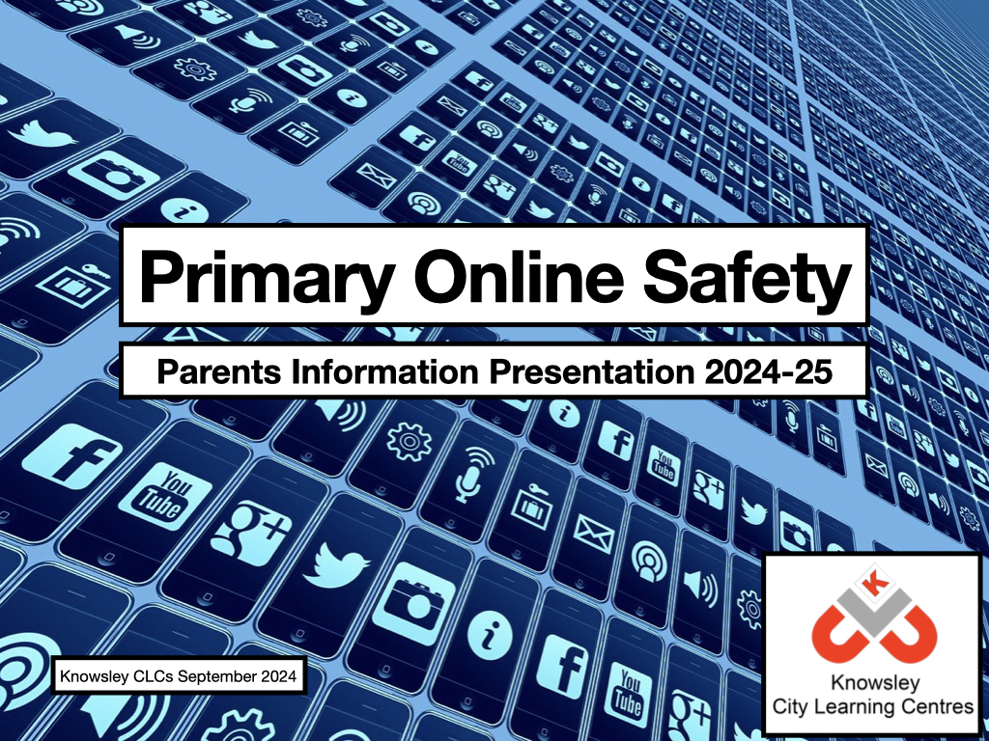

Slide 2
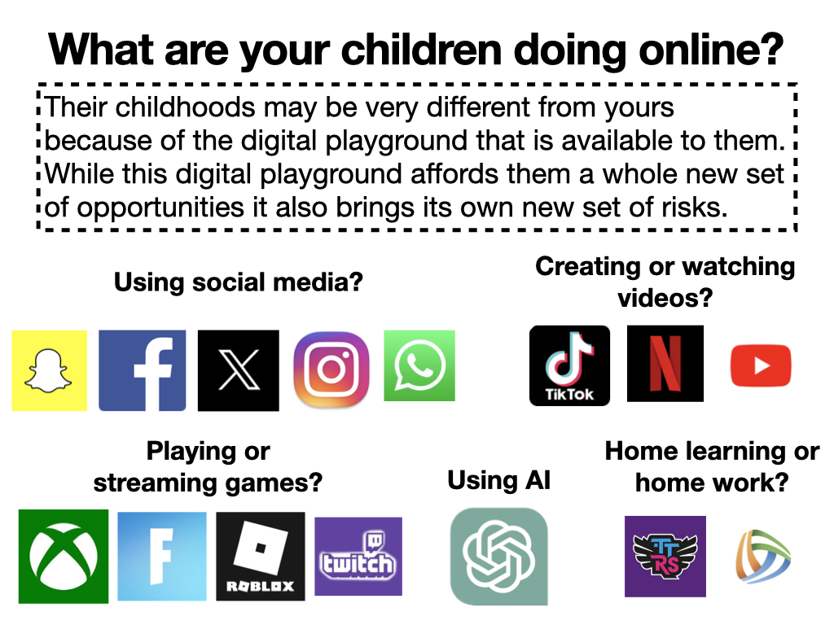

Slide 3
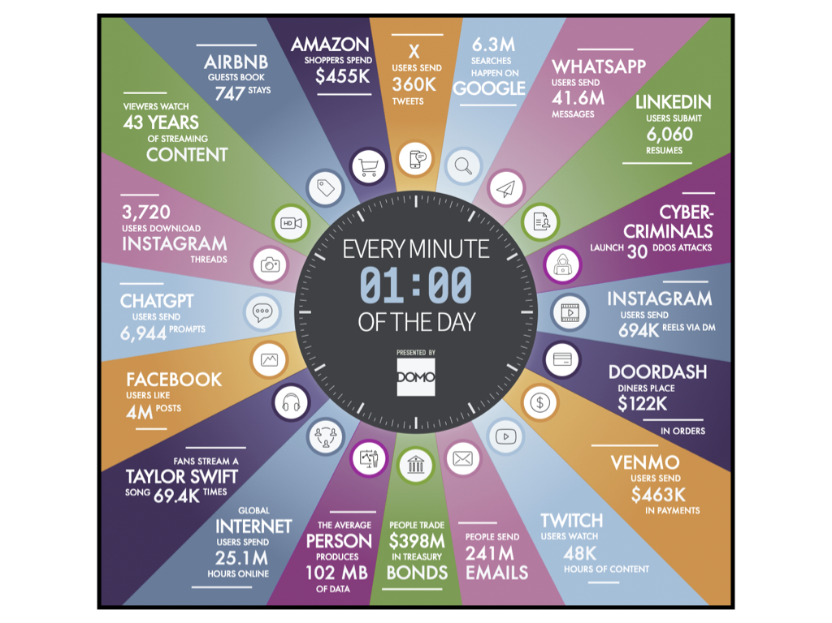

Slide 4
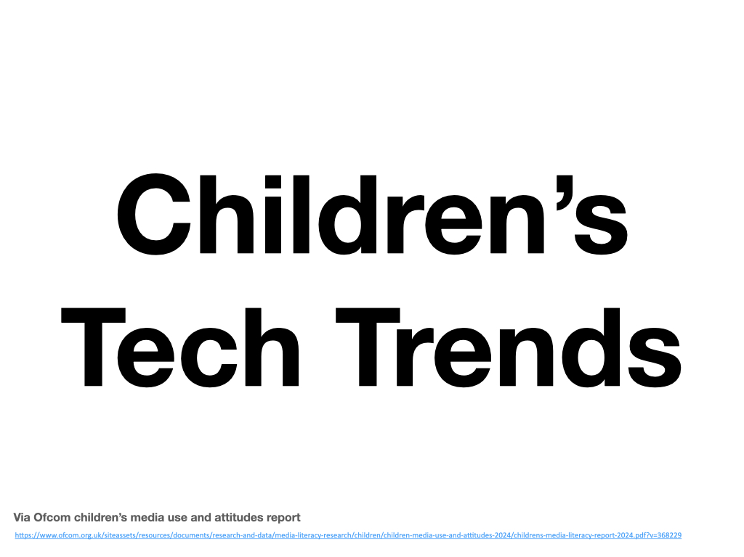
Via Ofcom children’s media use and attitudes report
https://www.ofcom.org.uk/siteassets/resources/documents/research-and-data/media-literacy-research/children/children-media-use-and-attitudes-2024/childrens-media-literacy-report-2024.pdf?v=368229

Slide 5
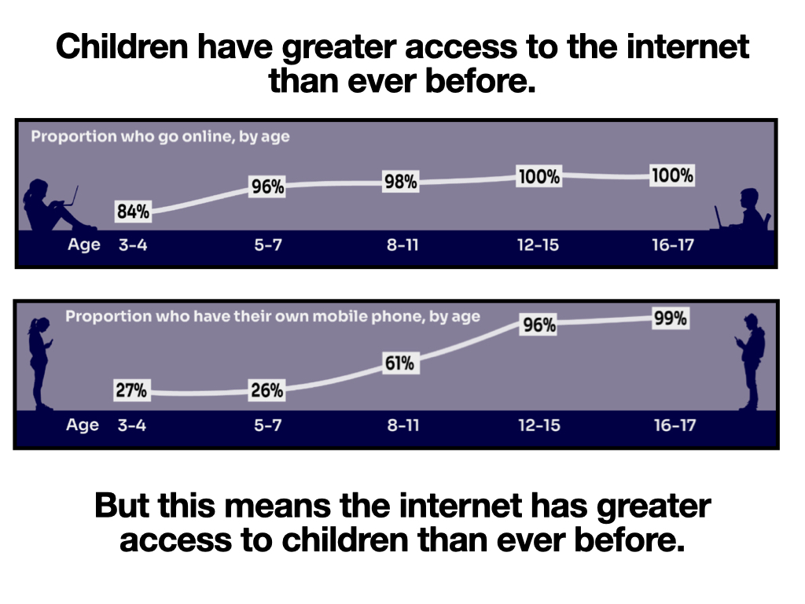

Slide 6
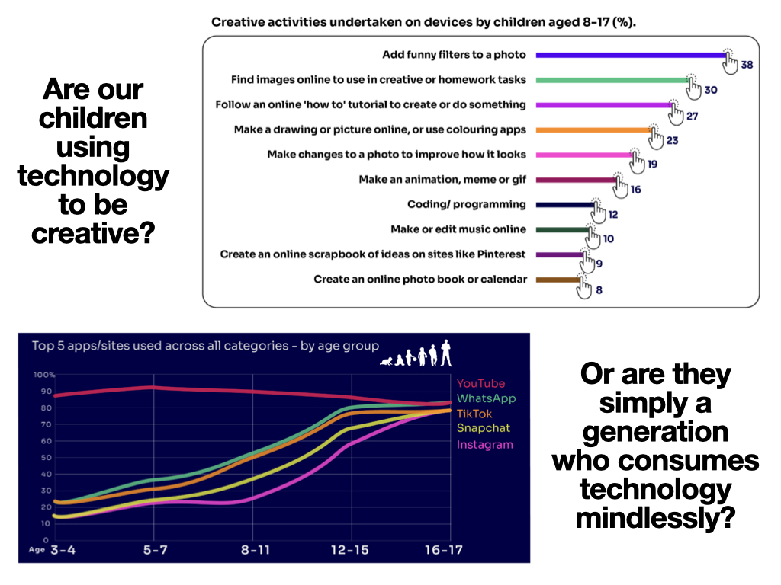

Slide 7
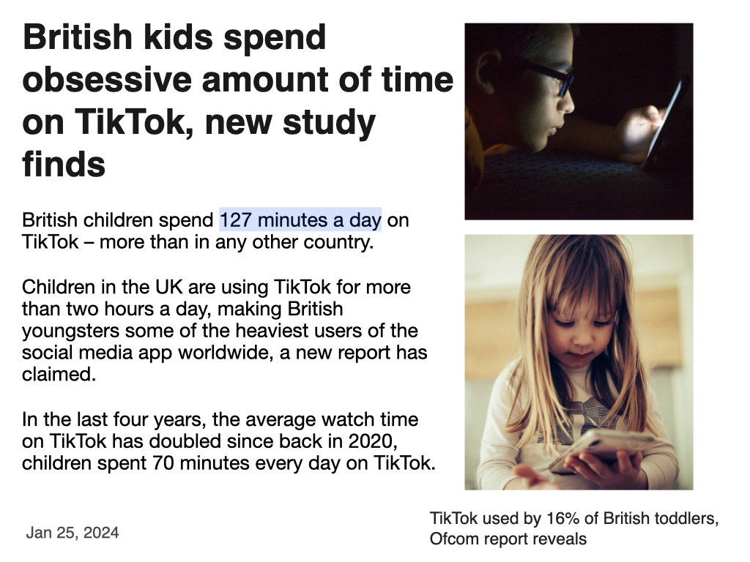

Slide 8
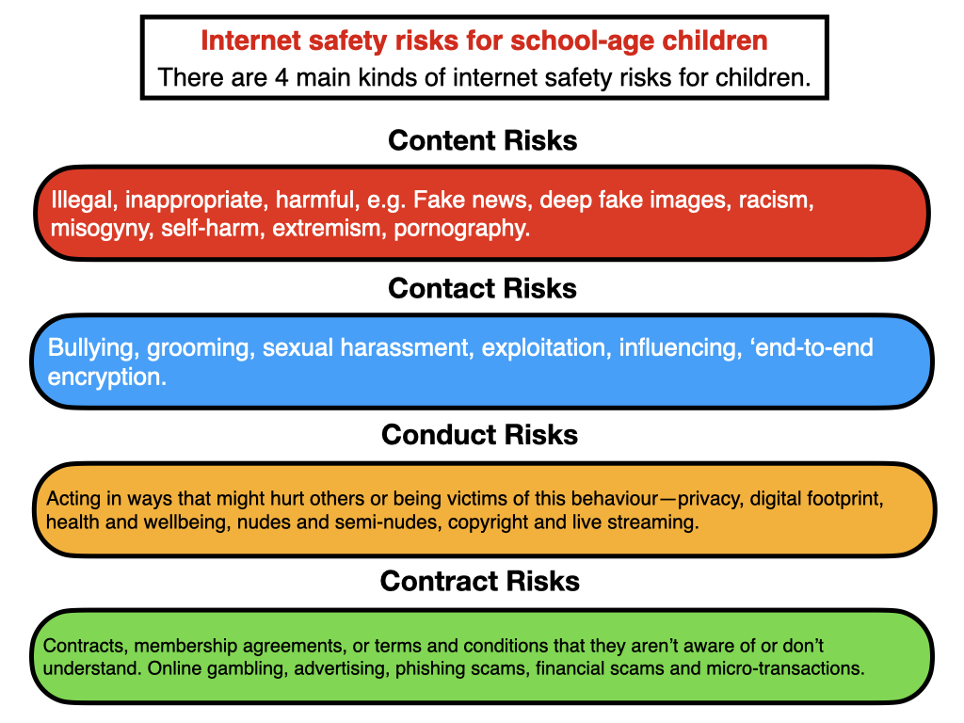

Slide 9
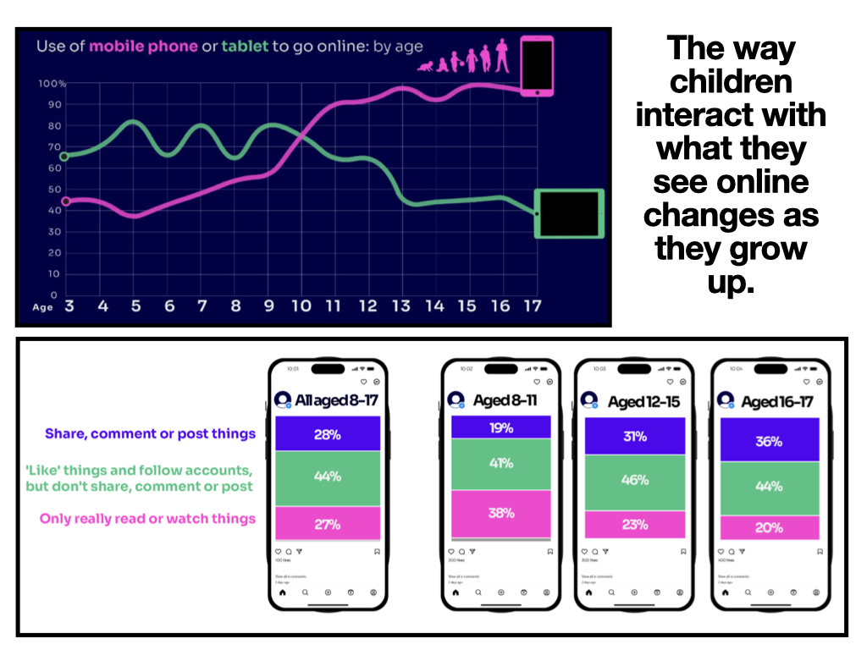

Slide 10
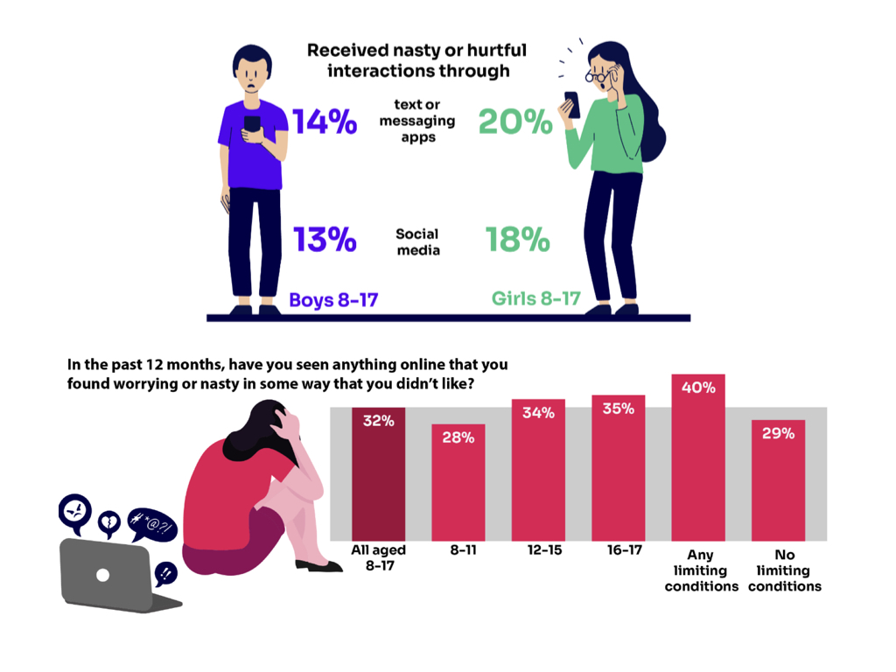

Slide 11


Slide 12
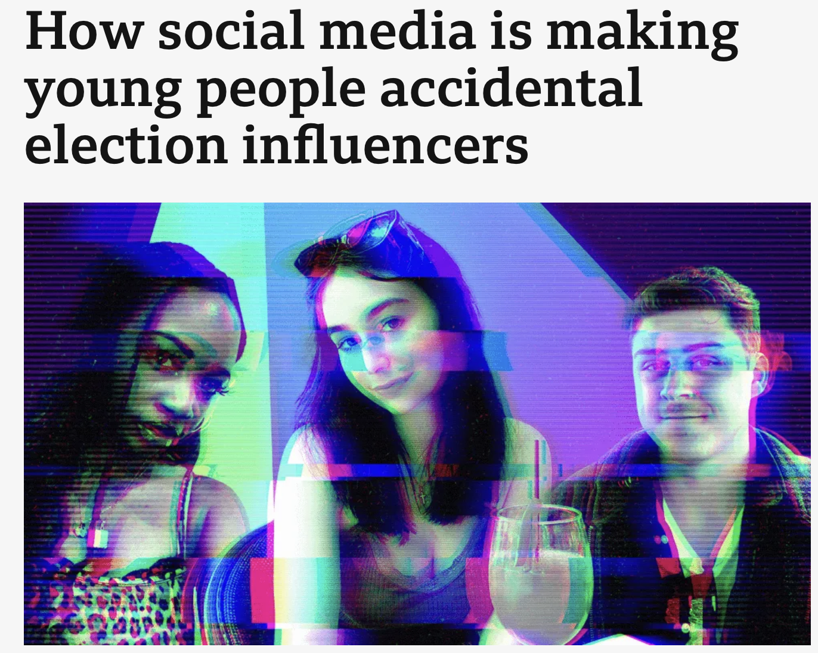
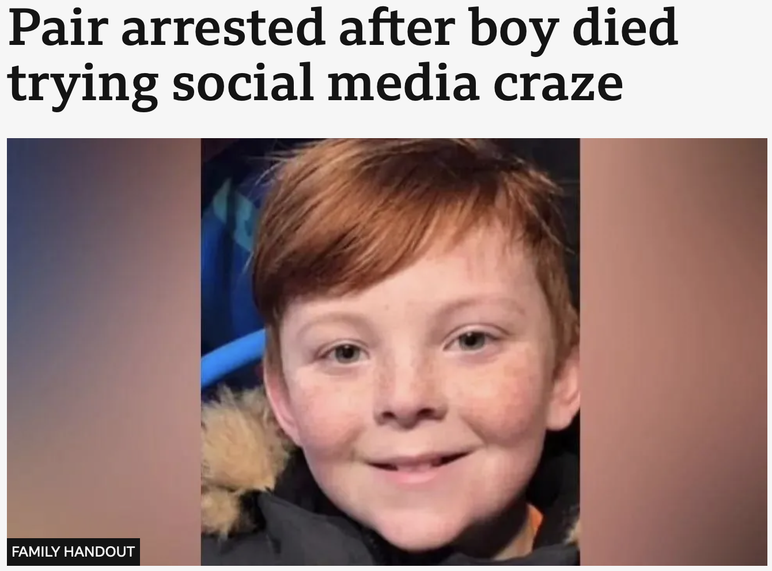
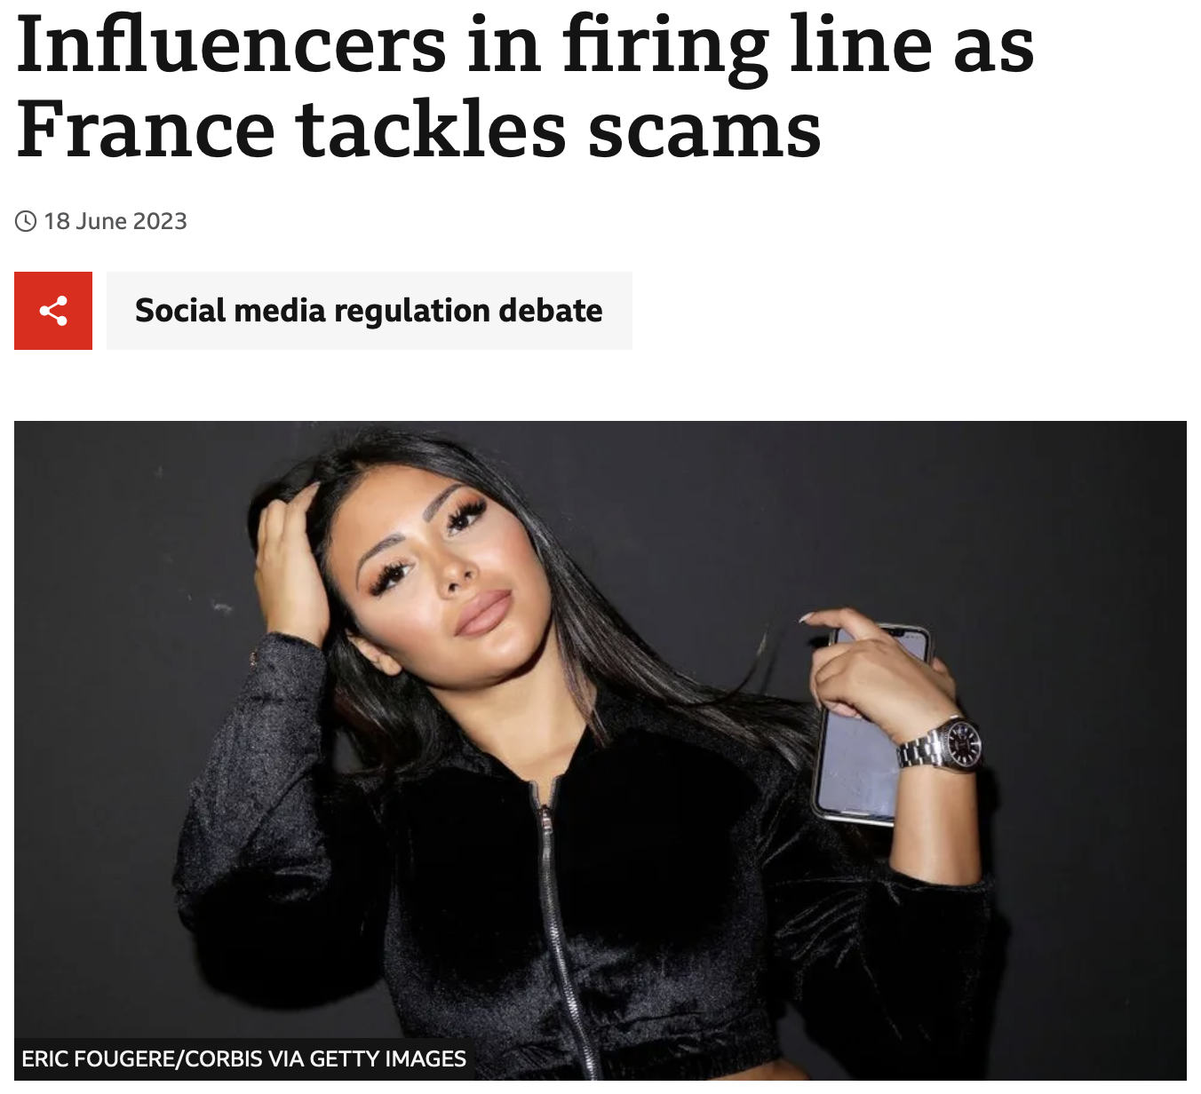
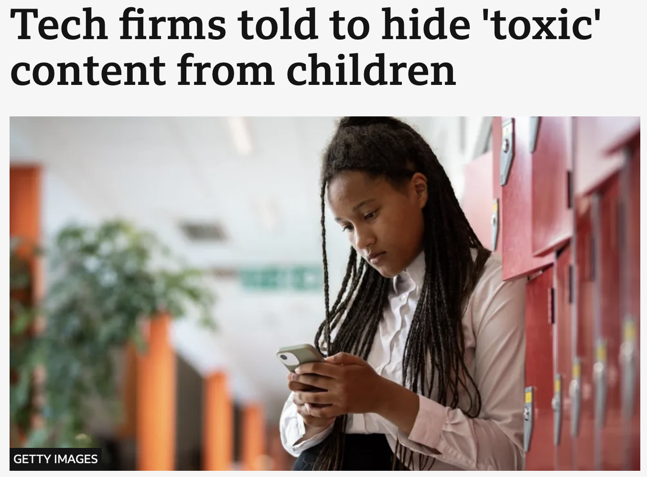
https://www.bbc.co.uk/news/articles/cd1rl6p5p32o
https://www.bbc.co.uk/news/articles/cyjjpkn4p7no
https://www.bbc.co.uk/news/world-europe-65916250
https://www.bbc.co.uk/news/articles/czrx13jj9p3o

Slide 13


Slide 14

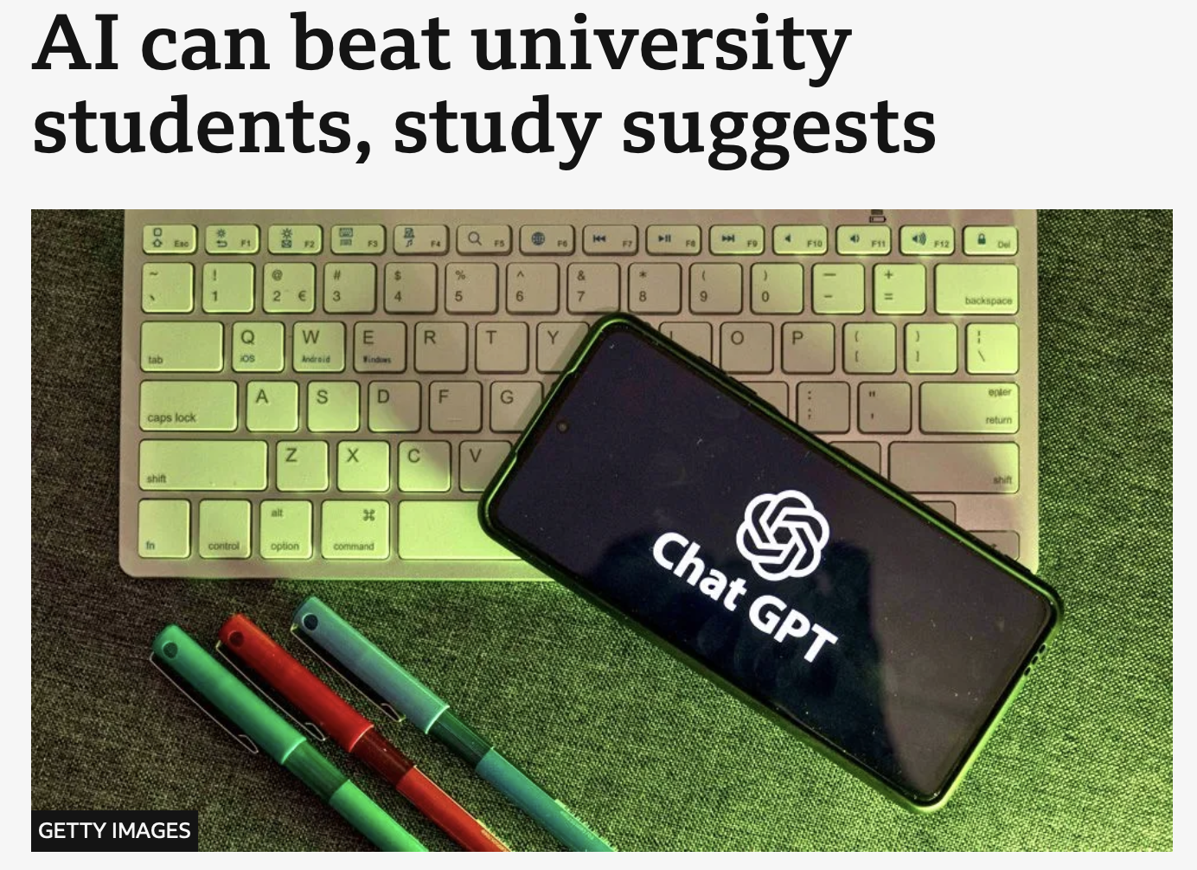
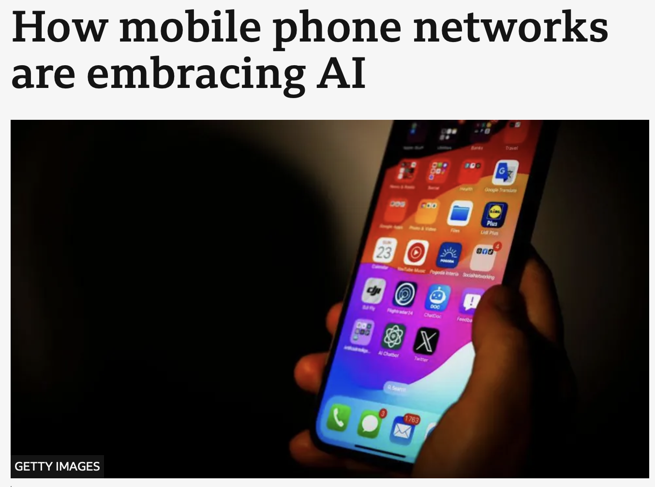
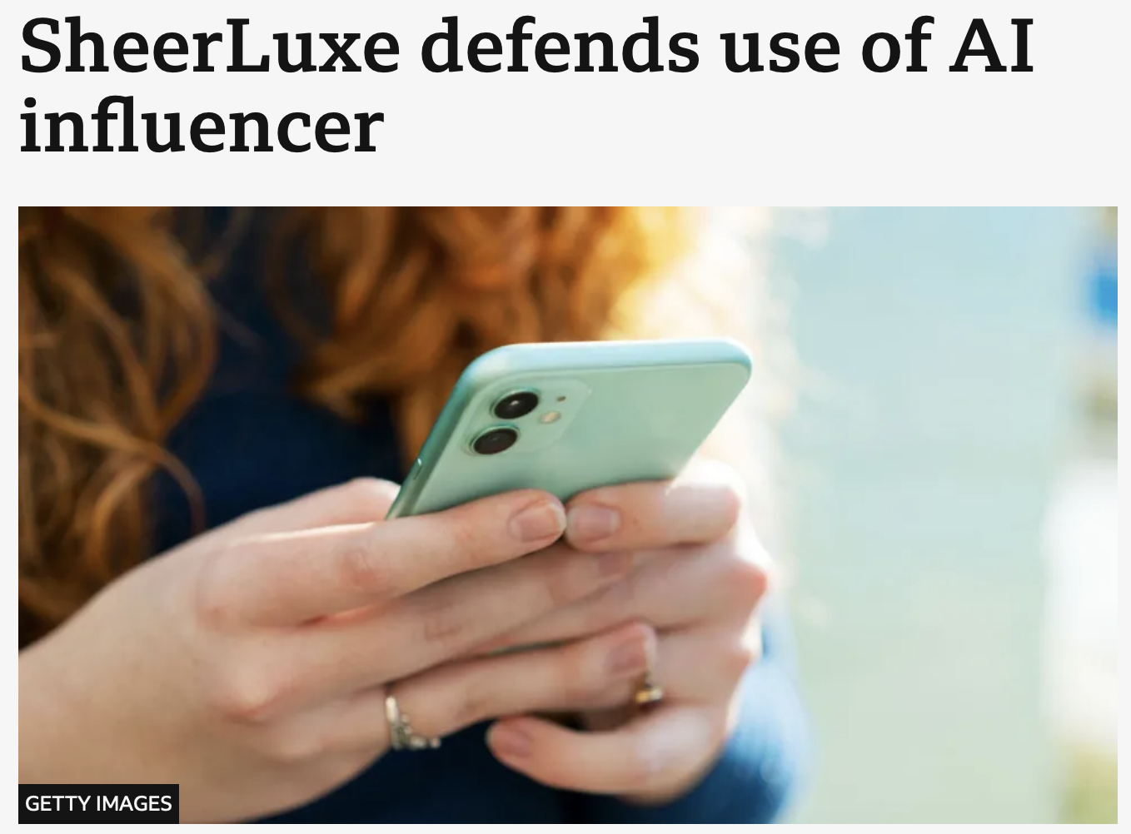
https://www.bbc.co.uk/news/articles/c999k57ky7ro
https://www.bbc.co.uk/news/articles/cqqqln0eg65o
https://www.bbc.co.uk/news/articles/c6pp1nvw5zwo
https://www.bbc.co.uk/news/articles/c3gw720vz3lo

Slide 15
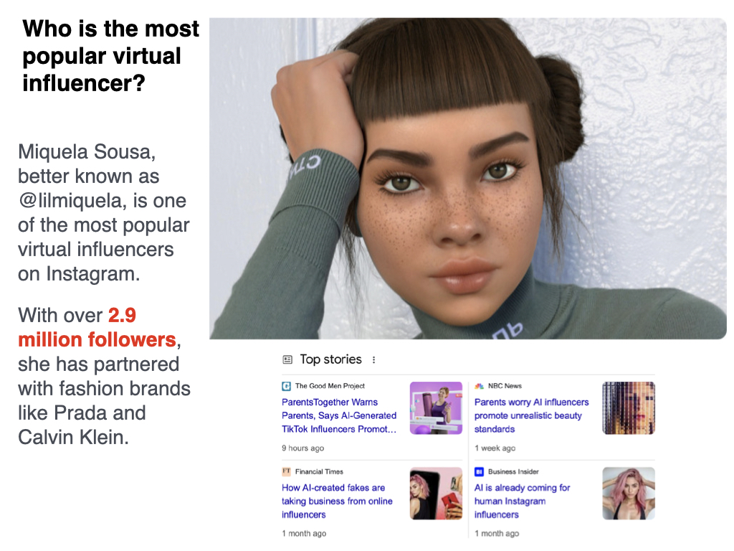

Slide 16


Slide 17
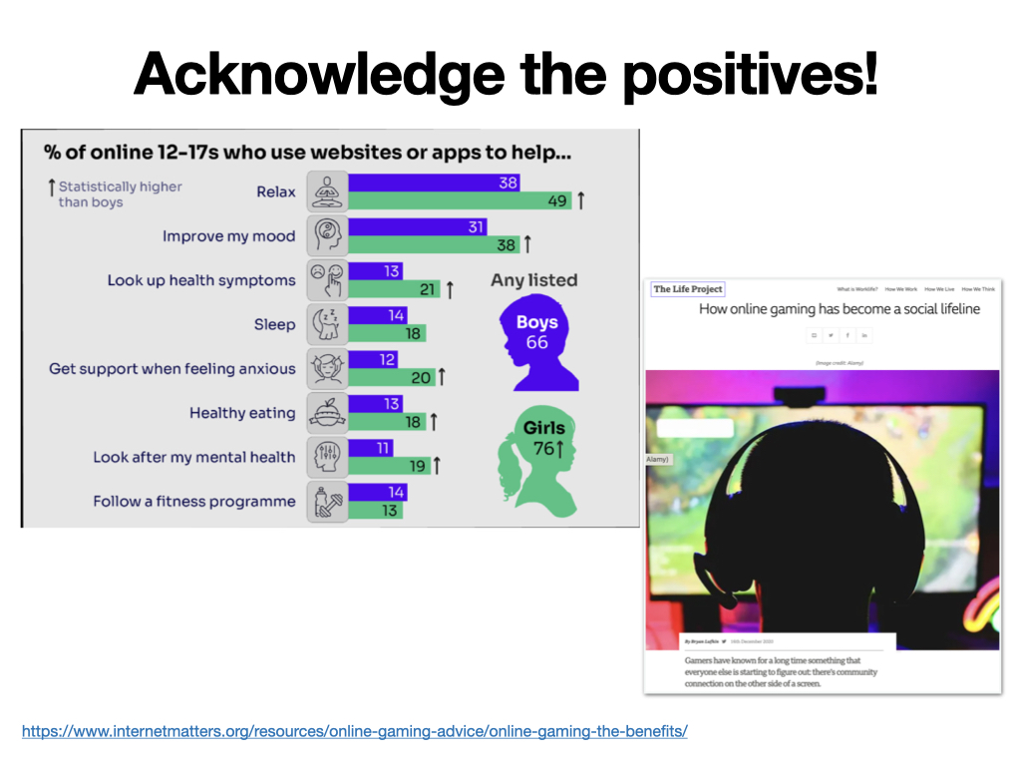
https://www.internetmatters.org/resources/online-gaming-advice/online-gaming-the-benefits/

Slide 18
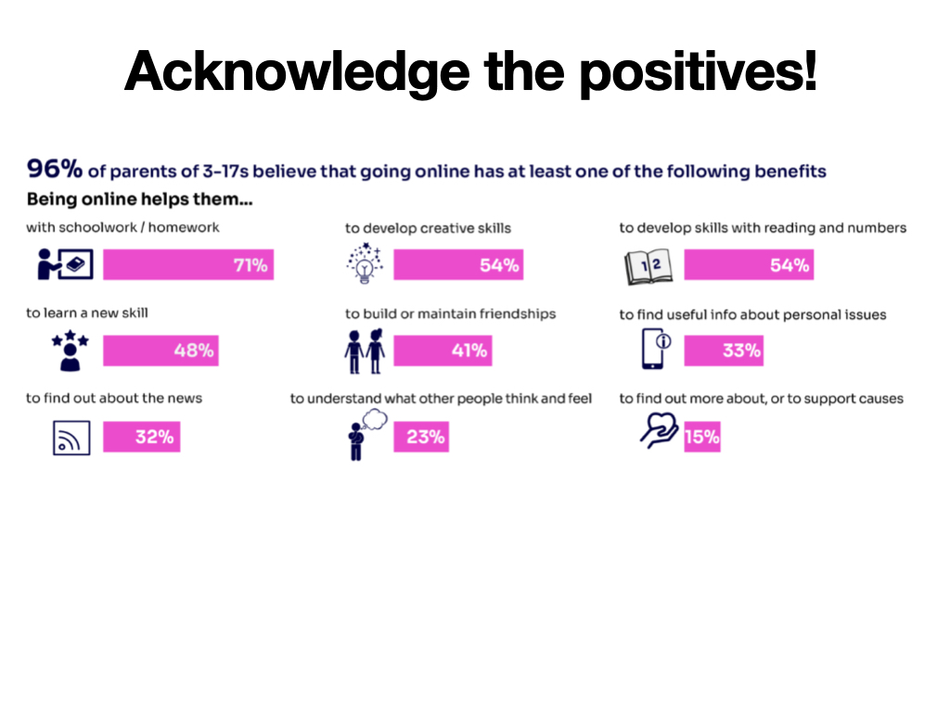

Slide 19
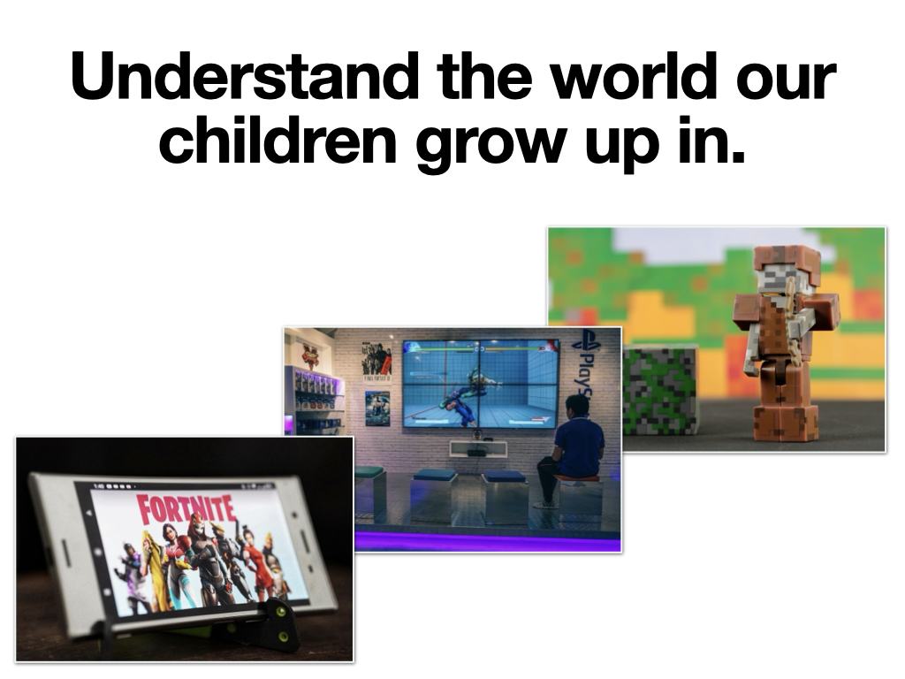

Slide 20
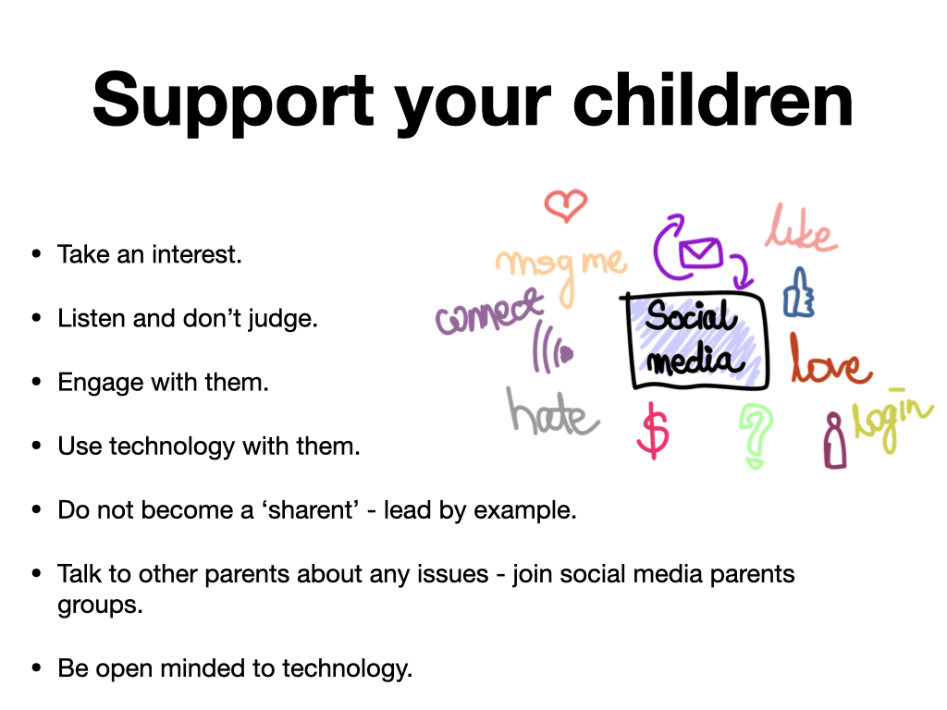

Slide 21
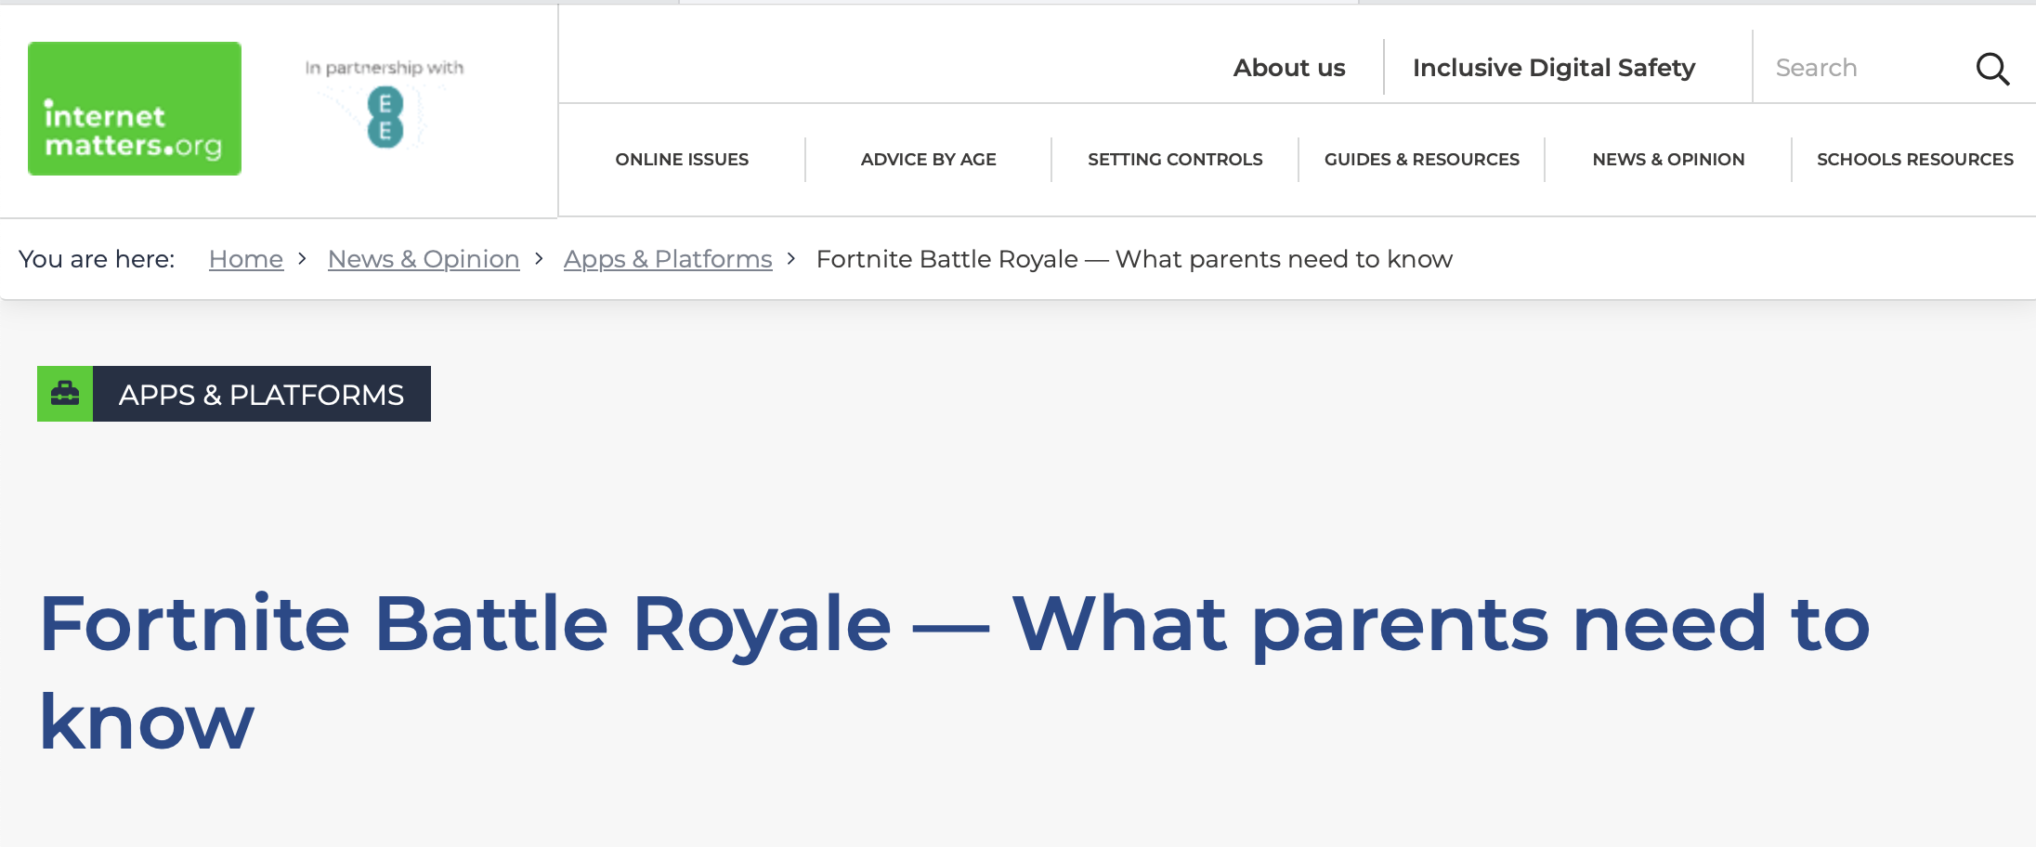

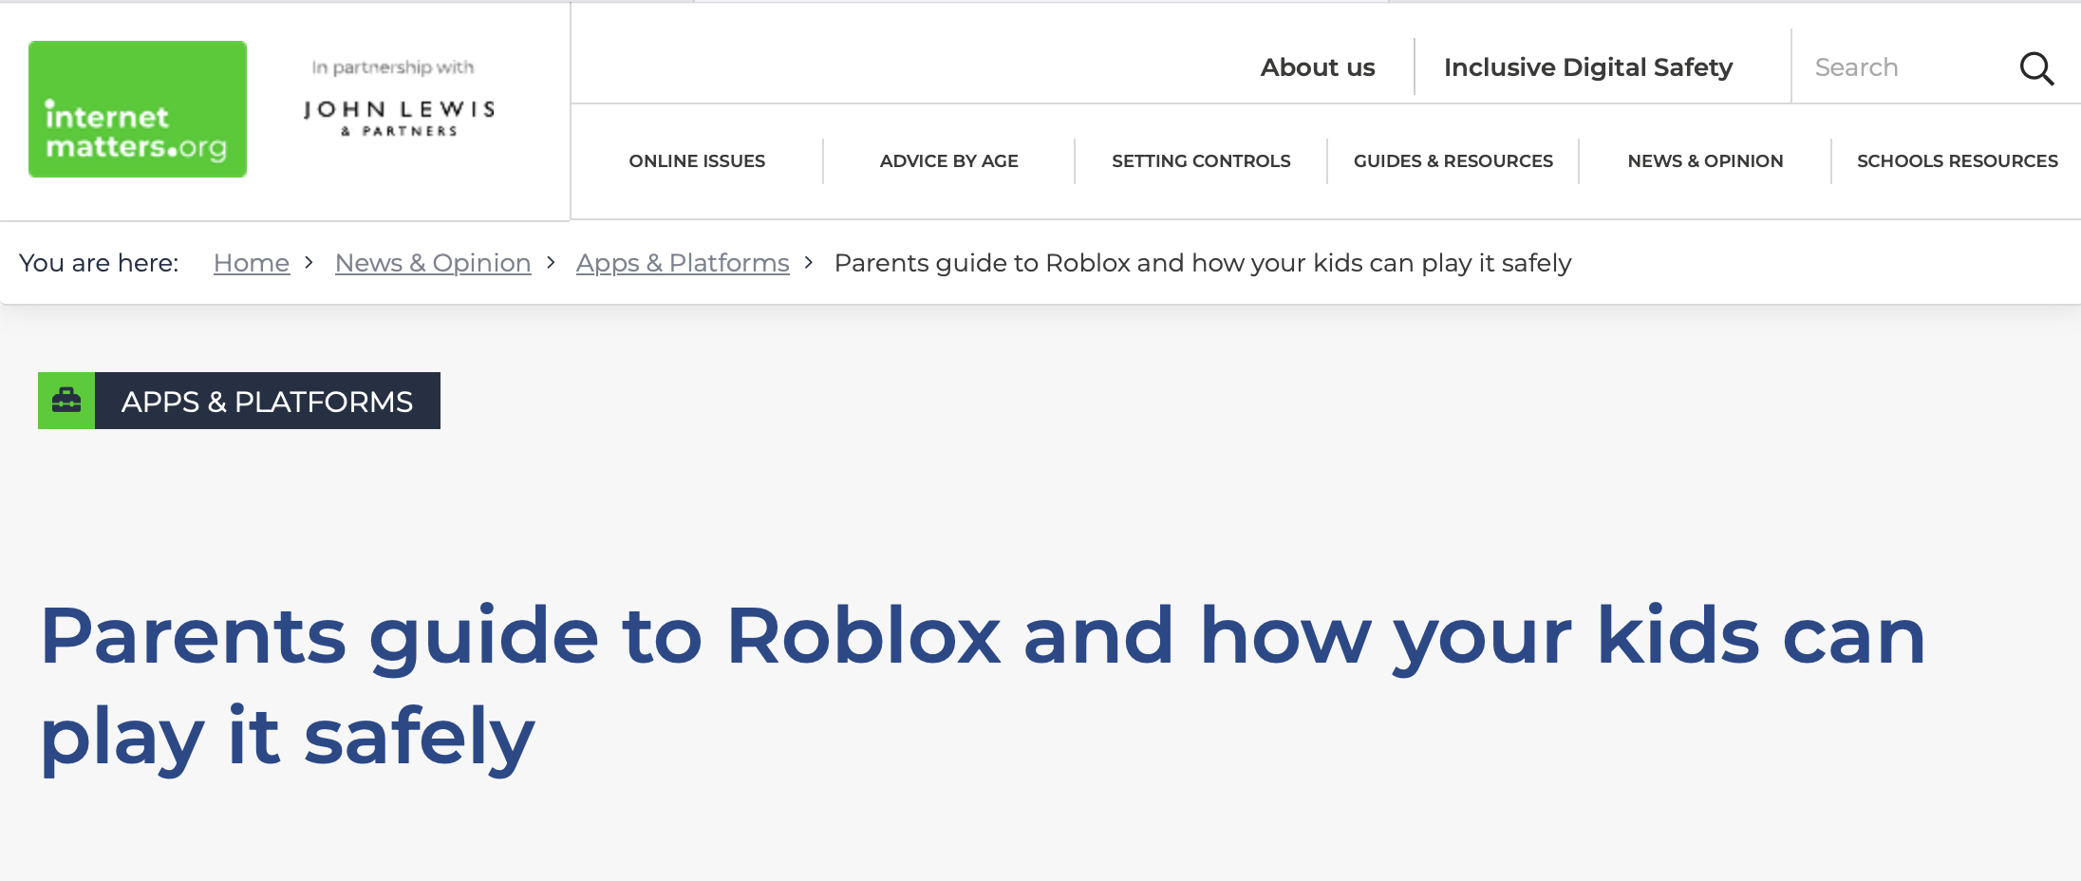
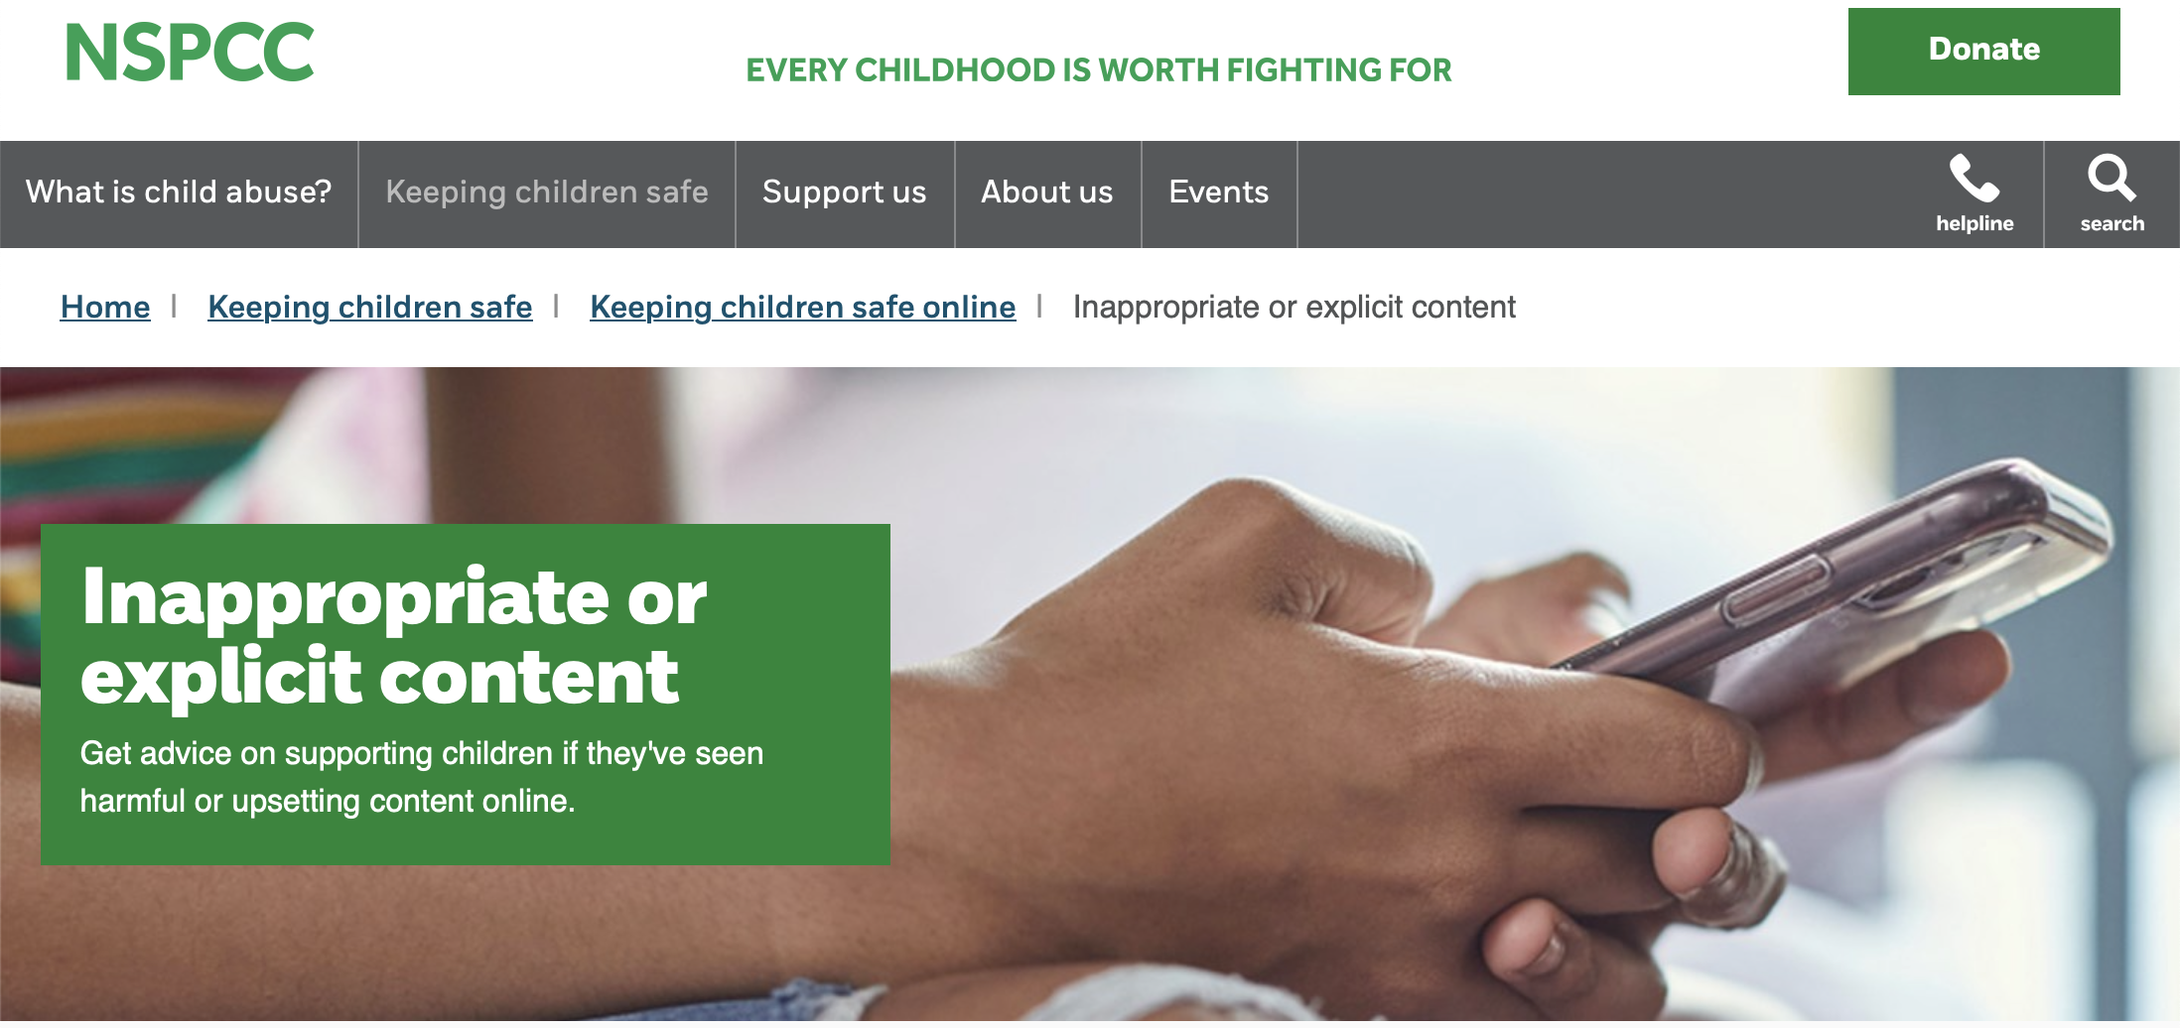
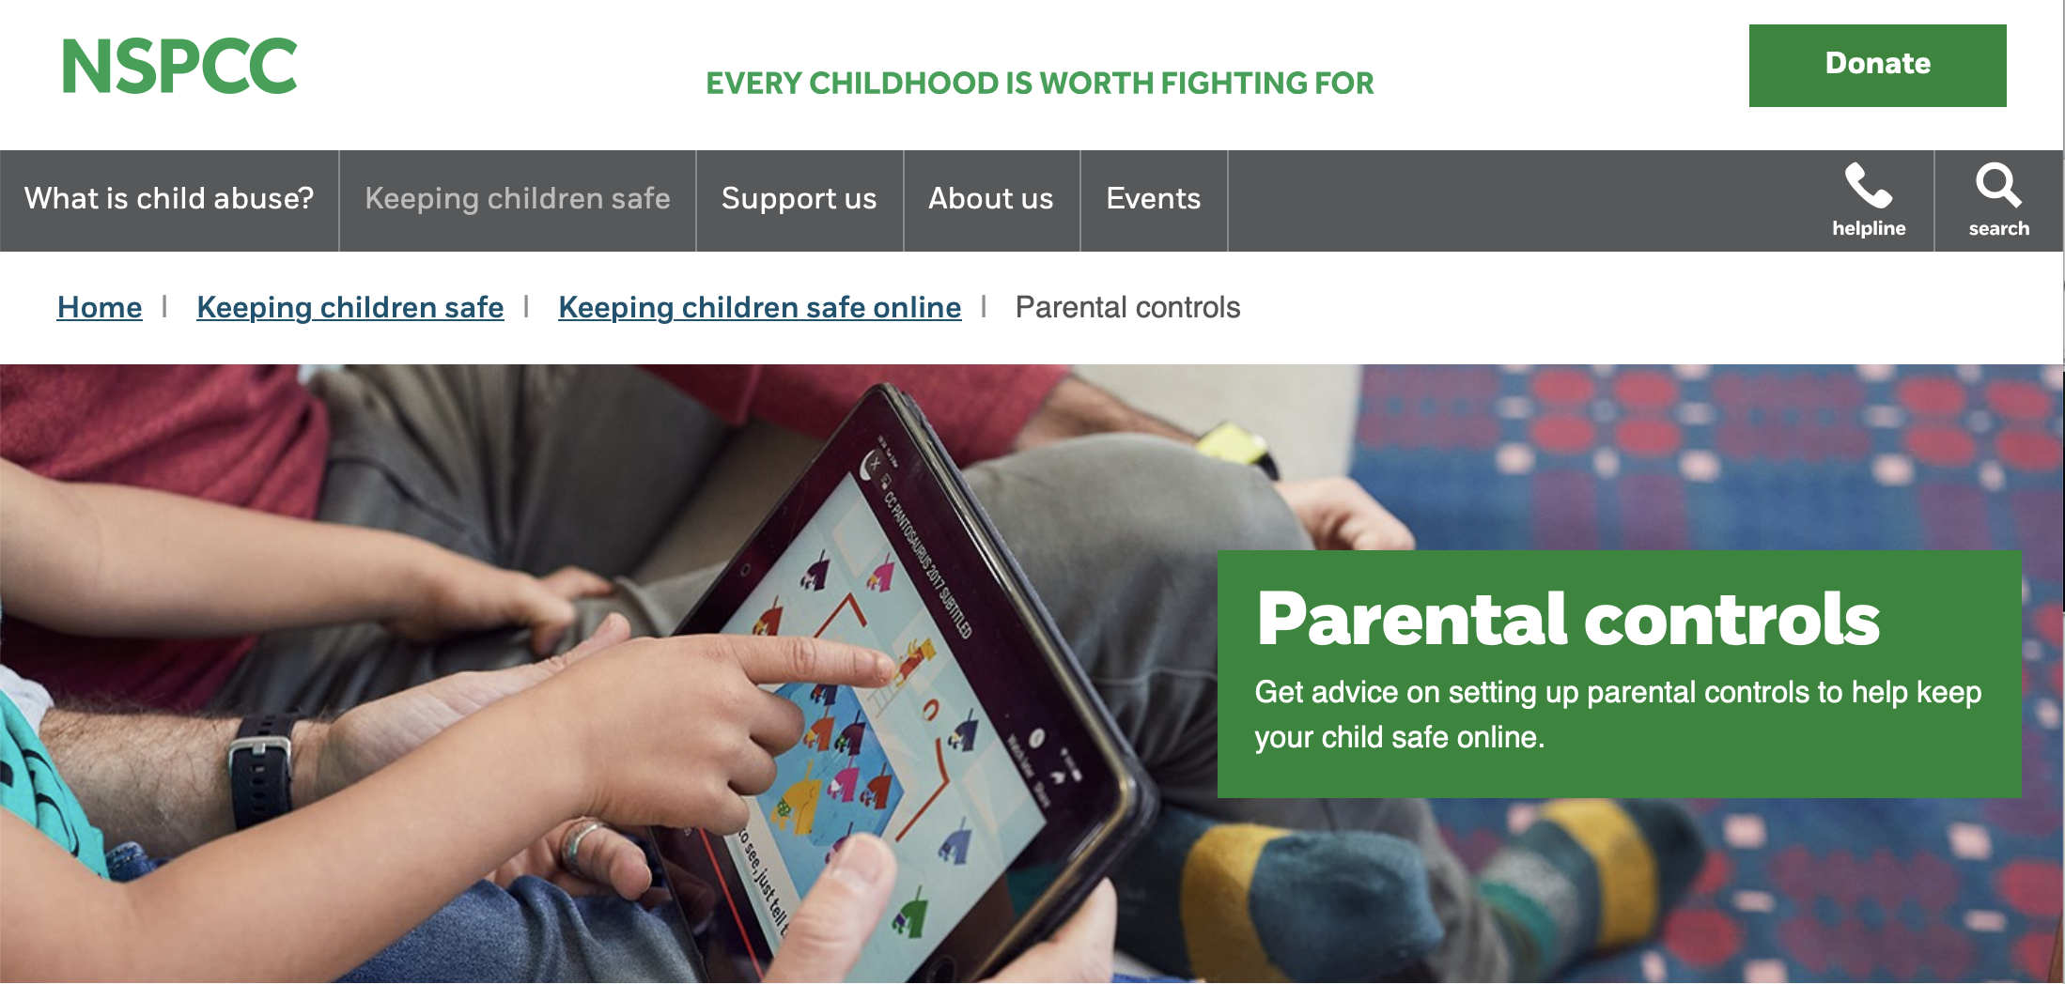
Be Knowledgeable
https://www.internetmatters.org/
https://www.nspcc.org.uk/keeping-children-safe/online-safety

Slide 22
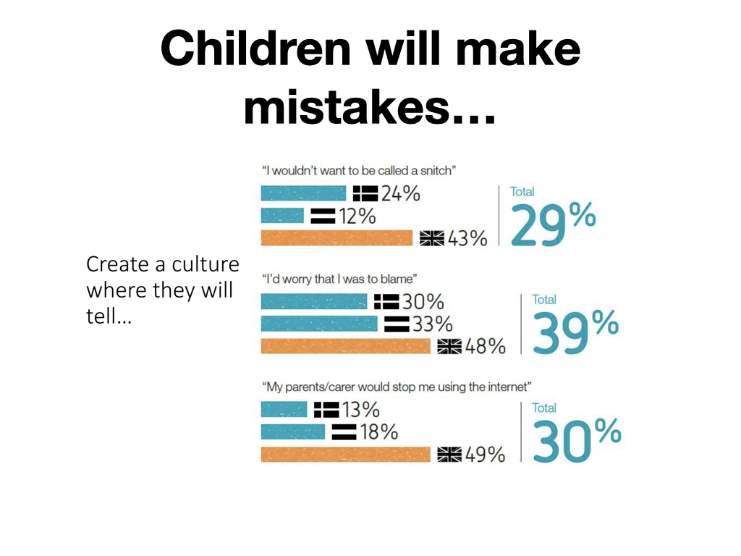

Slide 23
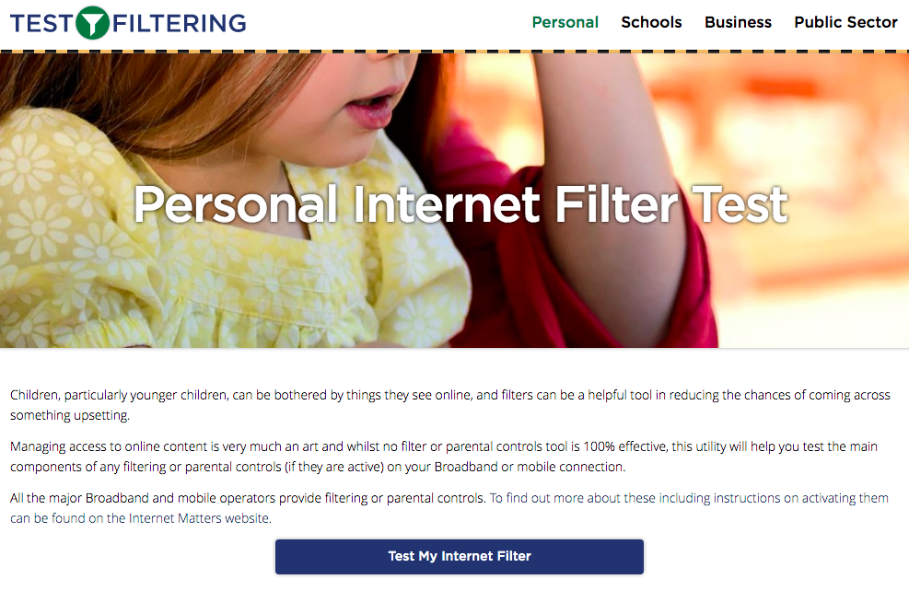
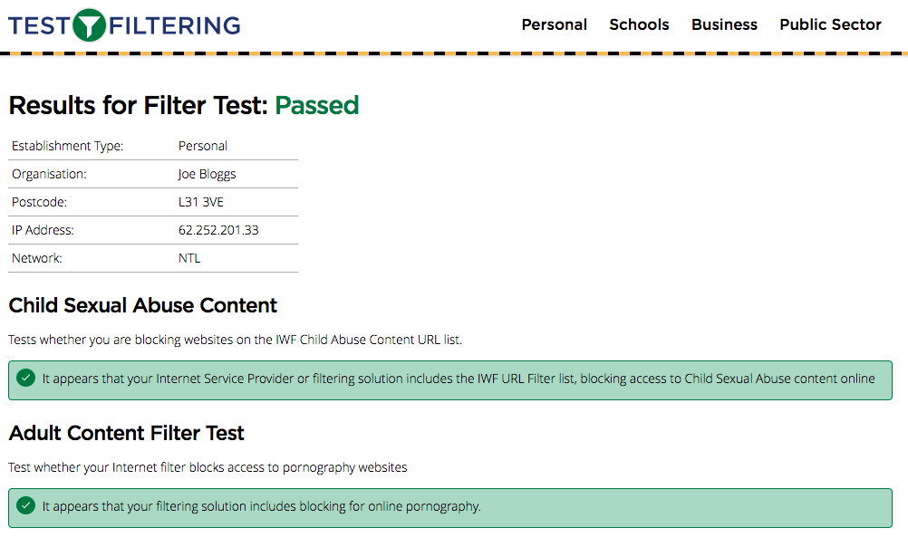
Test your home filtering
http://testfiltering.com/

Slide 24


Slide 25
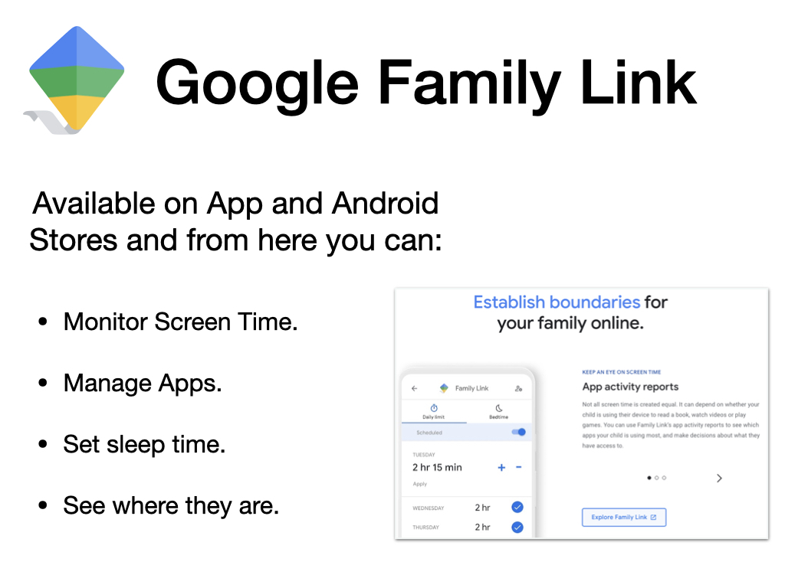

Slide 26
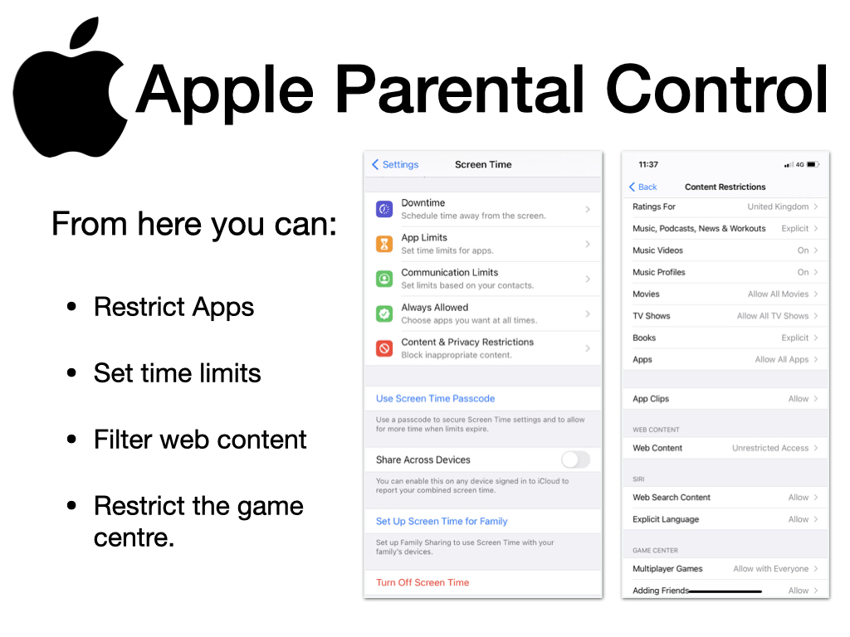

Slide 27
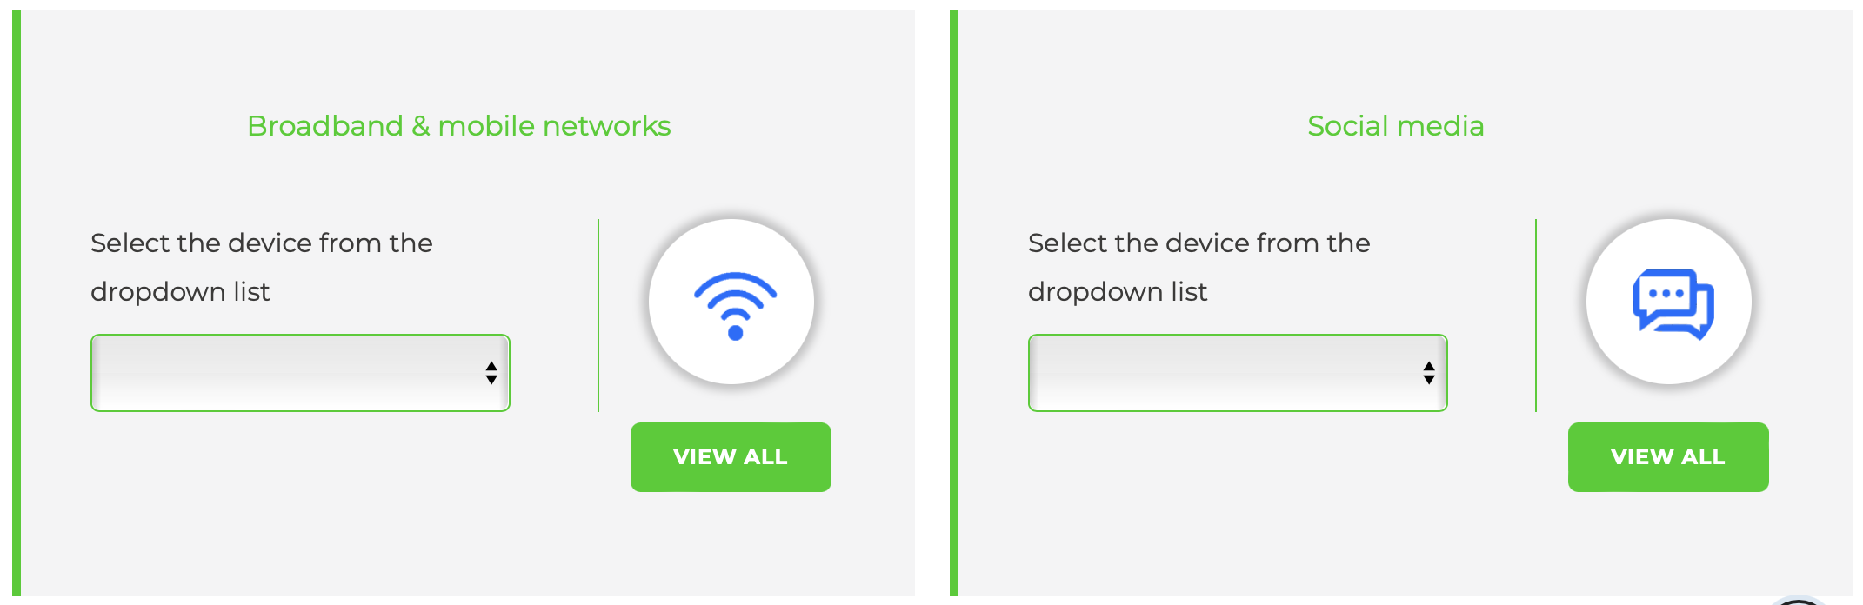
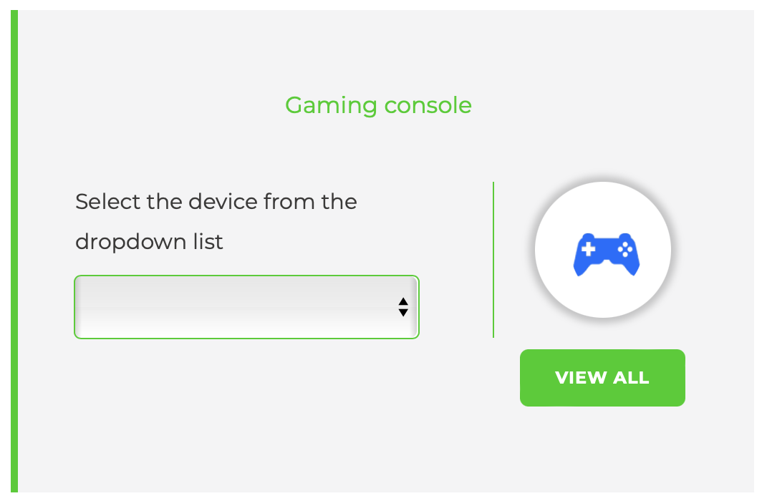
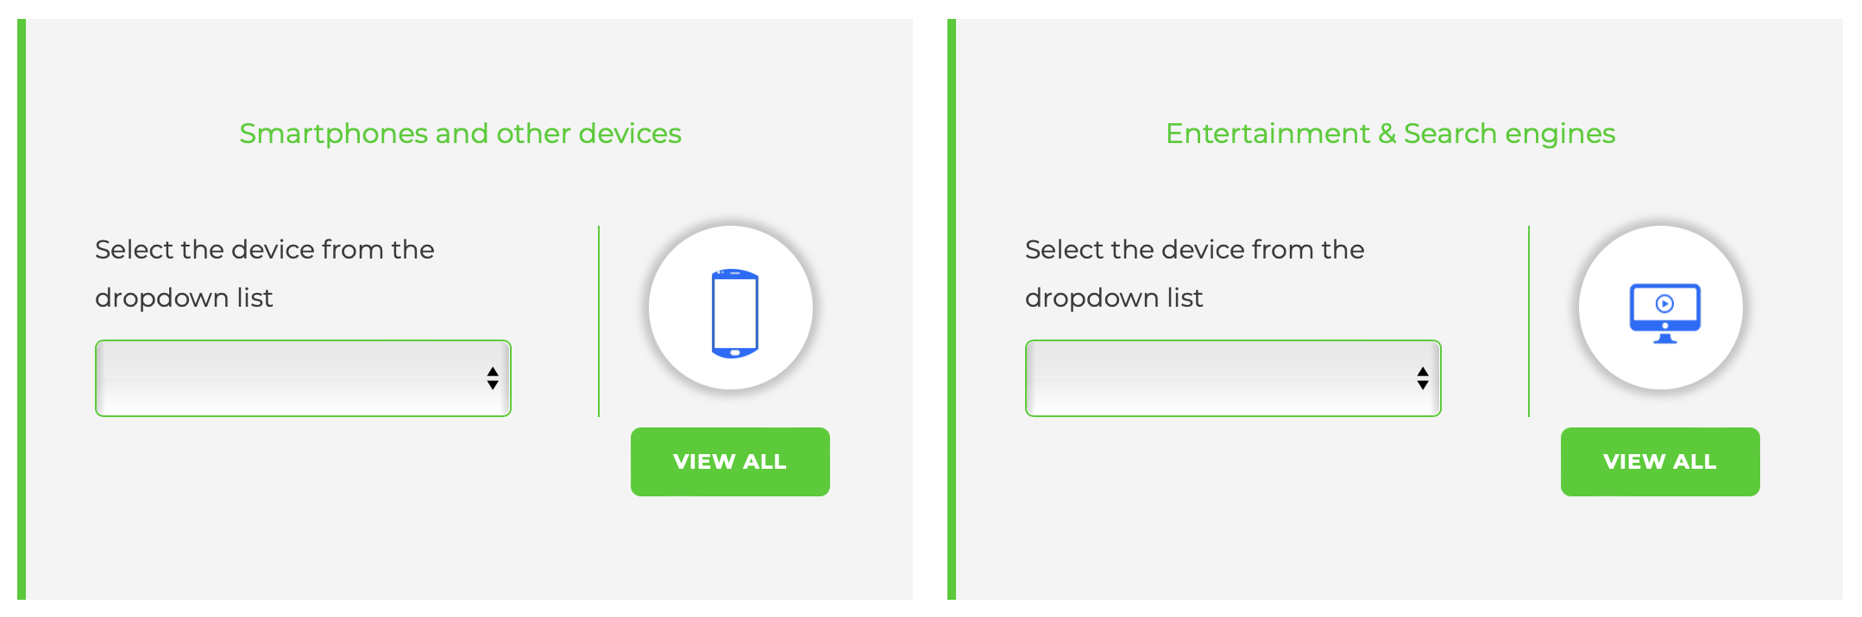
Internet matters also contains parental control guides for dozens of other devices including games consoles and smartphones
https://www.internetmatters.org/parental-controls

Slide 28
