Slide 1
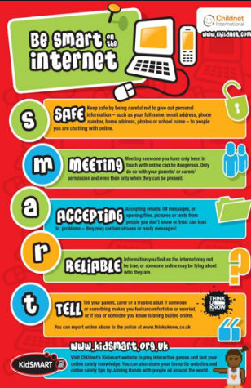
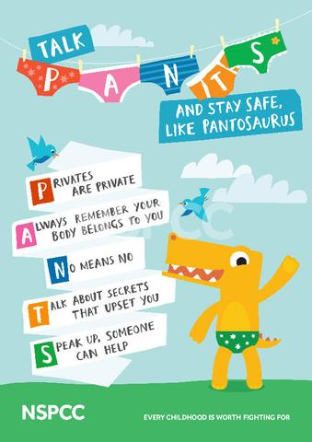
Keeping safe outside of school
Don’t advertise money or phones - put it in your pocket
Be street smart- walk sensibly
We should follow Rainbow and Owl and the Code of Conduct inside and outside school
Stay away from people who look unsafe
Stay close to your parents or a stranger might take you
E-Safety
Follow the SMART rules
Don’t open messages that say you have won something in case it’s SPAM or a virus
Have a very tricky password on your computer
When going on a website always look for the green padlock. If you go on a bank site with a green padlock it means it’s secure
Screenshot if someone says something hurtful
Keeping safe on the playground
Help people who fall over
Buddies are in high vis jackets
Make people smile each day
Divide teams fairly
Follow the football rules
If you get cross take 3 deep breaths and walk away calmly.
Jennett’s Park CE Primary Children’s Charter for Keeping Safe
Keeping safe inside school
We have the code of conduct . Everyone follows that rule to keep safe
Be a buddy not a bully
At home time when you say ‘I can see my parent’, make sure the teacher sees I am going
Class rules should be shared and known to all
Walk inside
PANTS
Don’t show other people your body
Keep the things you are not supposed to show people to yourself
Tell a friend or a trusted adult if someone teases you about your body
Candle time, Circle times and PSHEC Lessons
We should have weekly PHSEC lessons and circle time and candle time too.
We have a ‘Telling Box’ and worry monster in in every classroom so if you need to tell an adult you can do it without worrying
Adults are here to listen –if you report a worry they will hear you.

