Slide 1
What does it mean to be human?

Slide 2
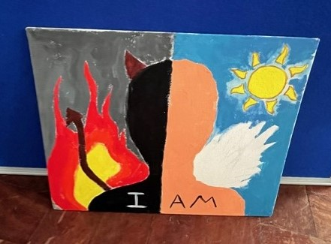
To live and do things, to be part of the world
To be mortal
Humans enjoy love
To have characteristics and relationships formed over time

Slide 3
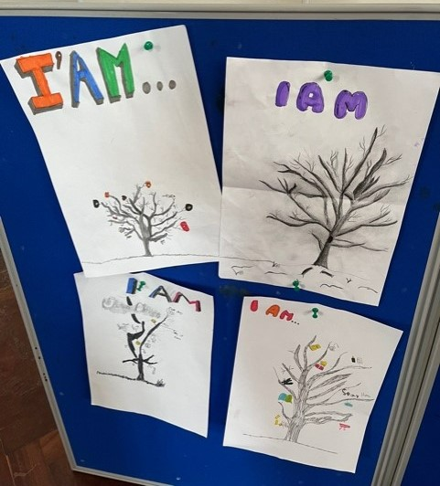
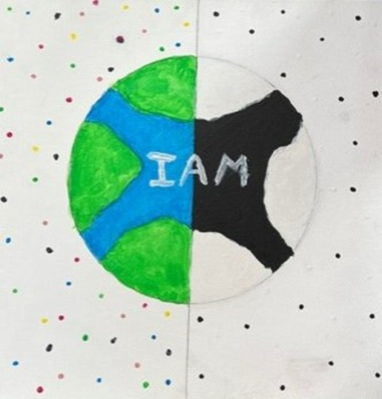
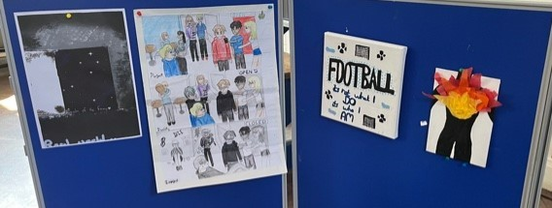
To experience human feelings
To have a beating heart
To have the physical appearance of a human, have flesh and blood

Slide 4
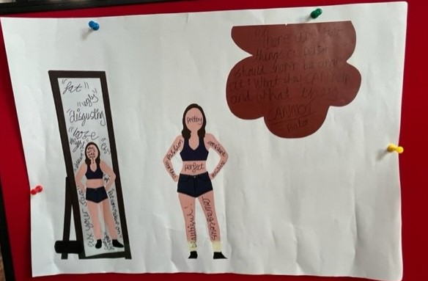
Born with IQ
To be different and unique
To be loving and caring
To be irrational
To feel emotions and expand on them

Slide 5
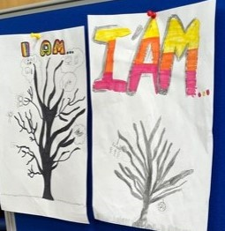
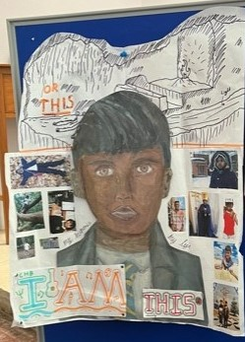
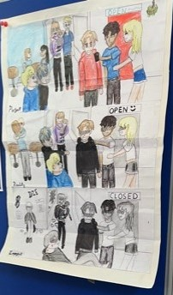
To have a mind and a personality
To communicate like a human
Able to make decisions needed in life

Slide 6
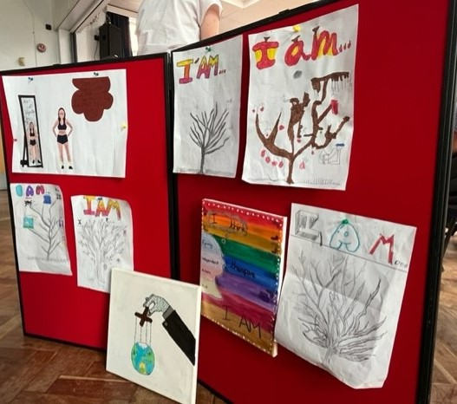
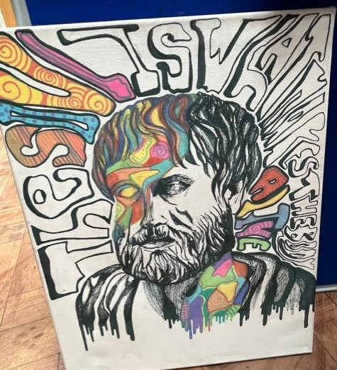
To have a soul and consciousness, to be spiritual
To have a soul and a body
Humanity vs personhood
Humans and animals have different thoughts

Slide 7
Do you believe humans have a soul?

Slide 8
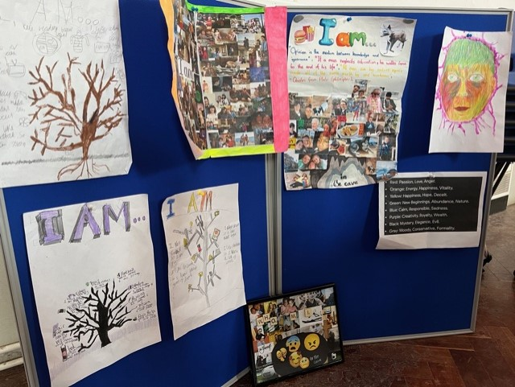
Yes but it depends on your beliefs
The soul holds your
emotions
Emotions are just chemical reactions happening in your body. The soul doesn’t have to be preset for these reactions to happen
No because we don’t know where it is – the brain could be responsible for all our decisions and consciousness

Slide 9
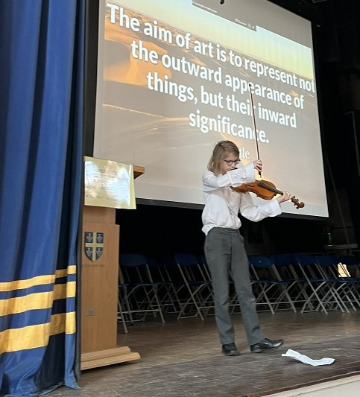
The soul makes us unique, it gives us characters
Some people think you don’t have a soul
– it’s just emotions
We don’t know if the soul is real
There is no physical proof
People believe that humans have a soul because they think that’s what goes to Heaven. Everyone has a soul to leave
Humans can’t have a soul because no one has seen it

Slide 10
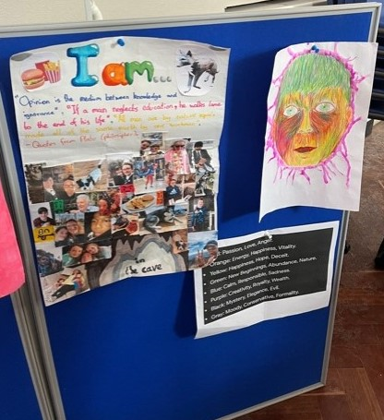
It’s connected to personality, we are not just bone and flesh, we have personalities. You might not have the same personality if you didn’t have a soul
Humans have a soul but animals don’t
The soul shows who you are
Evil people don’t have a soul
When someone dies, their soul leaves
The soul is in the heart rather than the mind

Slide 11
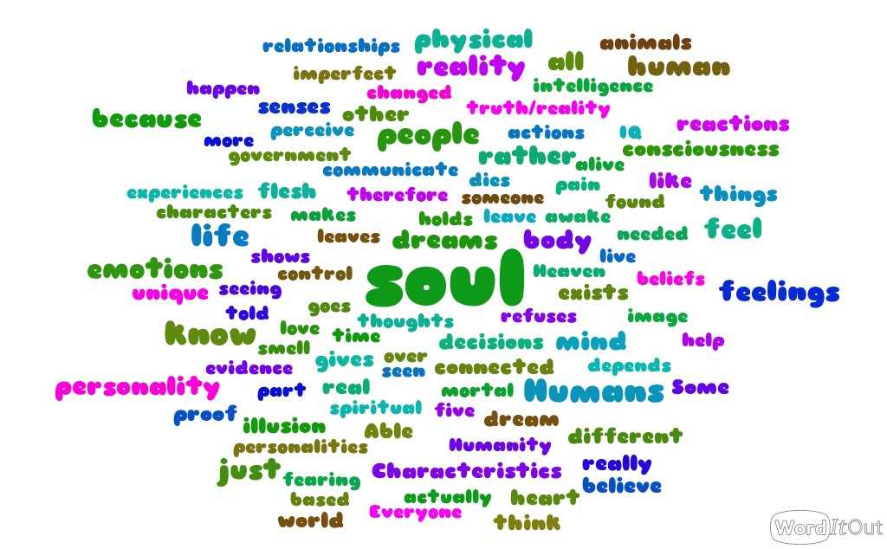

Slide 12
How do we know the reality we perceive really exists?

Slide 13
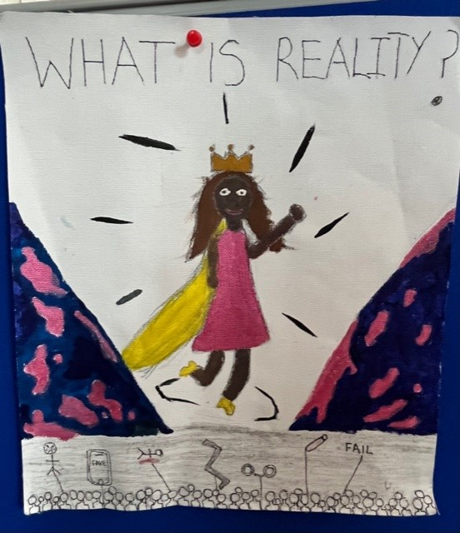
We don’t….
Our dreams could be real and life could be our dreams
We have no evidence that this reality really exists -
there is no proof
It could all be an illusion
There could be some other reality

Slide 14
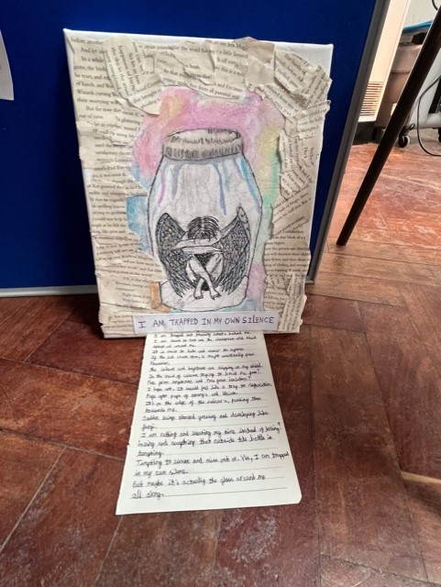
We can use our five senses
We are meeting other people
In your dreams, you can’t control you actions but it life, we feel like we do
Our senses can’t always be trusted so we don’t know what actually happens

Slide 15
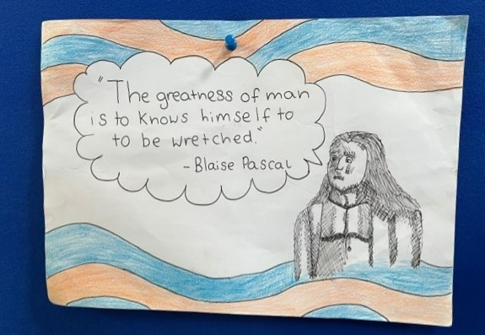
The world was perfect but imperfect people changed it
If we were in an illusion, we wouldn’t feel pain
We are alive
We dream, therefore we know if we are awake or not
We never know if life is an image – a hologram
Is our life a video game?

Slide 16
Some final thoughts…

Slide 17
Humans aren’t art – we should be less focused on the outside and more on the inside.
Why do so many people want to change their appearance and are unhappy about themselves.
To you you’re perfect but you may be imperfect to others – it’s the same for everyone

