Slide 1
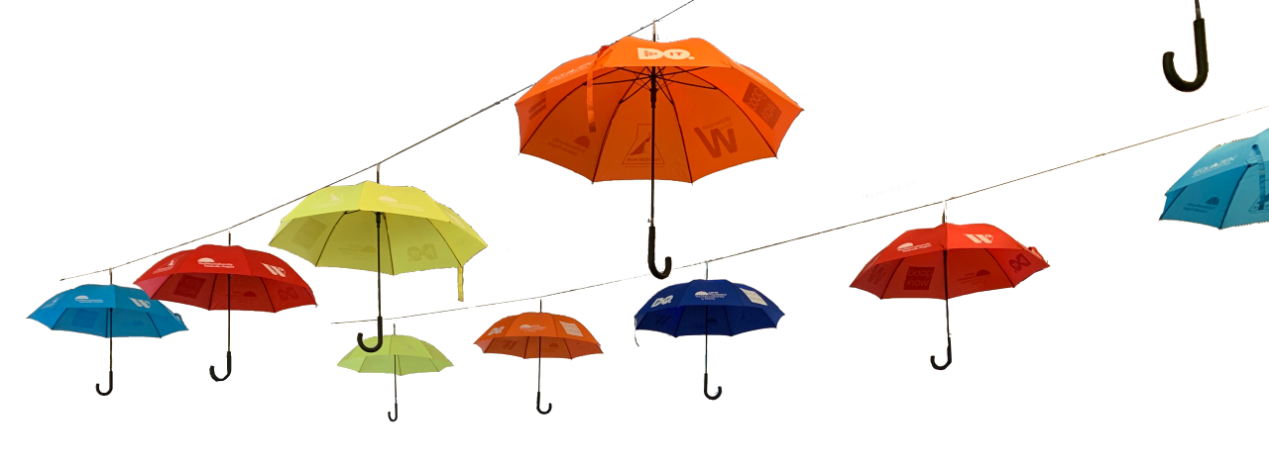
Neurodiversity Umbrella Project
2022
Notes:
<a href='https://www.freepik.com/vectors/check'>Check vector created by stories - www.freepik.com</a>

Slide 2
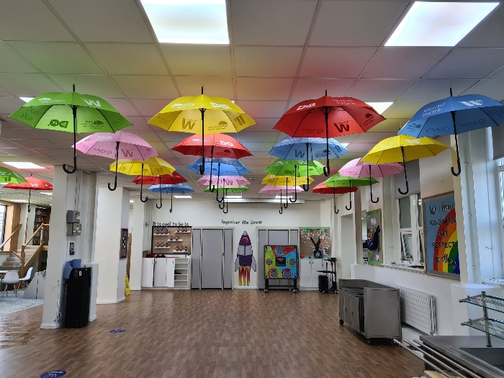
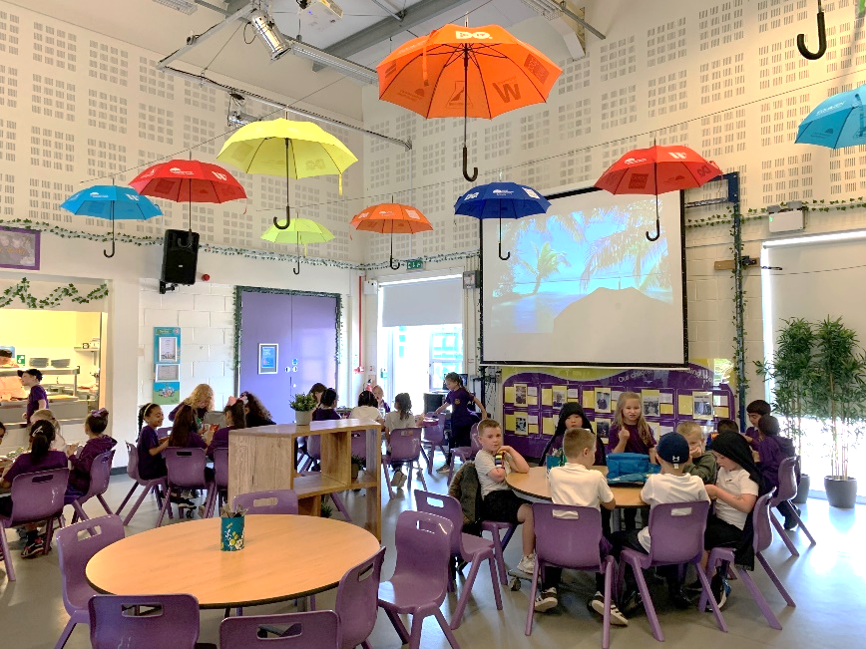
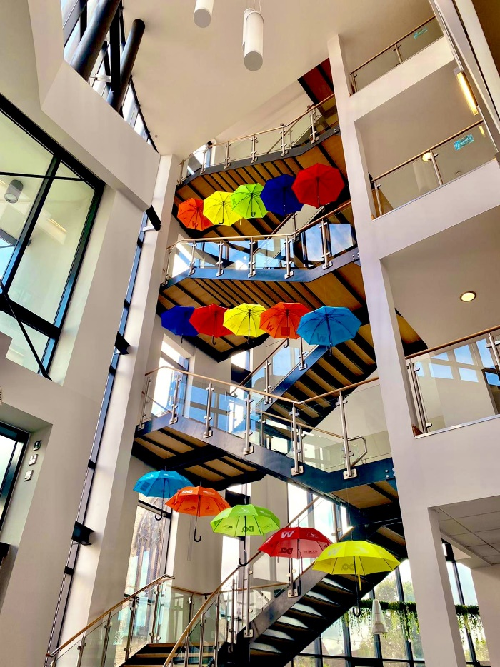
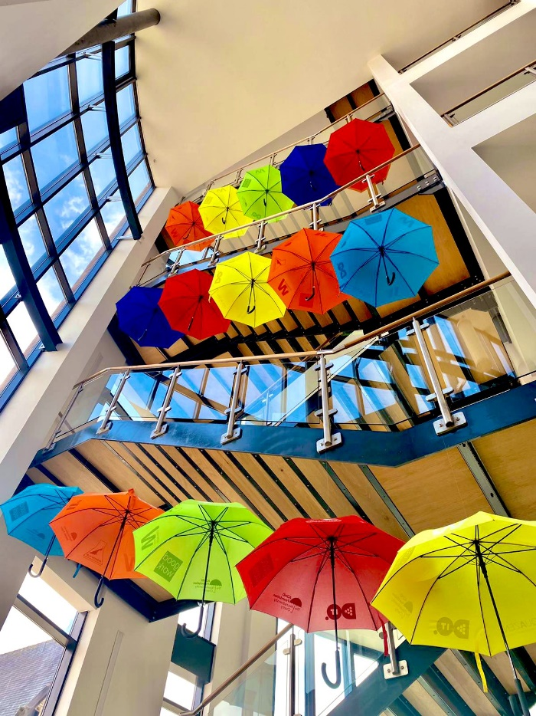
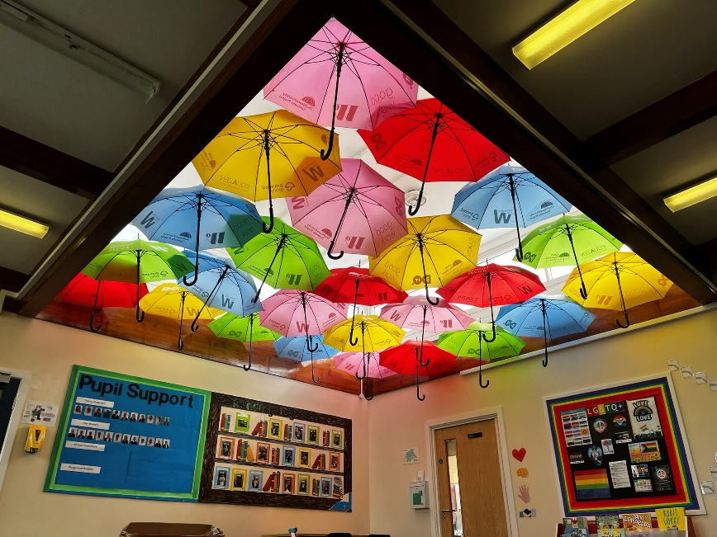
Have you seen something like this?
Notes:
<a href='https://www.freepik.com/vectors/check'>Check vector created by stories - www.freepik.com</a>

Slide 3

Brain
Diversity
Difference
Neuro
Just a different way for the brain to work
Notes:
<a href='https://www.freepik.com/vectors/check'>Check vector created by stories - www.freepik.com</a>

Slide 4

1 in 5
Notes:
<a href='https://www.freepik.com/vectors/check'>Check vector created by stories - www.freepik.com</a>

Slide 5
ADHD
Autism
Dyslexia
Dyspraxia/DCD
Dyscalculia
Dysgraphia
Tourette’s
1 in 5
Notes:
<a href='https://www.freepik.com/vectors/check'>Check vector created by stories - www.freepik.com</a>

Slide 6

People with ADHD can have difficulty with:
Staying focused when something is not interesting
Sitting still for a long time
Keeping track of time
Organising
Remember: Not everyone presents the same way!
Notes:
<a href='https://www.freepik.com/vectors/check'>Check vector created by stories - www.freepik.com</a>

Slide 7

People with ASC can have difficulty with:
Dealing with changes of routine
Managing emotions
Dealing with lots of noise
Communication
Remember: Not everyone presents the same way!
Notes:
<a href='https://www.freepik.com/vectors/check'>Check vector created by stories - www.freepik.com</a>

Slide 8

People with Dyslexia can have difficulty with:
Reading
Spelling
Taking notes
Remember: Not everyone presents the same way!
Notes:
<a href='https://www.freepik.com/vectors/check'>Check vector created by stories - www.freepik.com</a>

Slide 9
Remember: Not everyone presents the same way!
Notes:
<a href='https://www.freepik.com/vectors/check'>Check vector created by stories - www.freepik.com</a>

Slide 10

Did you know that there are lots of positives that come with these conditions?
Notes:
<a href='https://www.freepik.com/vectors/check'>Check vector created by stories - www.freepik.com</a>

Slide 11


ADHD
Insightful
ASC
Problem solving
Dysgraphia
Listening skills
Creative
Problem solving
Quick thinkers
Analytical thinking
Detailed
Memorising
Storytelling
Notes:
<a href='https://www.freepik.com/vectors/check'>Check vector created by stories - www.freepik.com</a>

Slide 12
Dyscalculia
Creativity
Dyspraxia
Problem solving
Problem solving
Intuitive thinking
Dyslexia
Spotting patterns
Creativity
Inventive
Big picture thinking
Determined
Notes:
<a href='https://www.freepik.com/vectors/check'>Check vector created by stories - www.freepik.com</a>

Slide 13
Fun to be with
Kind
Fearless
Neurodiverse people can also be...
Great friends
Creative
Courageous
Funny
Intelligent
Imaginative
Driven
Enthusiastic
Quick witted
Notes:
<a href='https://www.freepik.com/vectors/check'>Check vector created by stories - www.freepik.com</a>

Slide 14

Did you know that there are many successful people who are neurodiverse/neurodivergent?
Notes:
<a href='https://www.freepik.com/vectors/check'>Check vector created by stories - www.freepik.com</a>

Slide 15
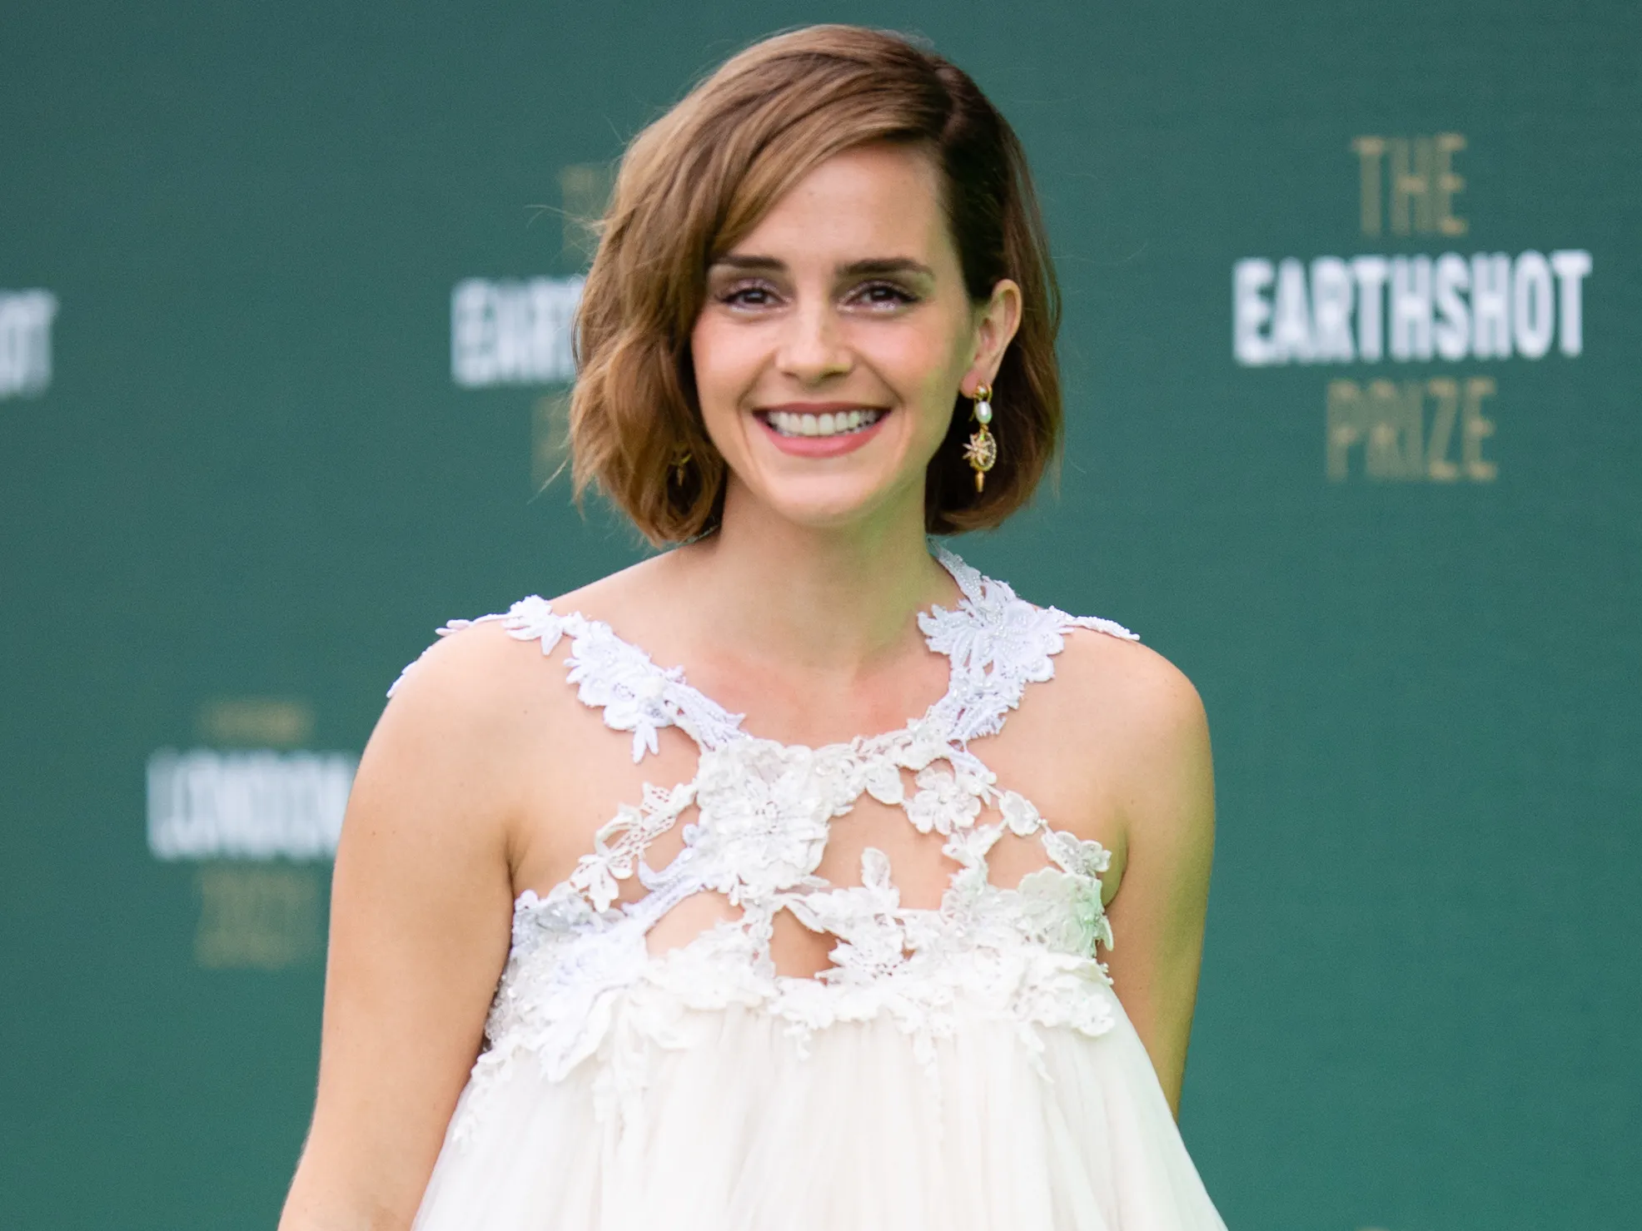
Emma Watson
Famous actress
Star of Harry Potter films
Has ADHD
Notes:
<a href='https://www.freepik.com/vectors/check'>Check vector created by stories - www.freepik.com</a>

Slide 16

Daniel Radcliffe
Famous actor
Star of Harry Potter films
Has Dyspraxia (DCD)
Notes:
<a href='https://www.freepik.com/vectors/check'>Check vector created by stories - www.freepik.com</a>

Slide 17

Billie Eilish
Successful music star
Won 7 Grammy Awards
Won an Oscar
Has Tourette's Syndrome
Notes:
<a href='https://www.freepik.com/vectors/check'>Check vector created by stories - www.freepik.com</a>

Slide 18
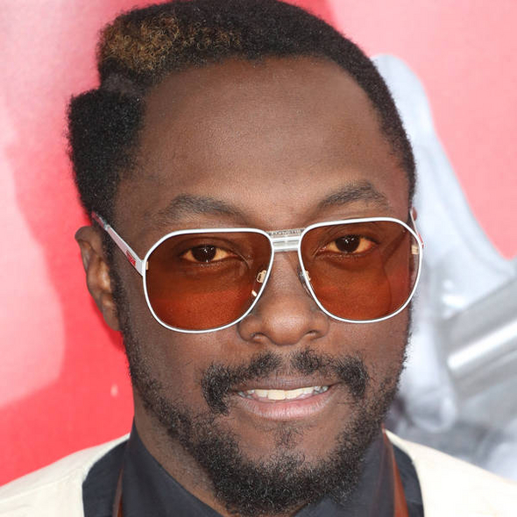
Will.i.am
Successful music star
Won 7 Grammy Awards
Won 8 American Music Awards
Has ADHD
Notes:
<a href='https://www.freepik.com/vectors/check'>Check vector created by stories - www.freepik.com</a>

Slide 19
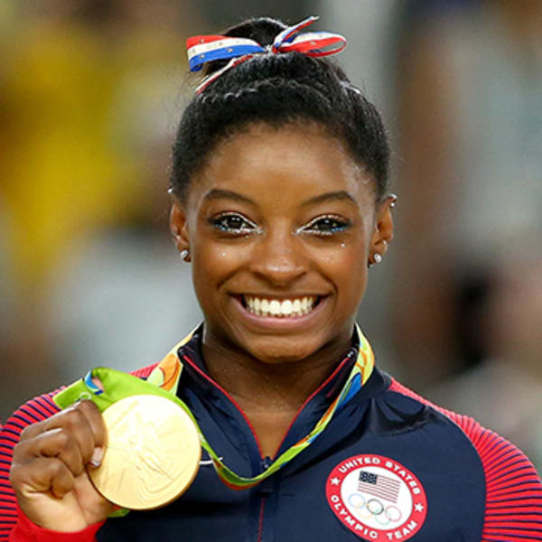
Simone Biles
Olympic gymnast
Most decorated gymnast of all time
Has won 32 medals
Has ADHD
Notes:
<a href='https://www.freepik.com/vectors/check'>Check vector created by stories - www.freepik.com</a>

Slide 20
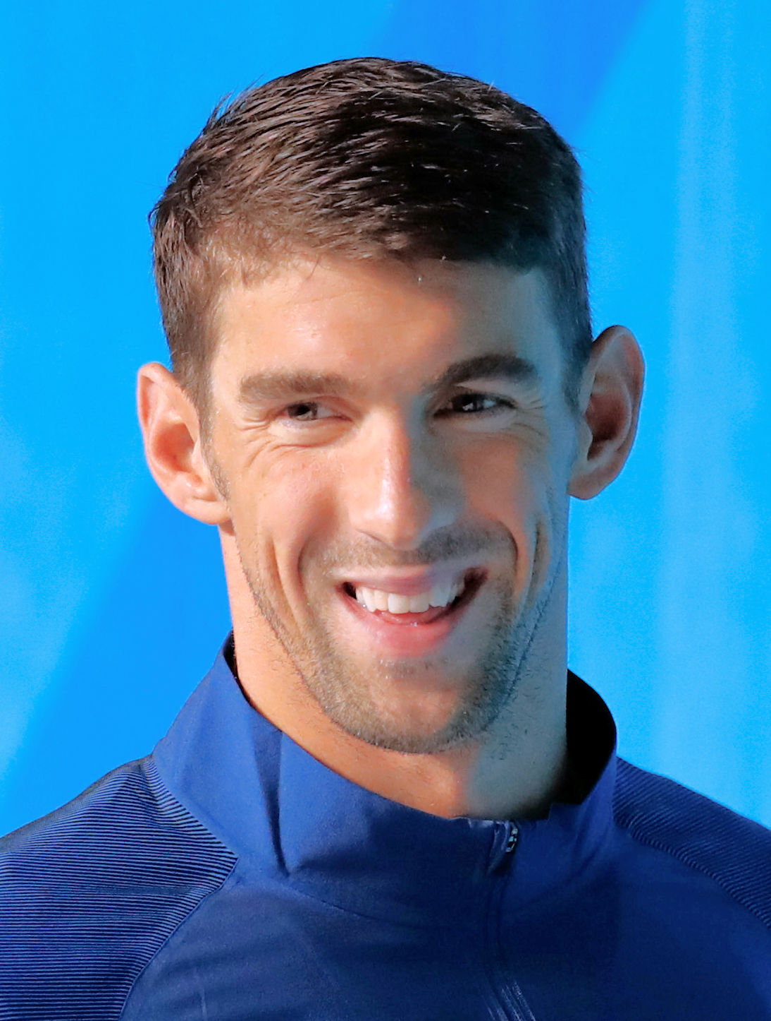
Michael Phelps
Olympic swimmer
Most successful Olympian of all time
Has 23 gold medals
Has ADHD
Notes:
<a href='https://www.freepik.com/vectors/check'>Check vector created by stories - www.freepik.com</a>

Slide 21

Richard Branson
One of the most successful business-people
Owns very big businesses
Has Dyslexia
Notes:
<a href='https://www.freepik.com/vectors/check'>Check vector created by stories - www.freepik.com</a>

Slide 22
It is important to celebrate all of these differences.
That is what the Umbrella Project is all about!
Notes:
<a href='https://www.freepik.com/vectors/check'>Check vector created by stories - www.freepik.com</a>

