Slide 1
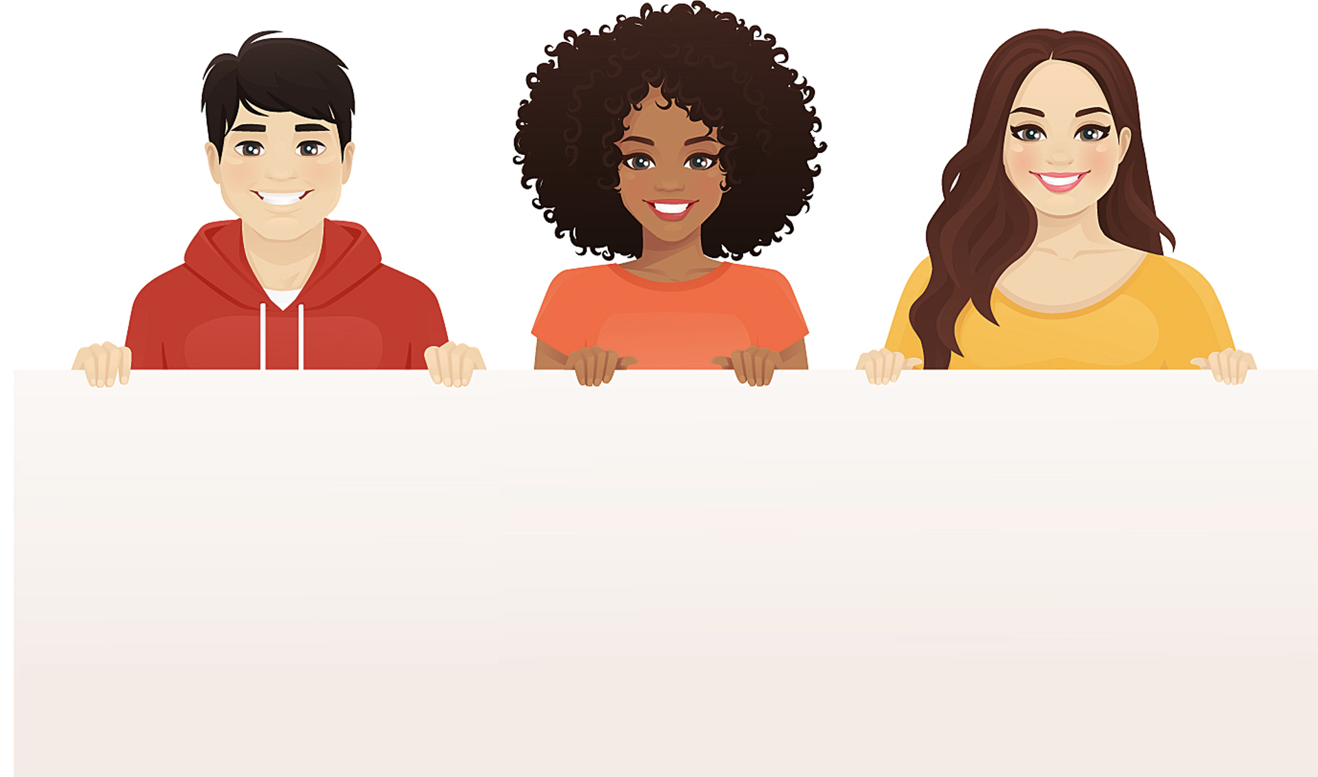
Celebrating our unique
strengths and differences.
MARCH 2021

Slide 2
What is Neurodiversity?
Have you noticed that everyone thinks and processes information differently?
Neurodiversity is based on the idea that everyone has a differently-wired brain and their own unique way of thinking and experiencing the world.
Neurodiversity is about recognizing that everyone’s brain works differently.

Slide 3
Respecting Differences
Neurodiversity is about recognizing and respecting that we don’t all learn the same way.
Differences in the way our brains are wired means that
you may struggle to do things
that others find easy.
You may also find things easy that other people struggle with.
We each have our own strengths and challenges.

Slide 4
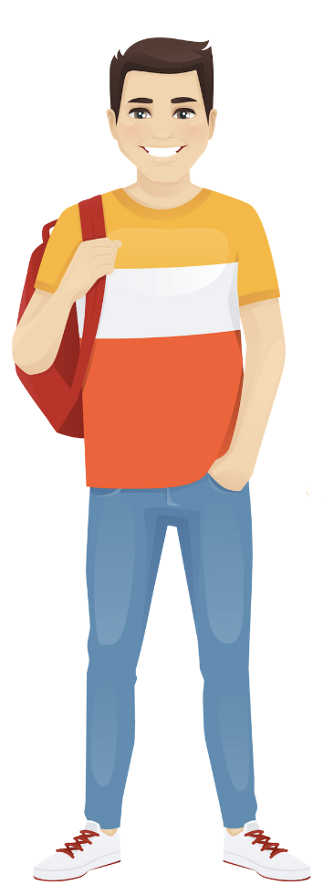
Do These Differences Have a Name?
Some of the different ways of thinking, learning, interacting and perceiving the world have been given labels, such as:
ADHD
autism
dyslexia
dyspraxia
I have
ADHD,
which can
make it
hard to
focus.

Slide 5
ADHD
About 4% of the population have ADHD.
ADHD affects a person's ability to focus. It can cause inattention, hyperactivity and impulsiveness.
People with ADHD can be some of the most creative resources on a team, bringing energy and new approaches to their projects.
Several studies have shown that adults with ADHD tend to be out-of-the-box thinkers.

Slide 6
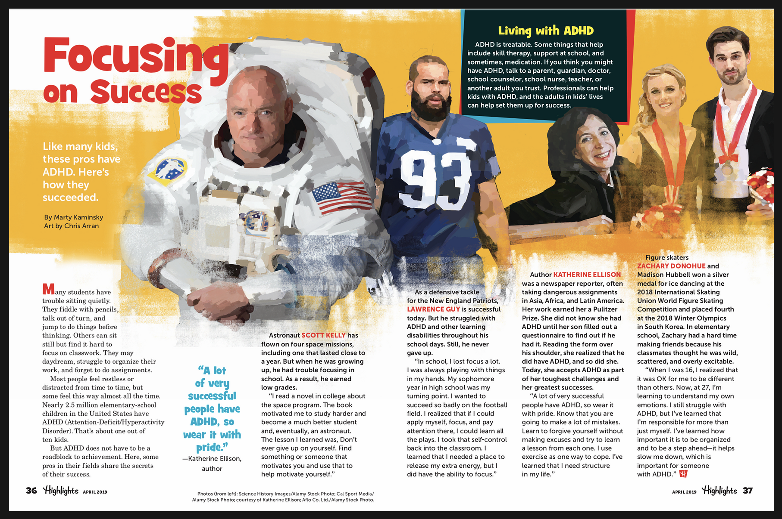

Slide 7
Autism
About 2% of the population is autistic.
Autism impacts how a person perceives the world and interacts with others, making it difficult for them to pick up social cues and interpret them.
Autistic people are very sensitive to lights, noise, touch and smells, which can sometimes cause them distress.
People on the autistic spectrum are highly logical and good at absorbing and remembering facts, attention to detail, and recognizing patterns.

Slide 9
Dyslexia
About 10% of the population are dyslexic.
Dyslexia is a language processing difficulty that can cause problems with reading, writing and spelling.
It can cause difficulties with processing information quickly, organisation, sequencing, spoken language and motor skills.
People with dyslexia can be very good at creative thinking, problem solving, story-telling and verbal communication.

Slide 11
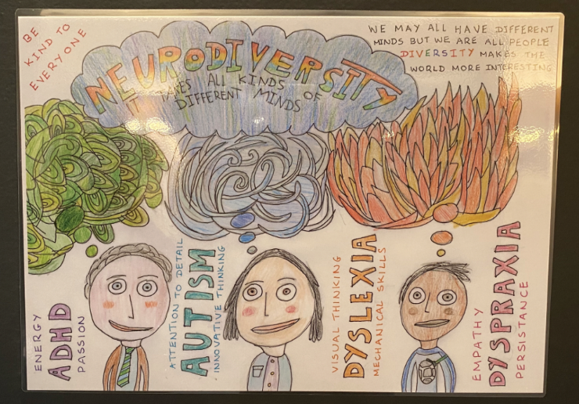
Winner of 2020 Neurodiversity Celebration Week Art Competition

Slide 12
What is Neurodiversity
Celebration Week About?
Neurodiversity Celebration Week is about celebrating the strengths and talents of people who are autistic and people with learning differences.
Sadly, these students are often teased and bullied for their difference.
Neurodiversity Celebration Week is one way of reminding everyone of the importance of being kind, tolerant and accepting of everyone, especially classmates who are autistic or have ADHD.

Slide 13
There are currently
Over 1,100 schools
Over 680,000 students
taking part worldwide

Slide 14
What Can You Do To Help?
Don’t tease or make fun of anyone in your class who is different or who is finding something difficult.
Instead, be kind, understanding and encouraging.
Never forget that you have the power to make a positive difference to someone who
may be having a difficult time.
Make someone’s day by being understanding and kind.

