Slide 1
Year 1 and 2
Harvest Artwork

Slide 2
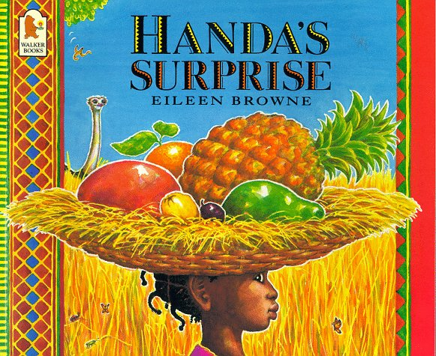
Year 1 have read the story of Handa’s Surprise and were inspired by ‘Bring a stick to school day’ to create her basket.
We then used a variety of different techniques to create fruits to go in the basket.

Slide 3
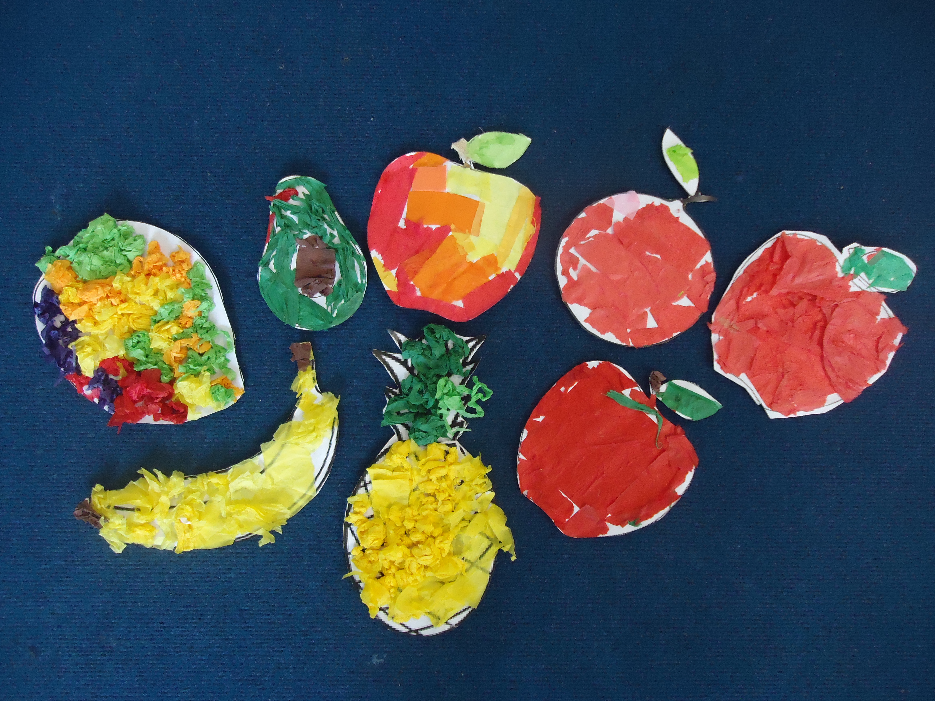
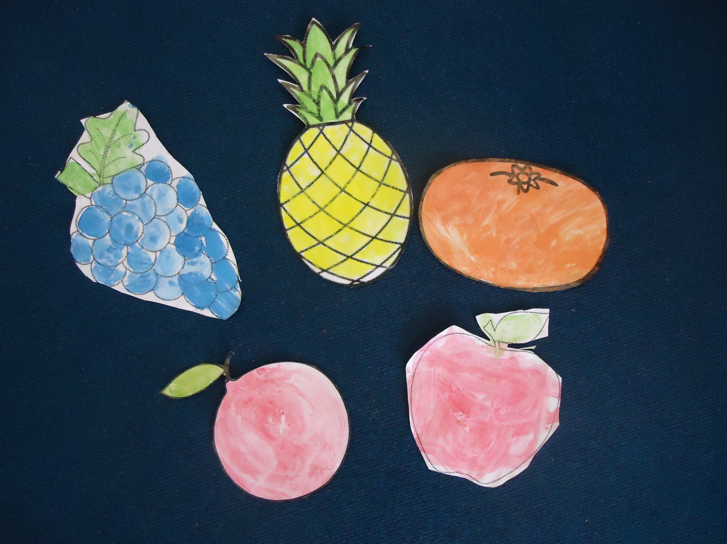
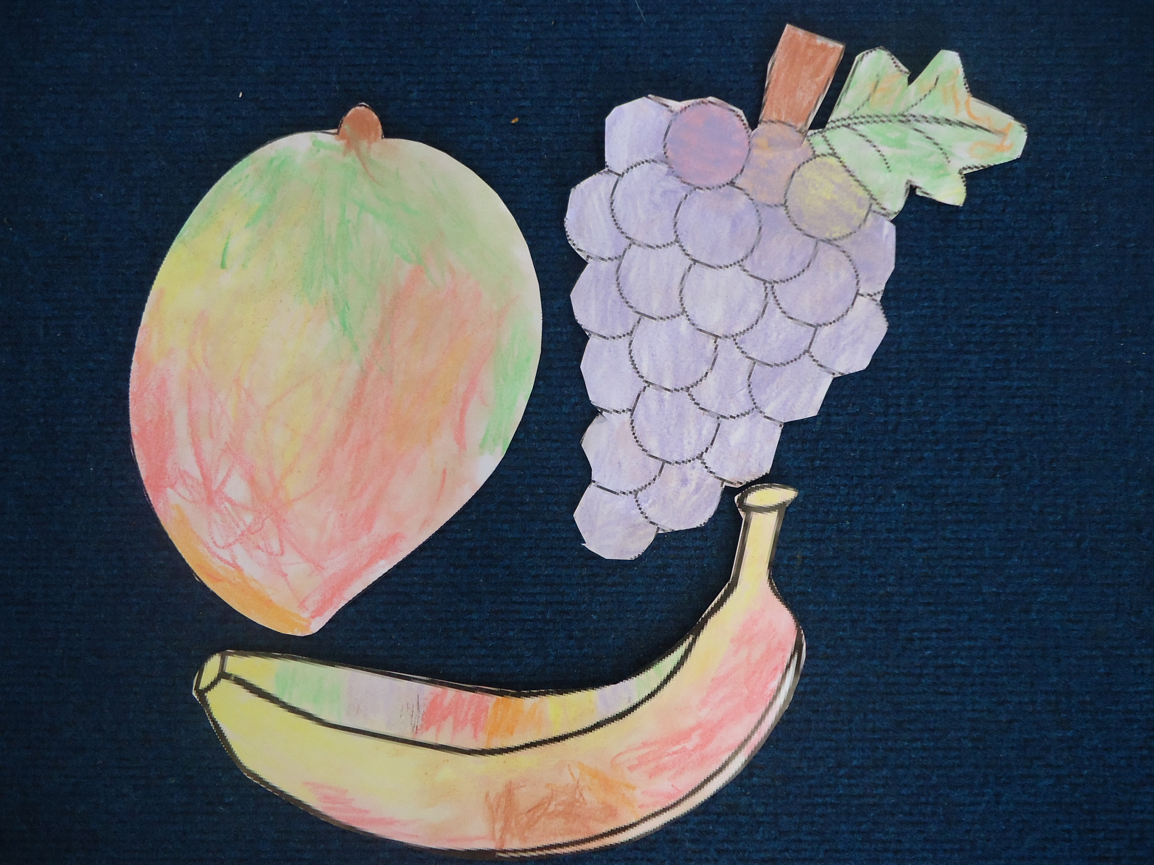
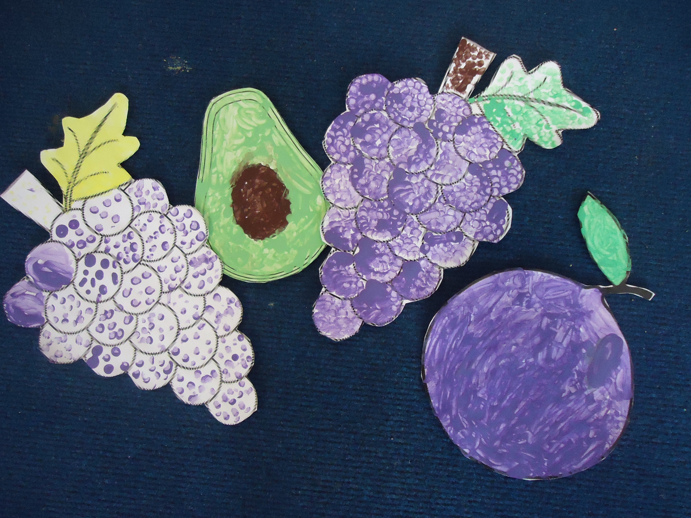

Slide 4
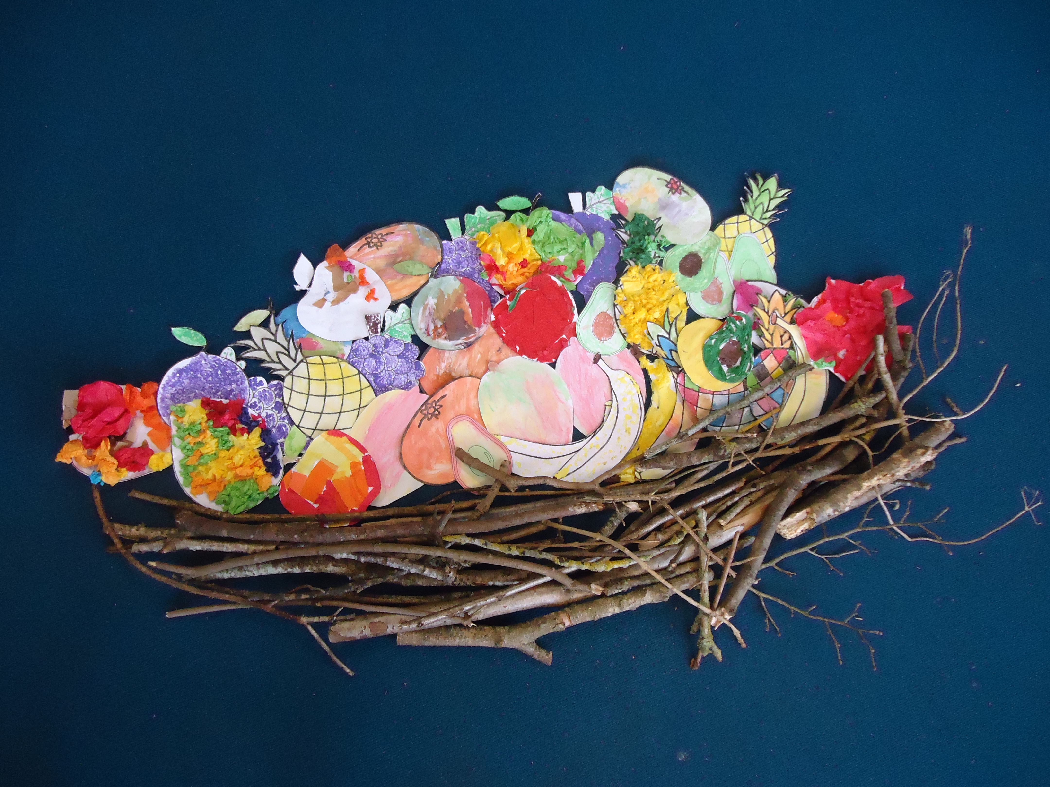
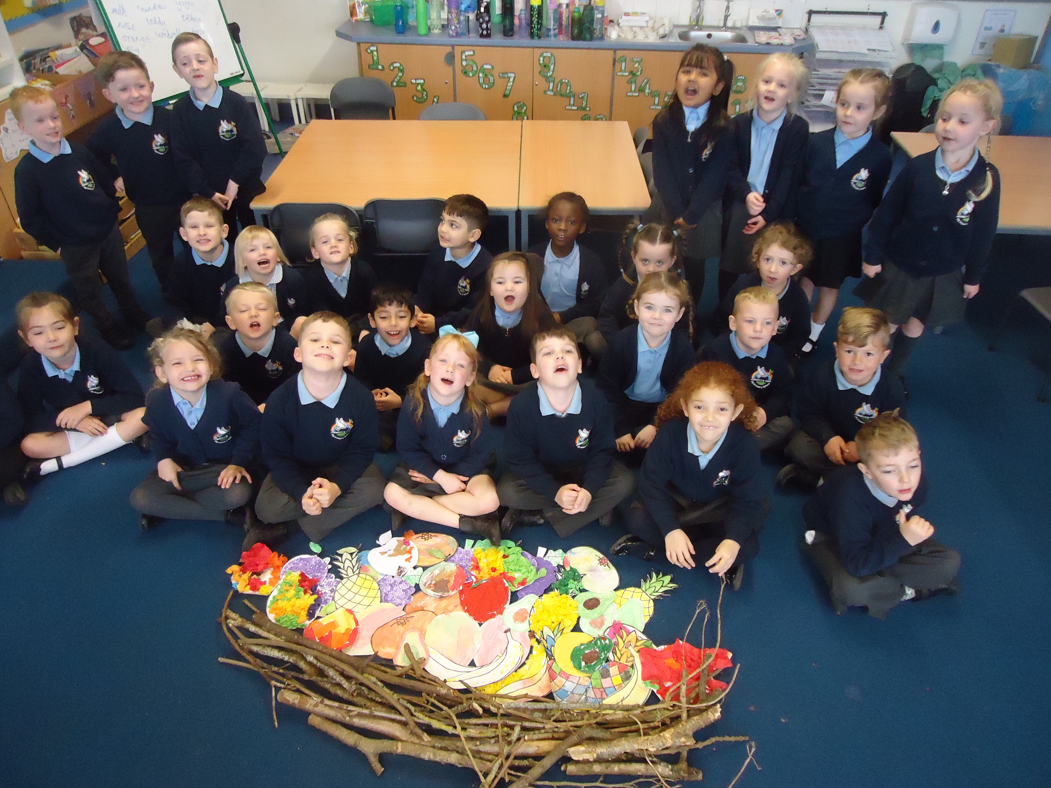
Stonechats were very proud of their final basket!

Slide 5
Whinchats created a whole class basket as well as some miniature ones.

Slide 6
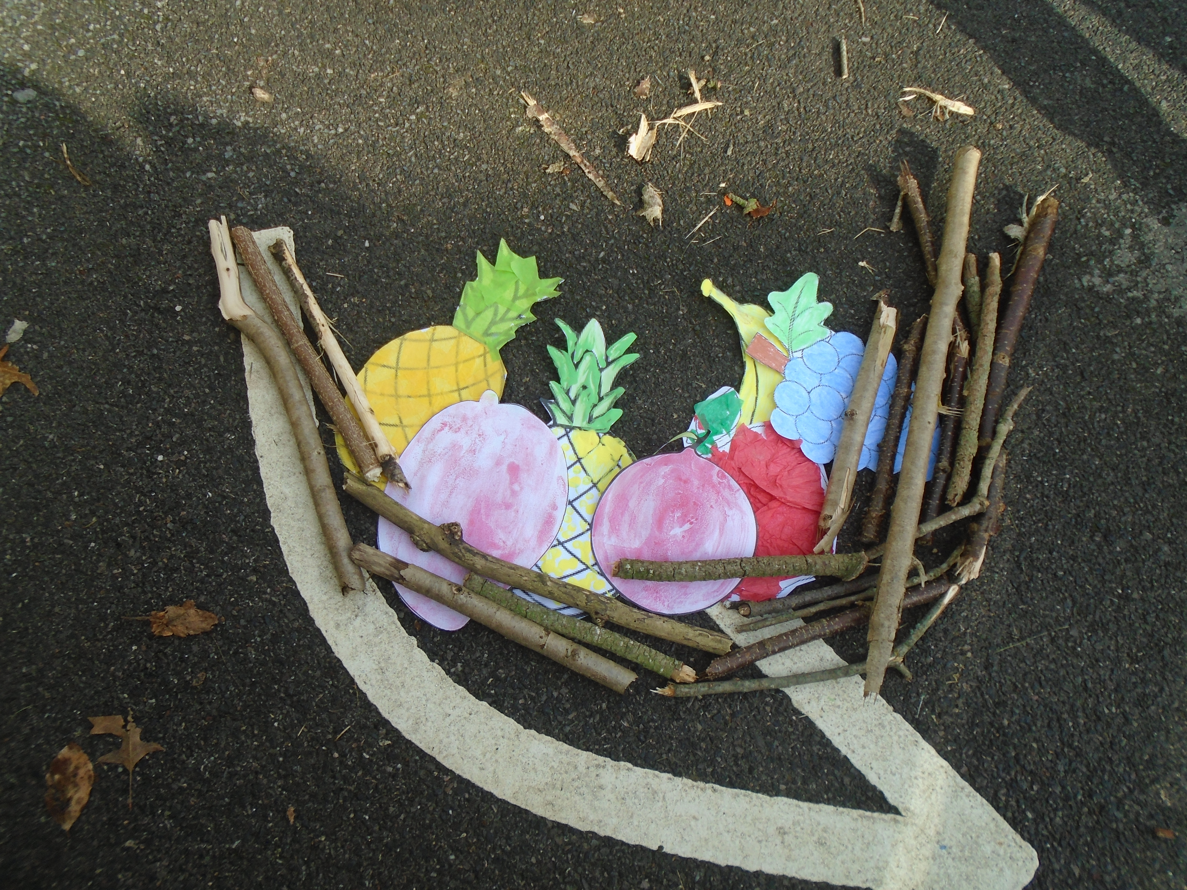
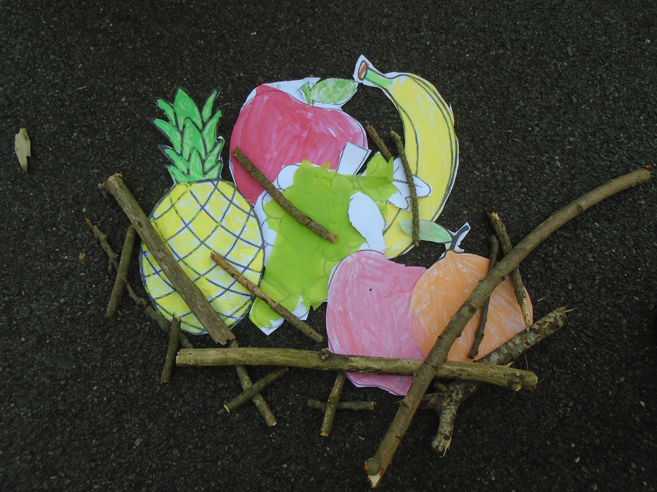

Slide 7
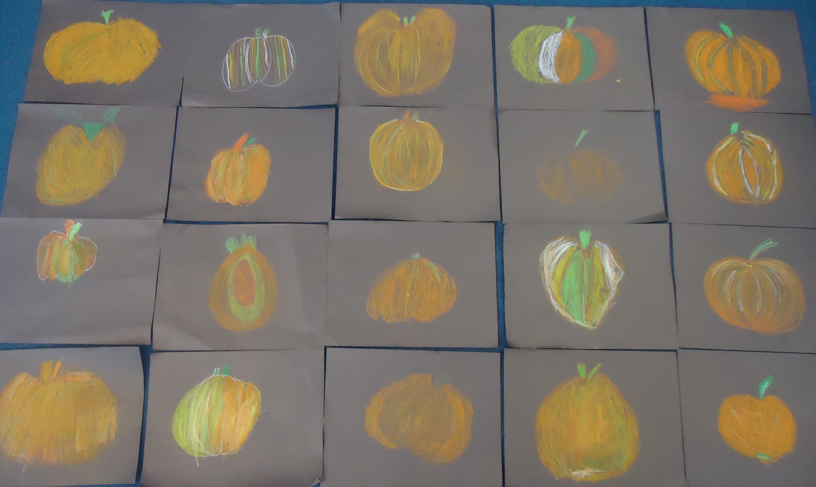
Year 2 explored how to use oil pastels and learnt how to blend the colours to create a beautiful harvest pumpkin.

Slide 8
