Slide 1
Barbados
Notes:
This beautiful island is non other than the island of Barbados.

Slide 2
Notes:
Barbados is a small tropical island situated in the Southeastern Caribbean Sea, near the Equator.

Slide 3
Notes:
This is the flag of Barbados. Blue represents the sea and sky of Barbados, while gold represents the sand of the island's beaches. The symbol at the centre of the flag represents the Trident of the mythical sea god, Neptune - the shaft of the trident is broken symbolising Barbados becoming independent of Great Britain.

Slide 4
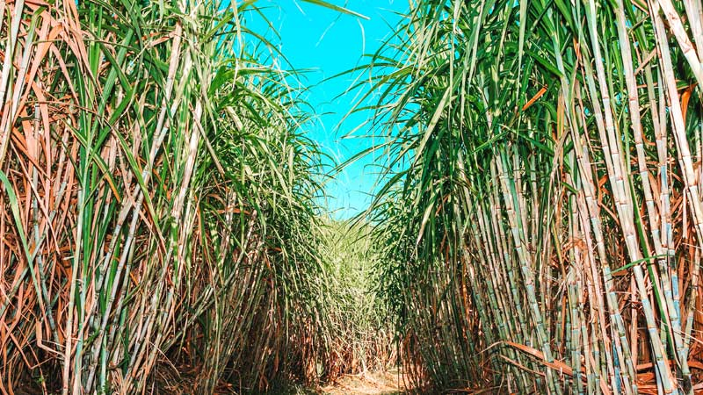
Notes:
This is a picture of sugar cane which is harvested here. Harvest in Barbados is called Crop Over. It is a festival which started in 1687.

Slide 5
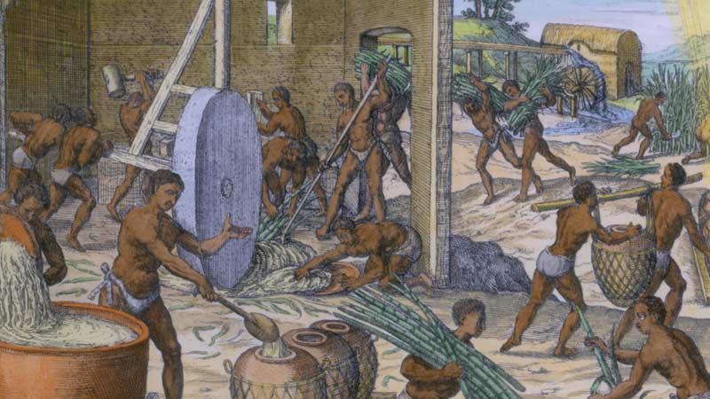
Notes:
At first, the festival was called Harvest Home because it was influenced by the English festival Harvest Home and the African Yam festival. The festival was established to celebrate the end of the crop season.

Slide 6
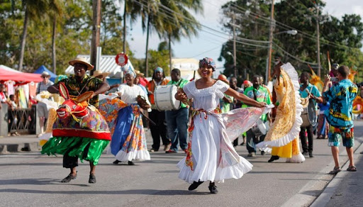
Notes:
A woman dressed in all white, with beautiful, colourful flowers stuck in her headwrap led the parade. She was followed by the cane workers carrying the last batch of crops.

Slide 7
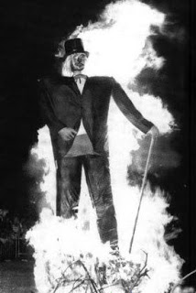

Slide 8
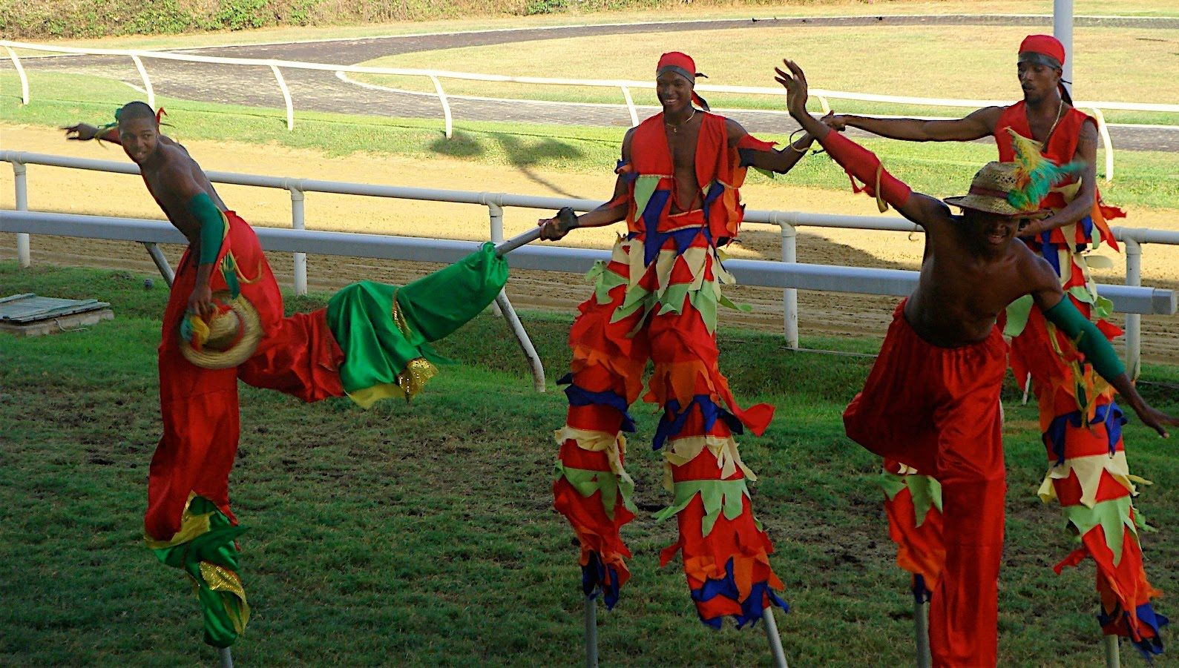
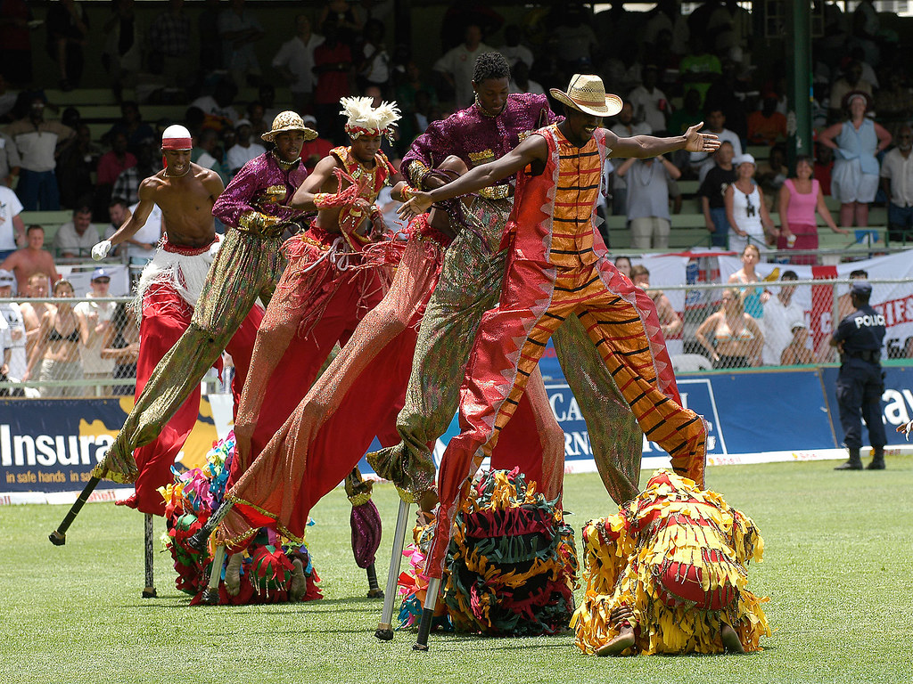
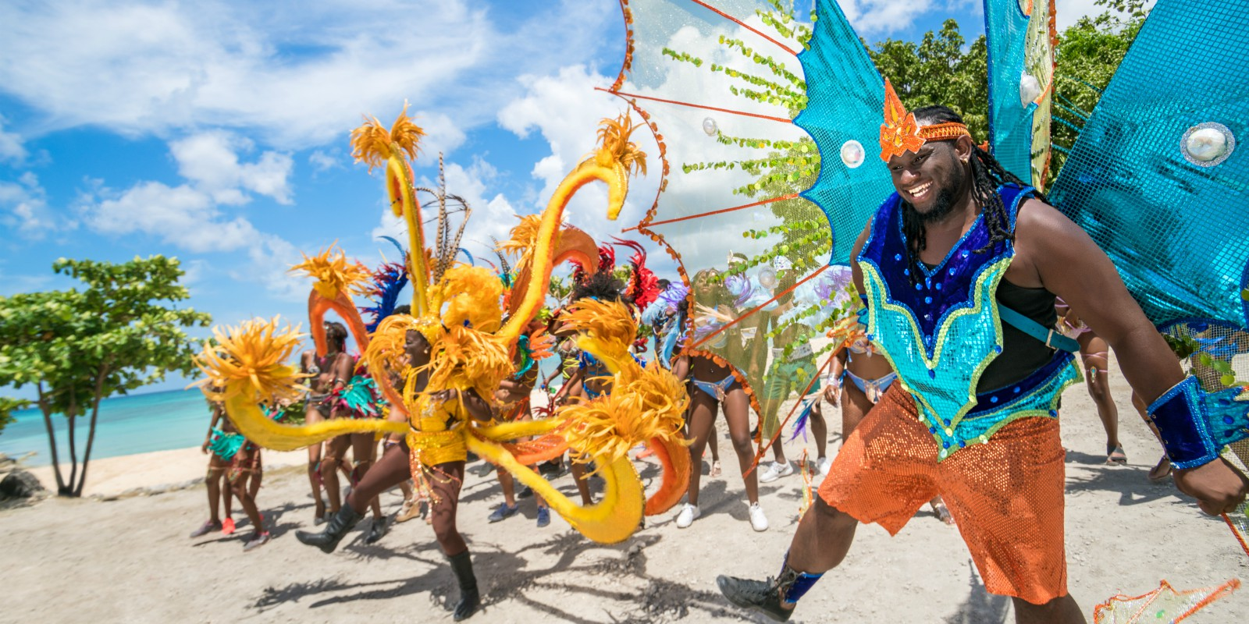
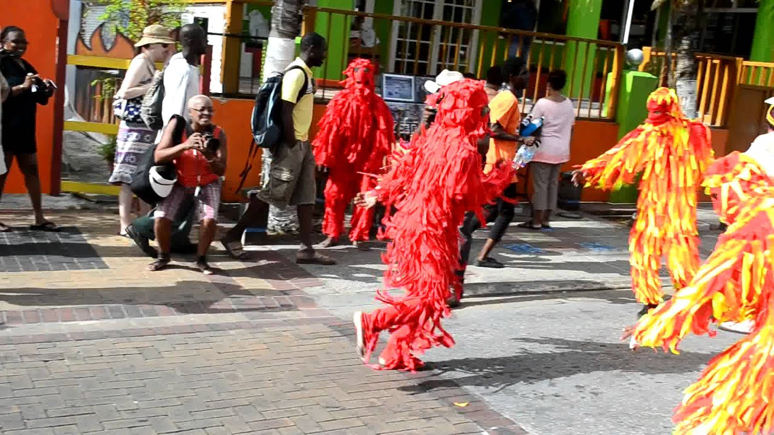

Slide 9
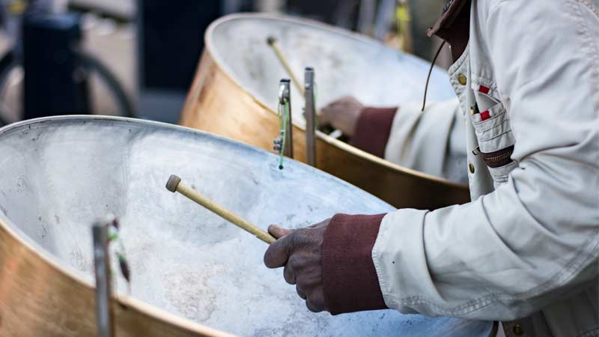
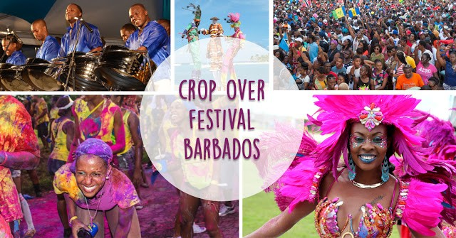

Slide 10
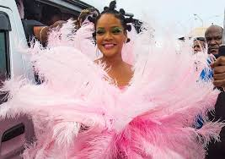
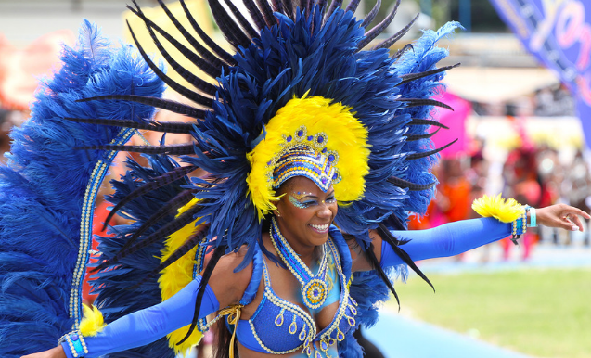
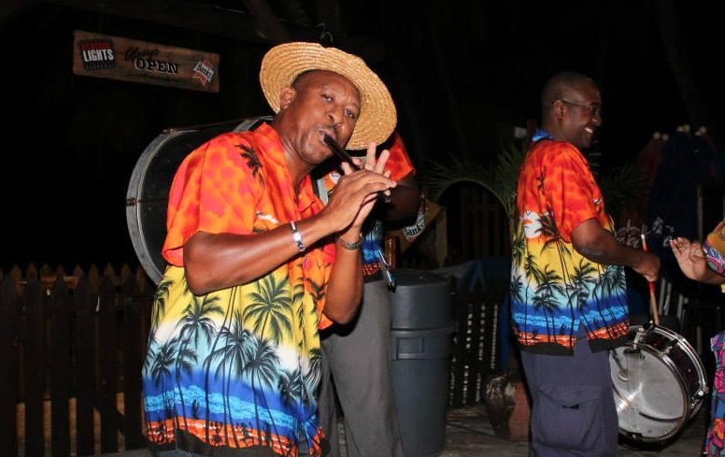
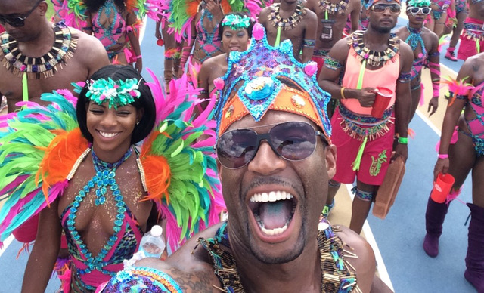

Slide 11
